Slide 1
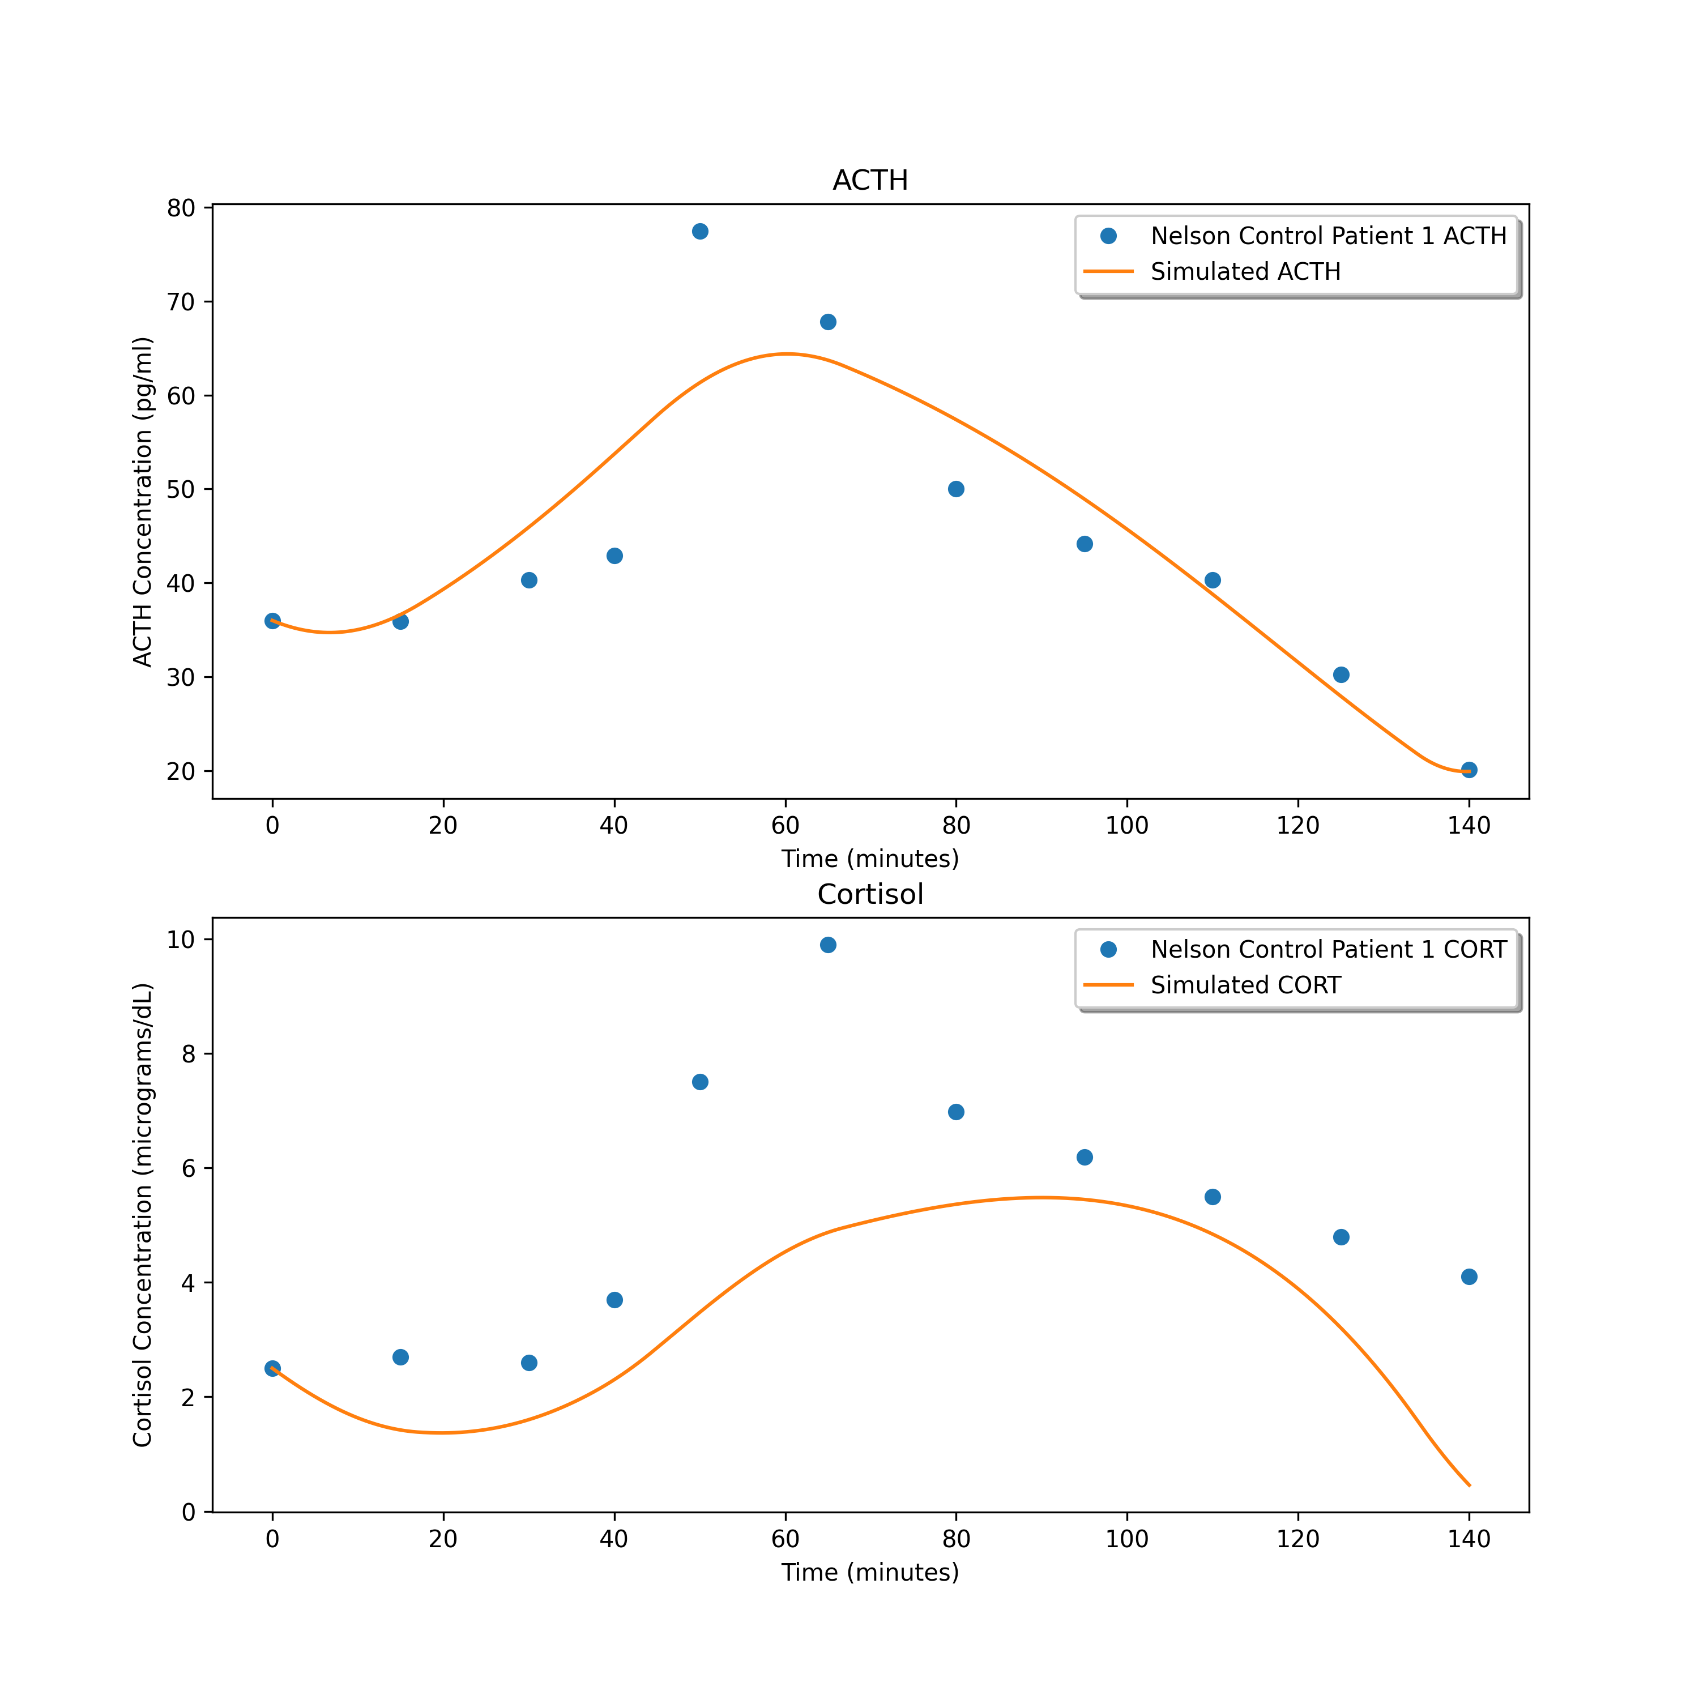
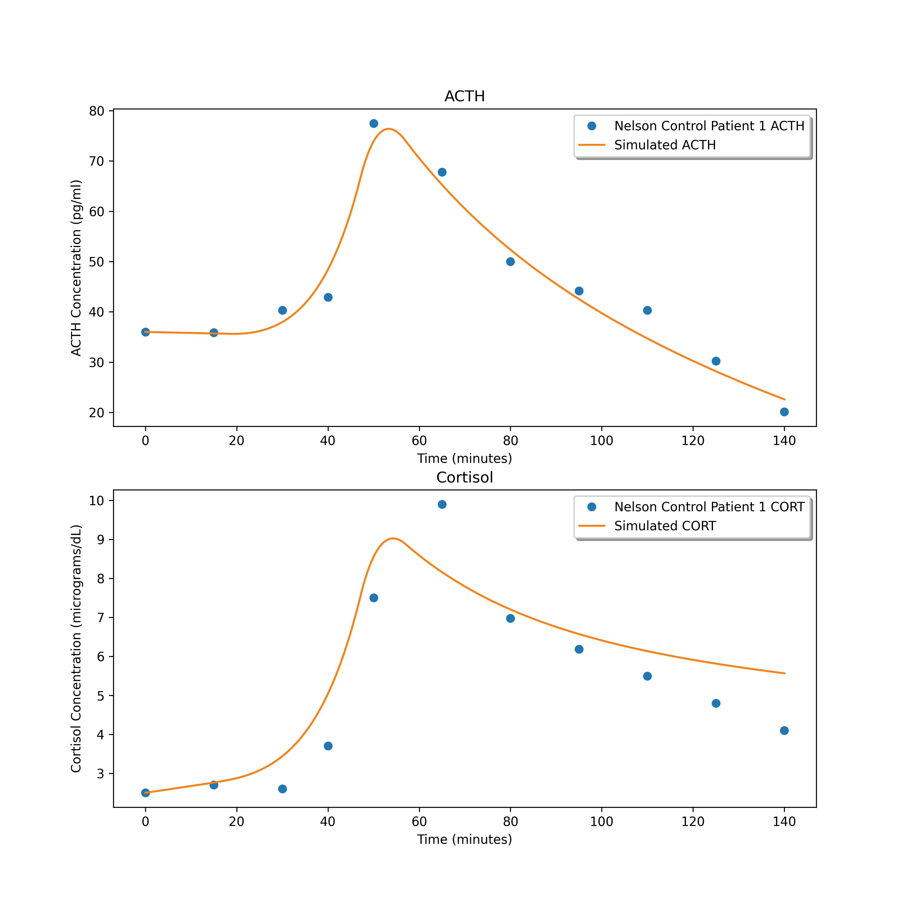
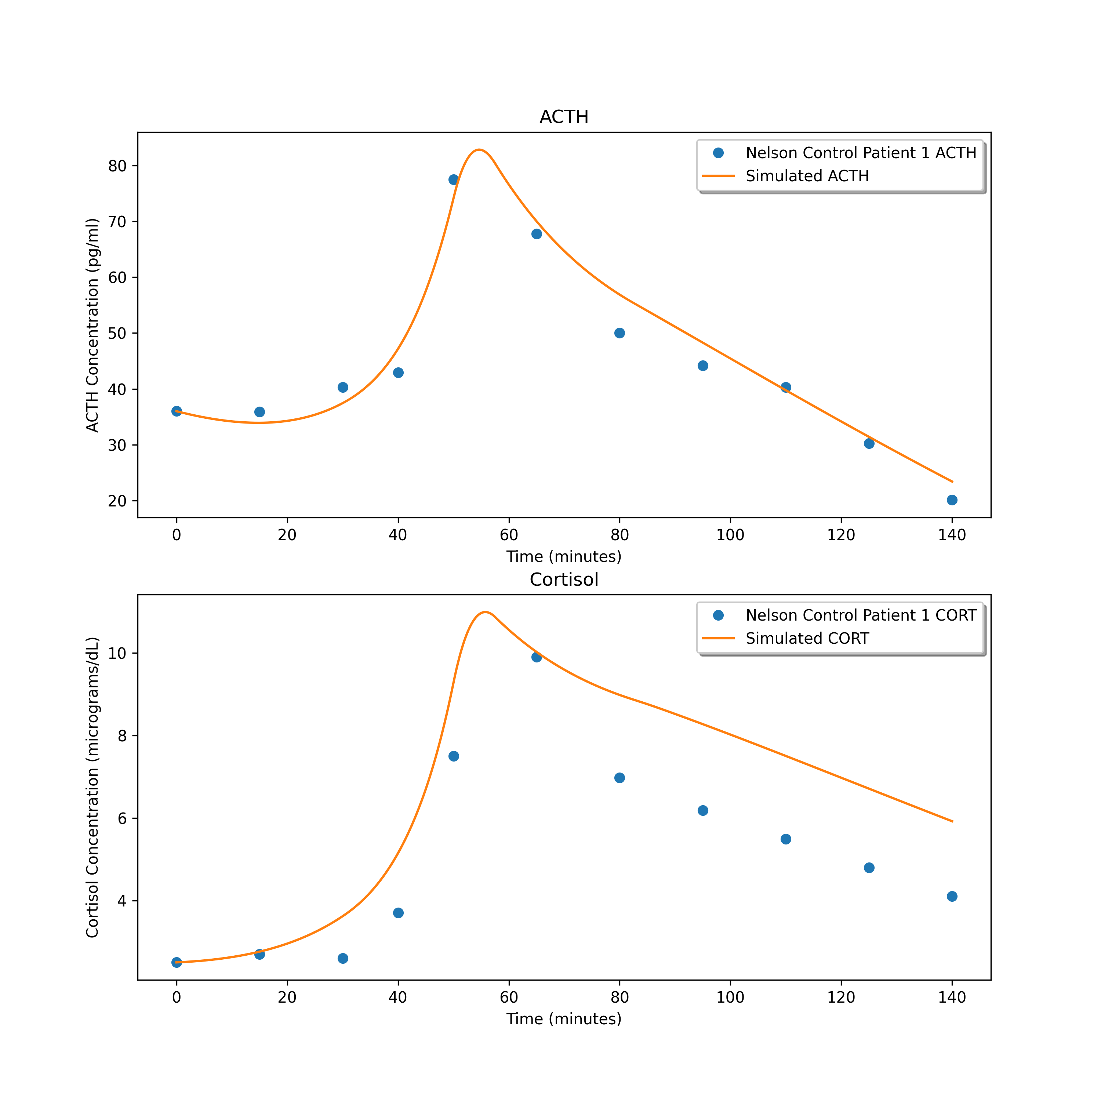
26.269296214909136
5.271148418272468
6.789682616438102

Slide 2
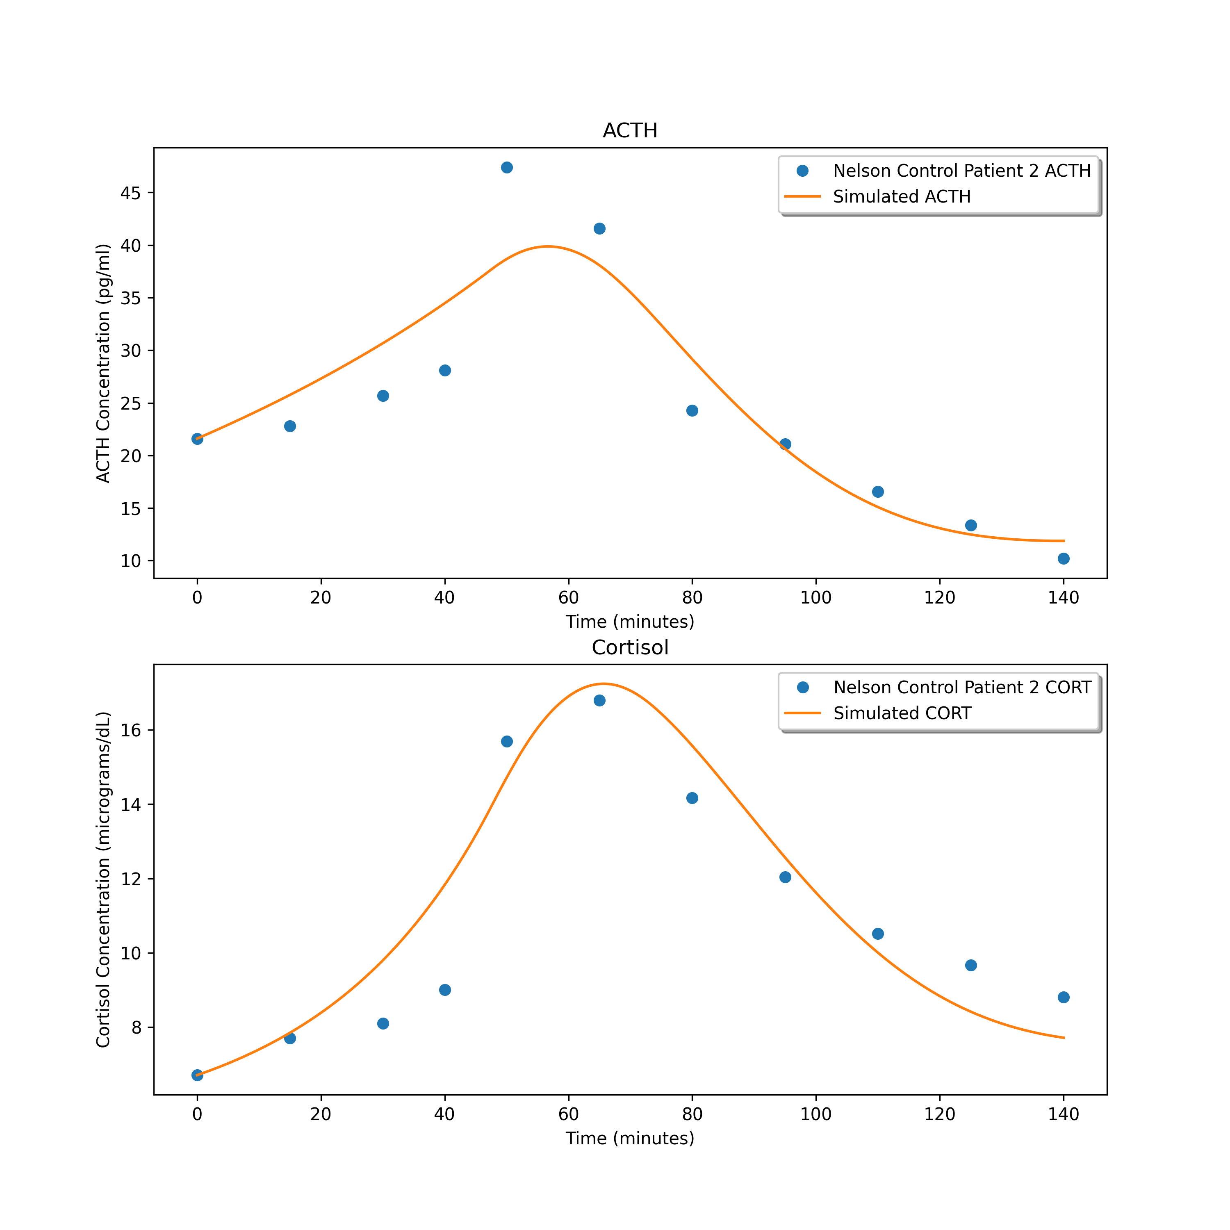
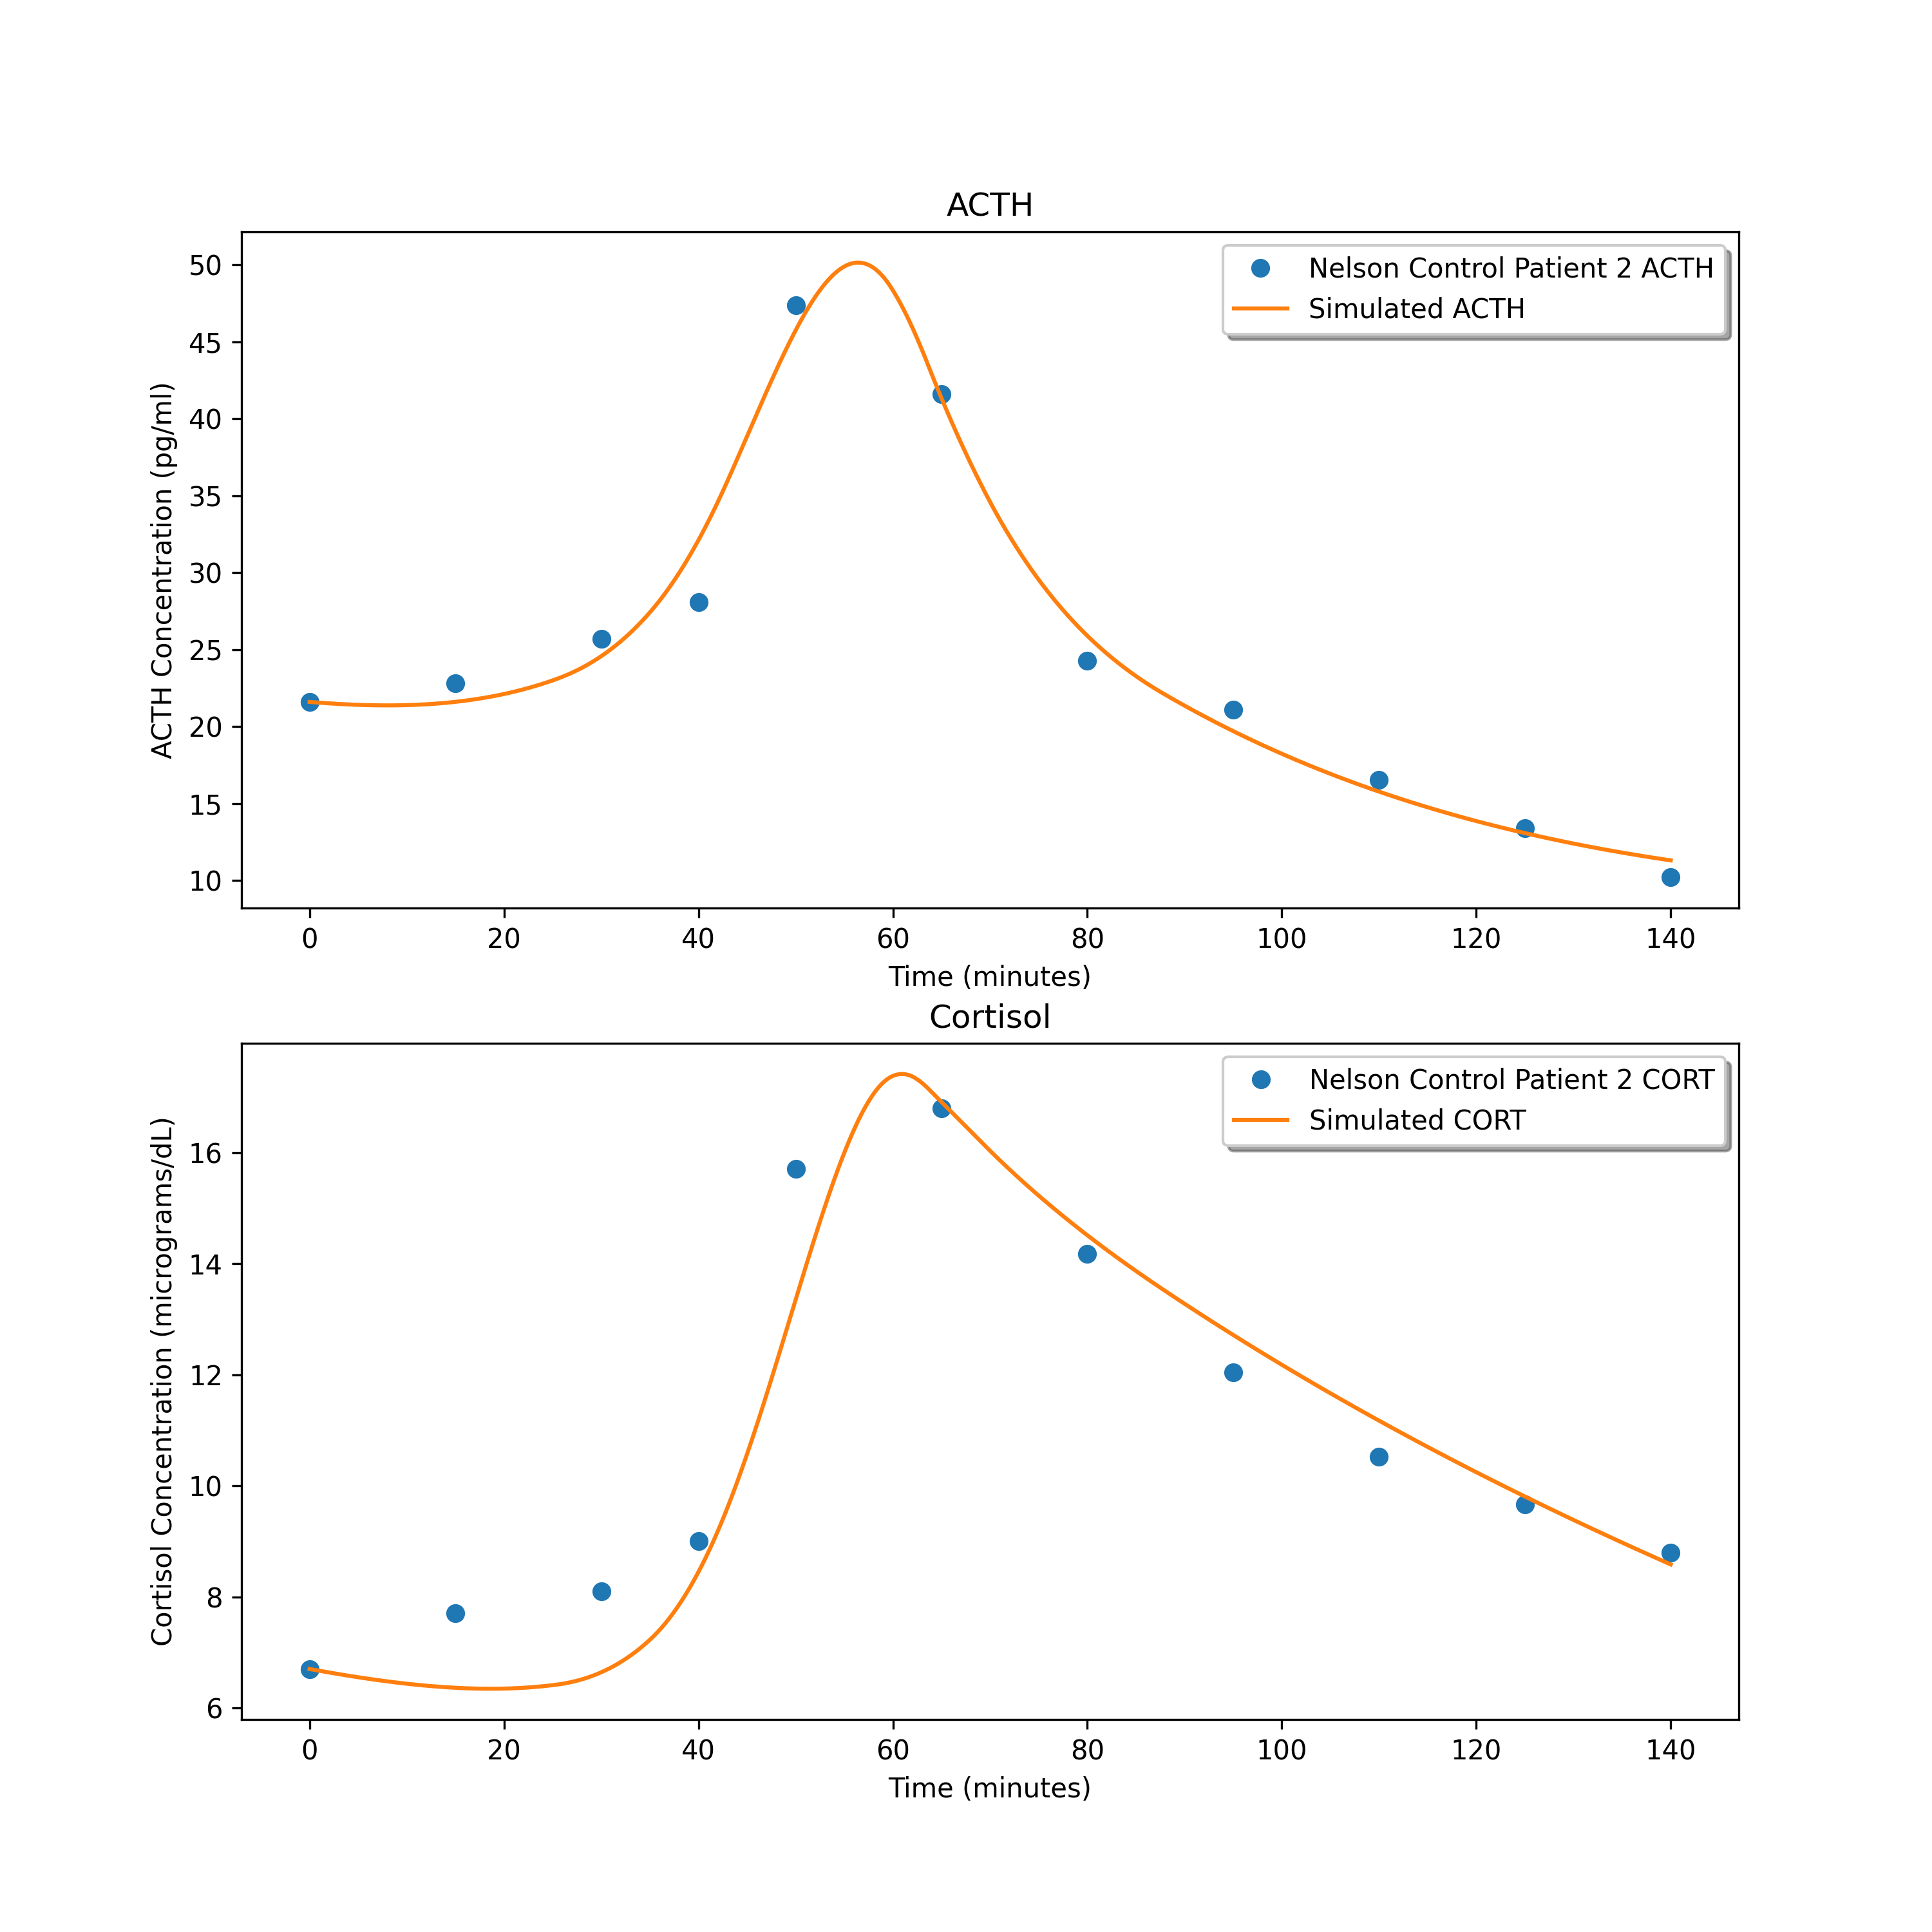
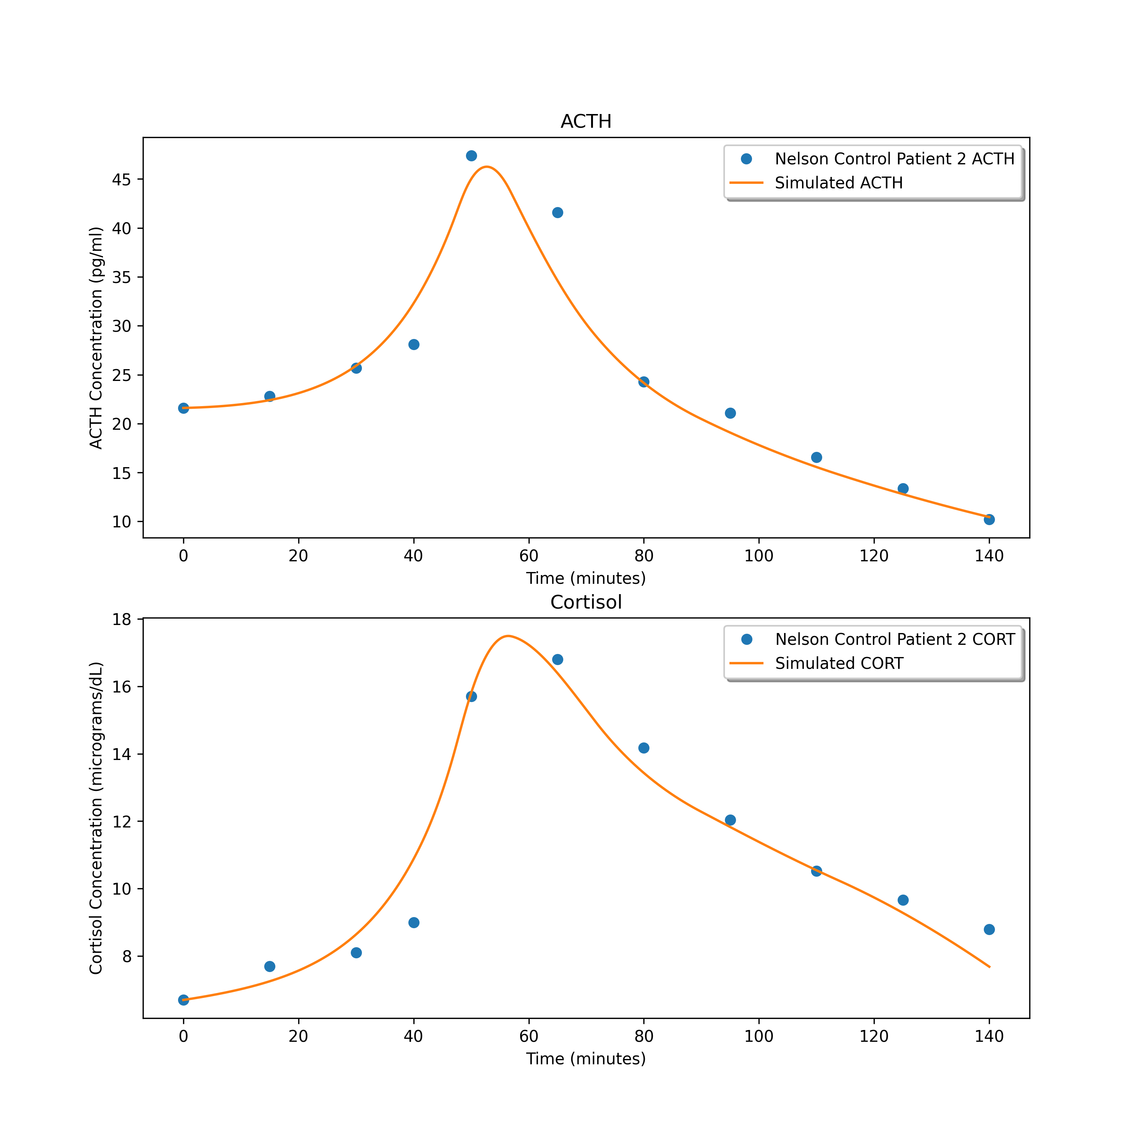
9.52625466481116
3.818606903482386
1.7655671462826348

Slide 3
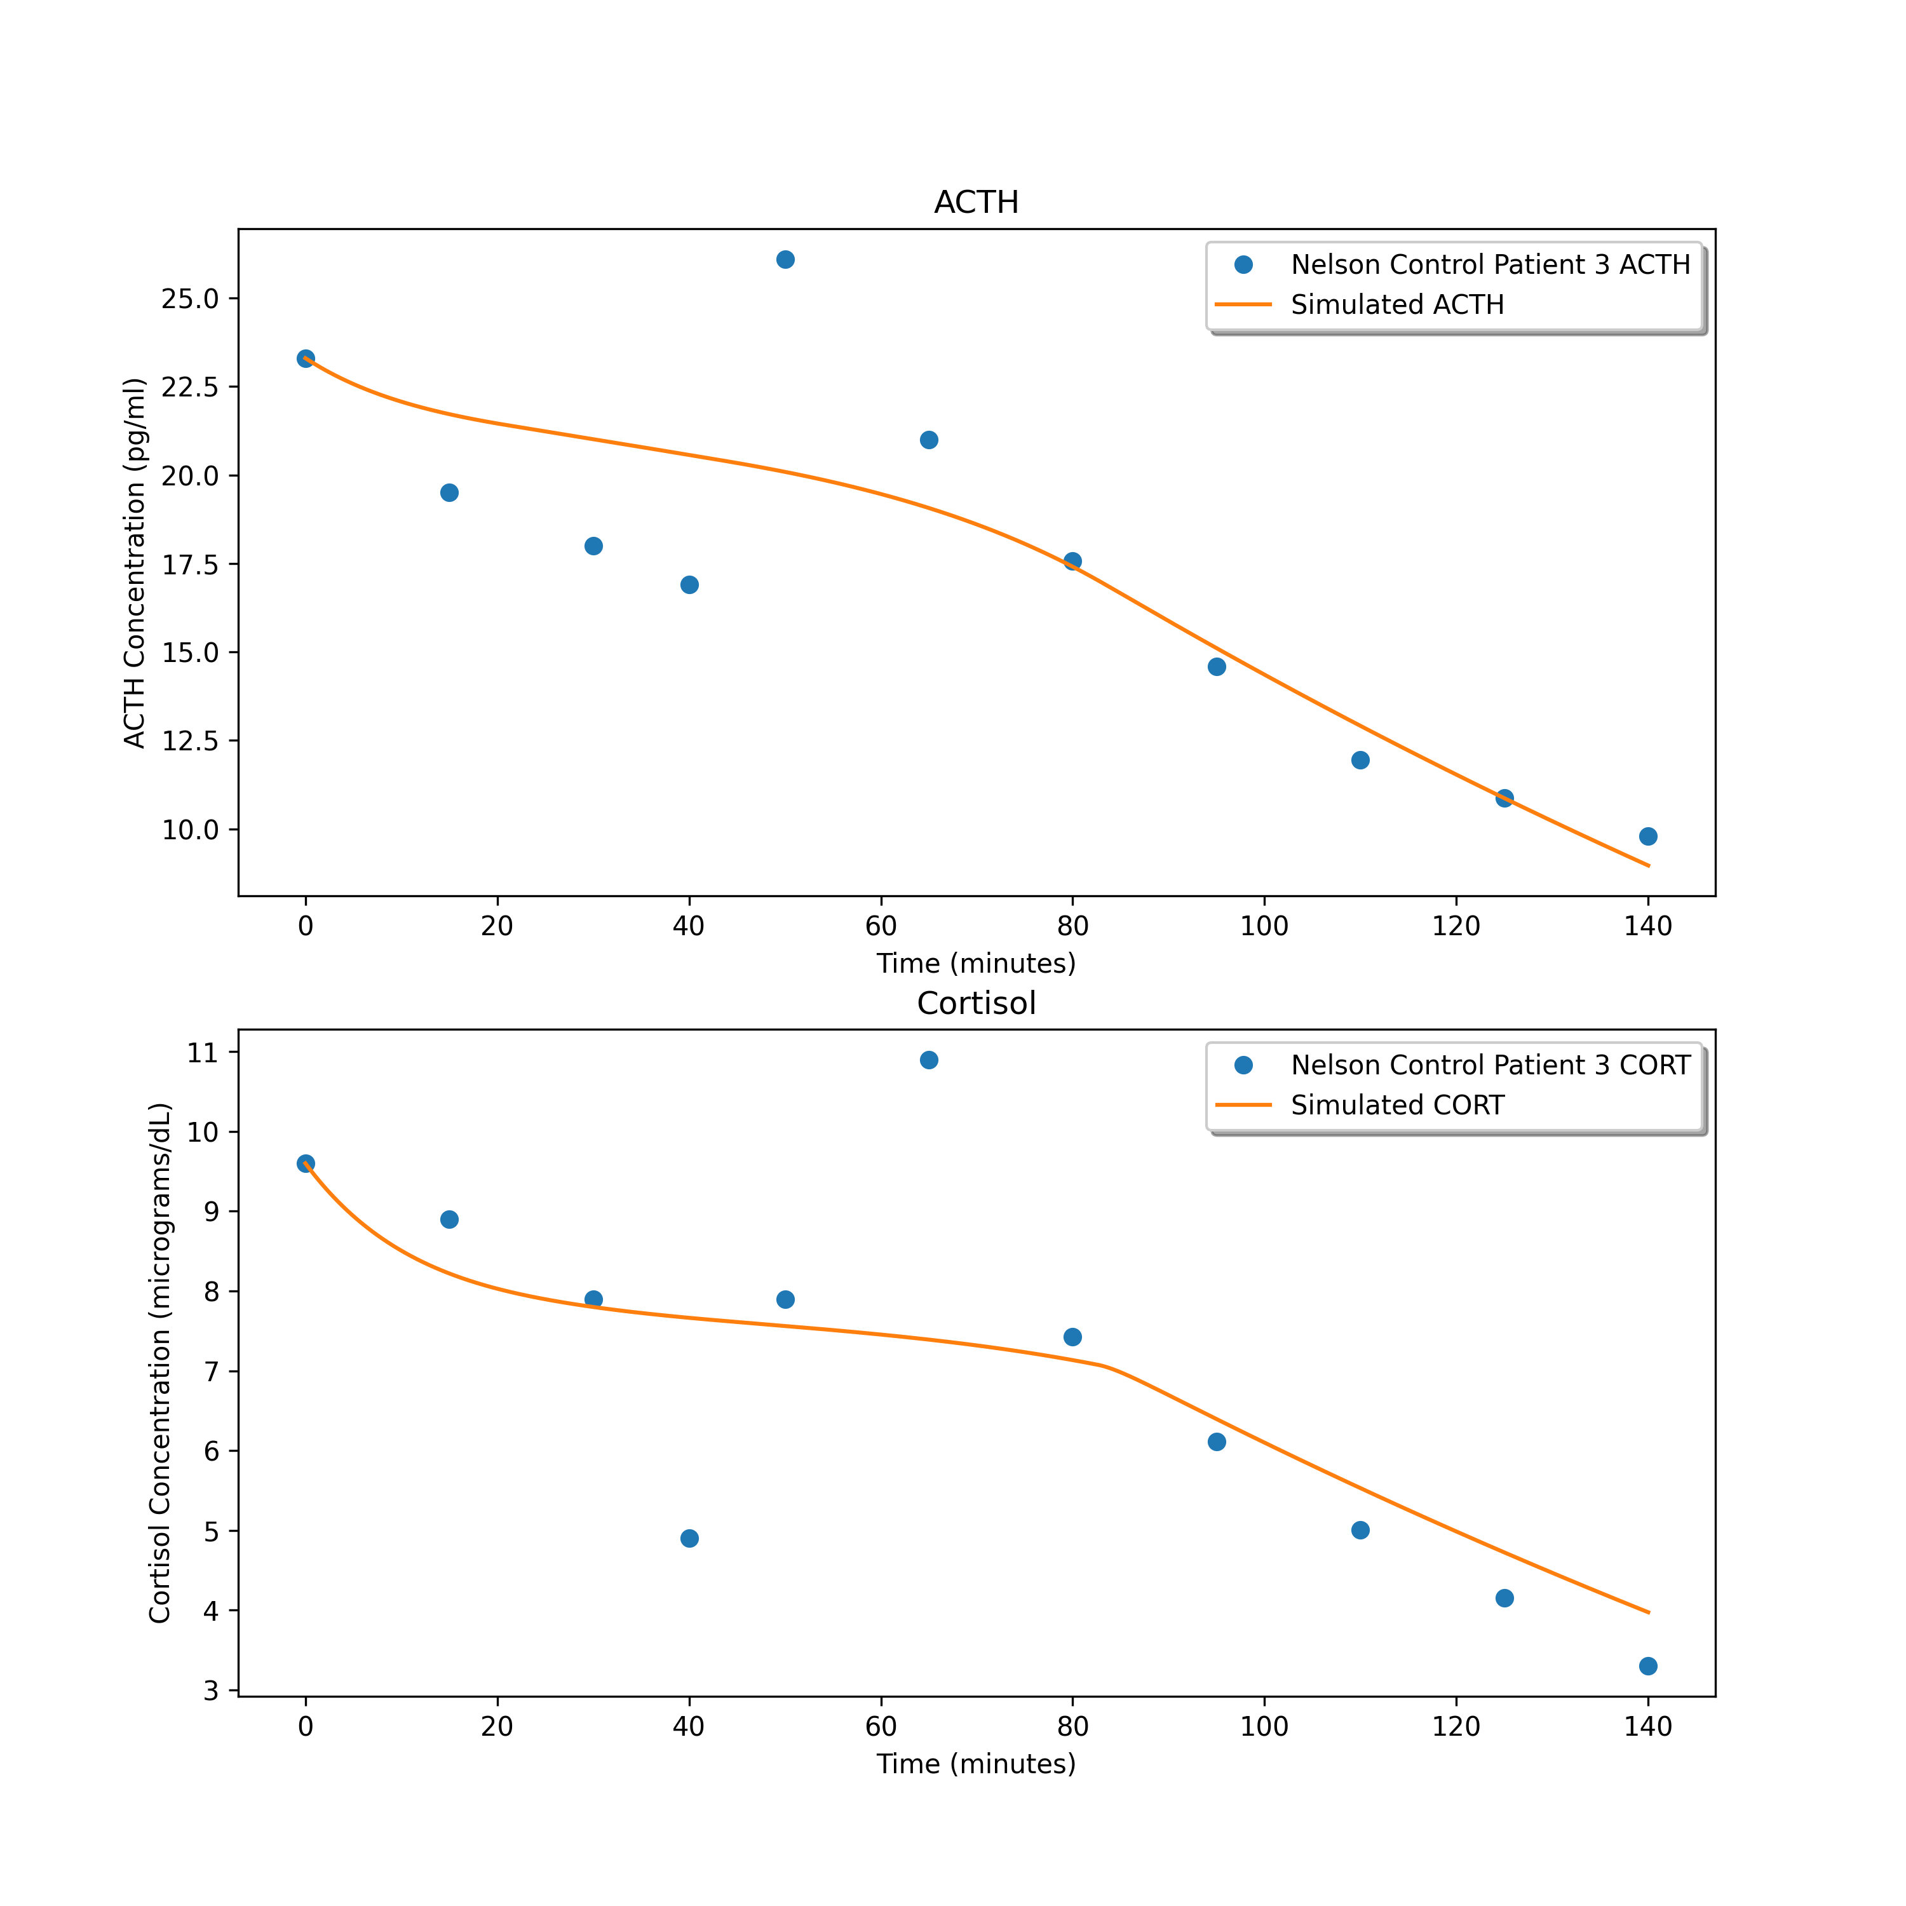
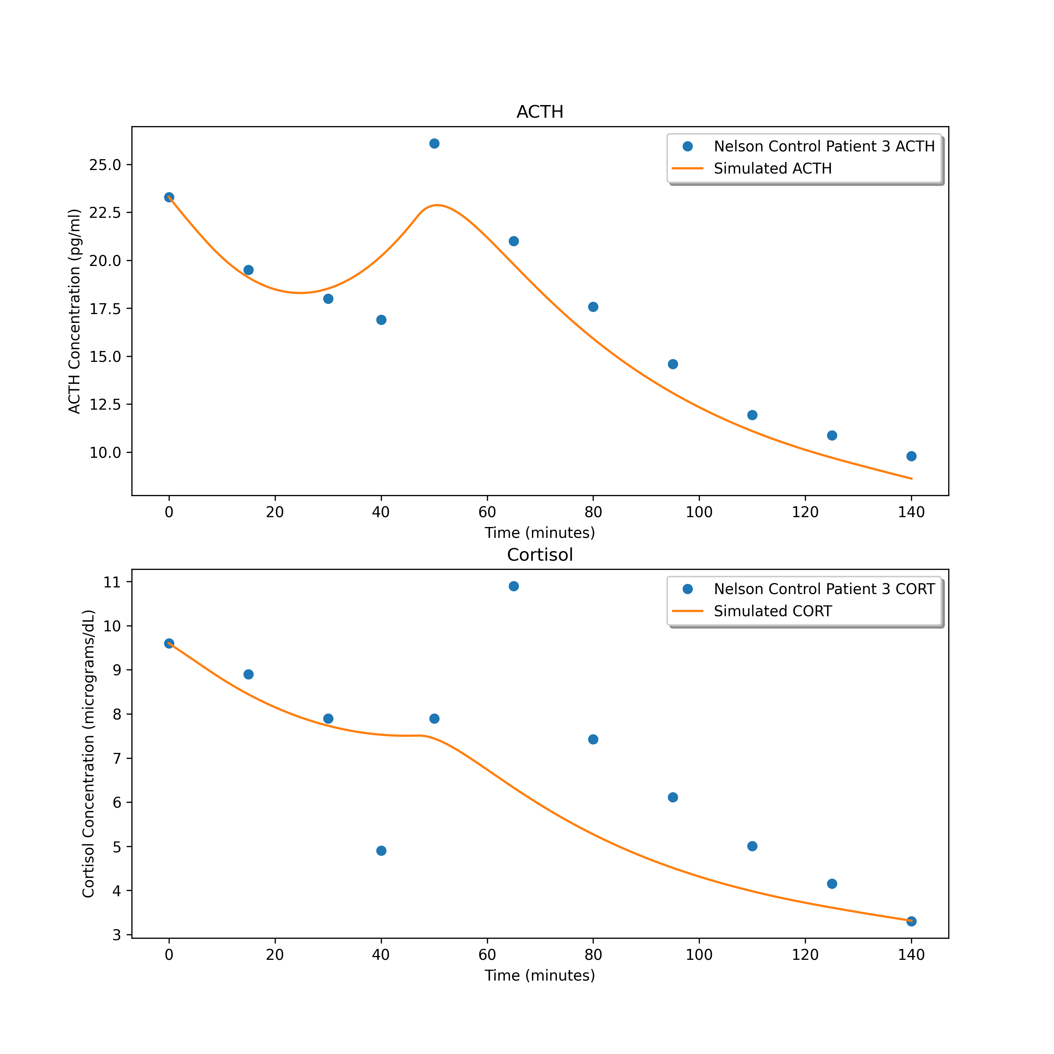
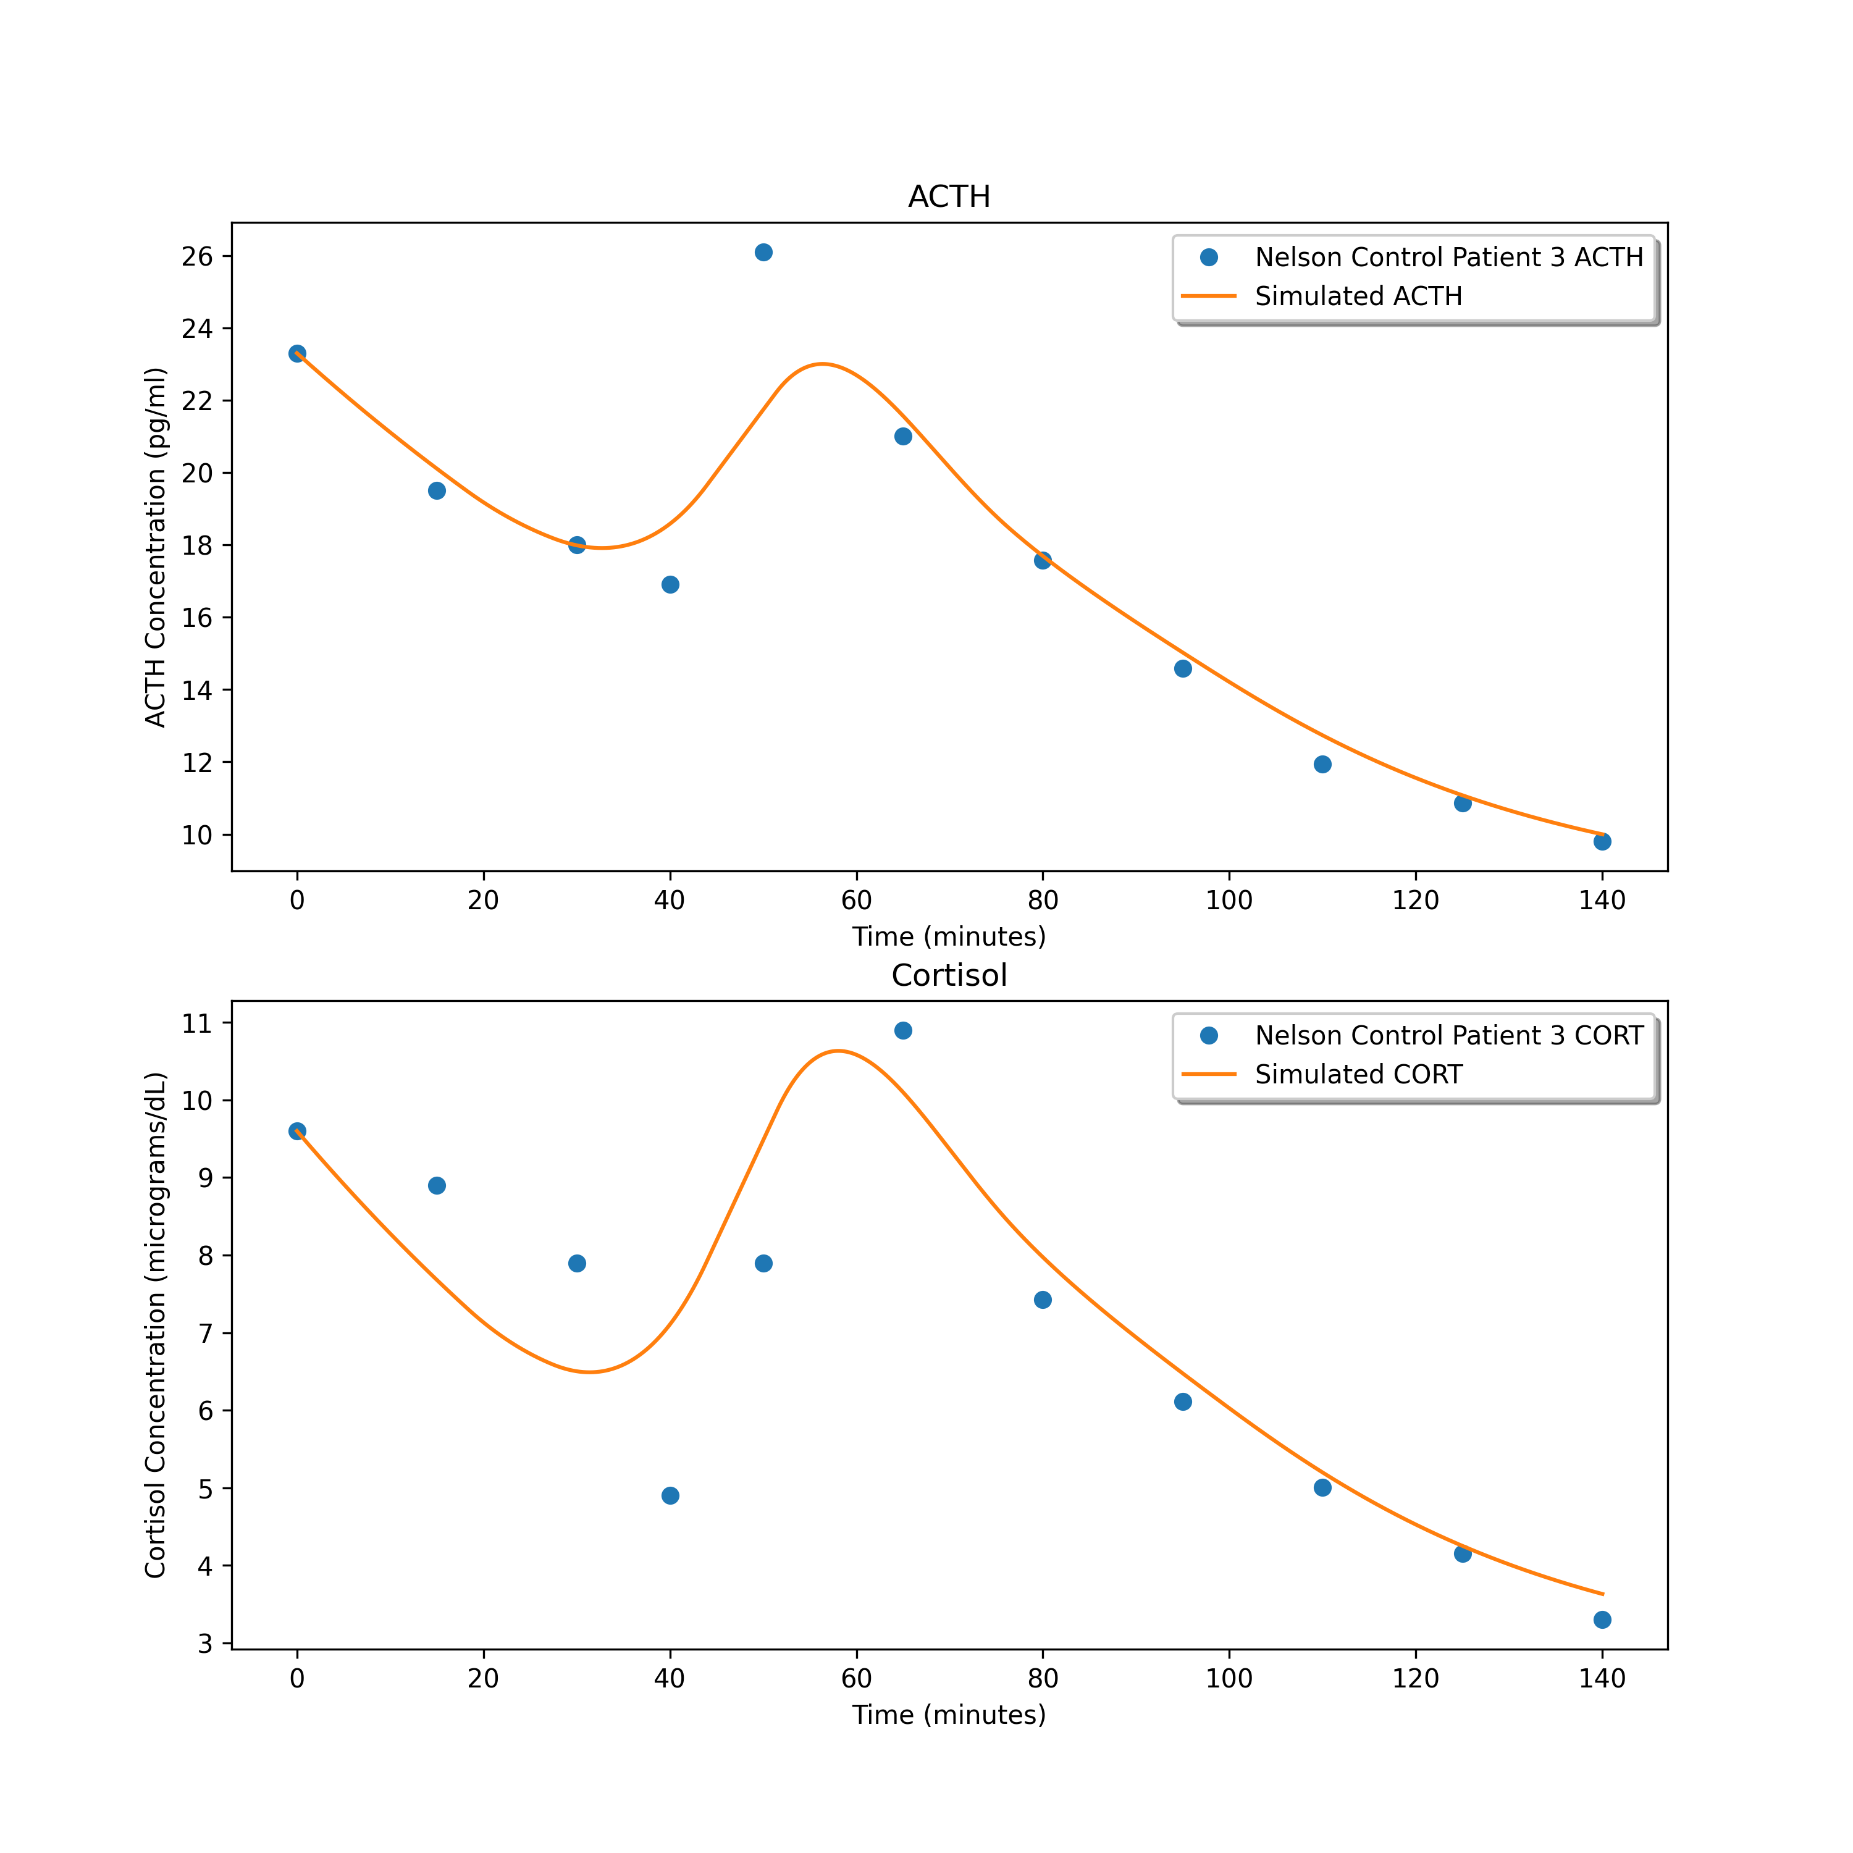
4.136361322447688
3.1213882847042673
1.6138590963125639

Slide 4
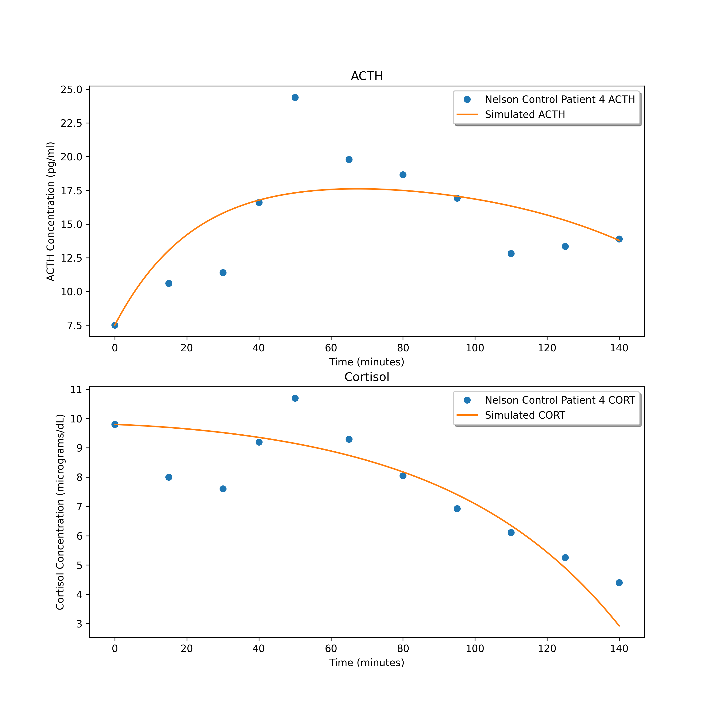
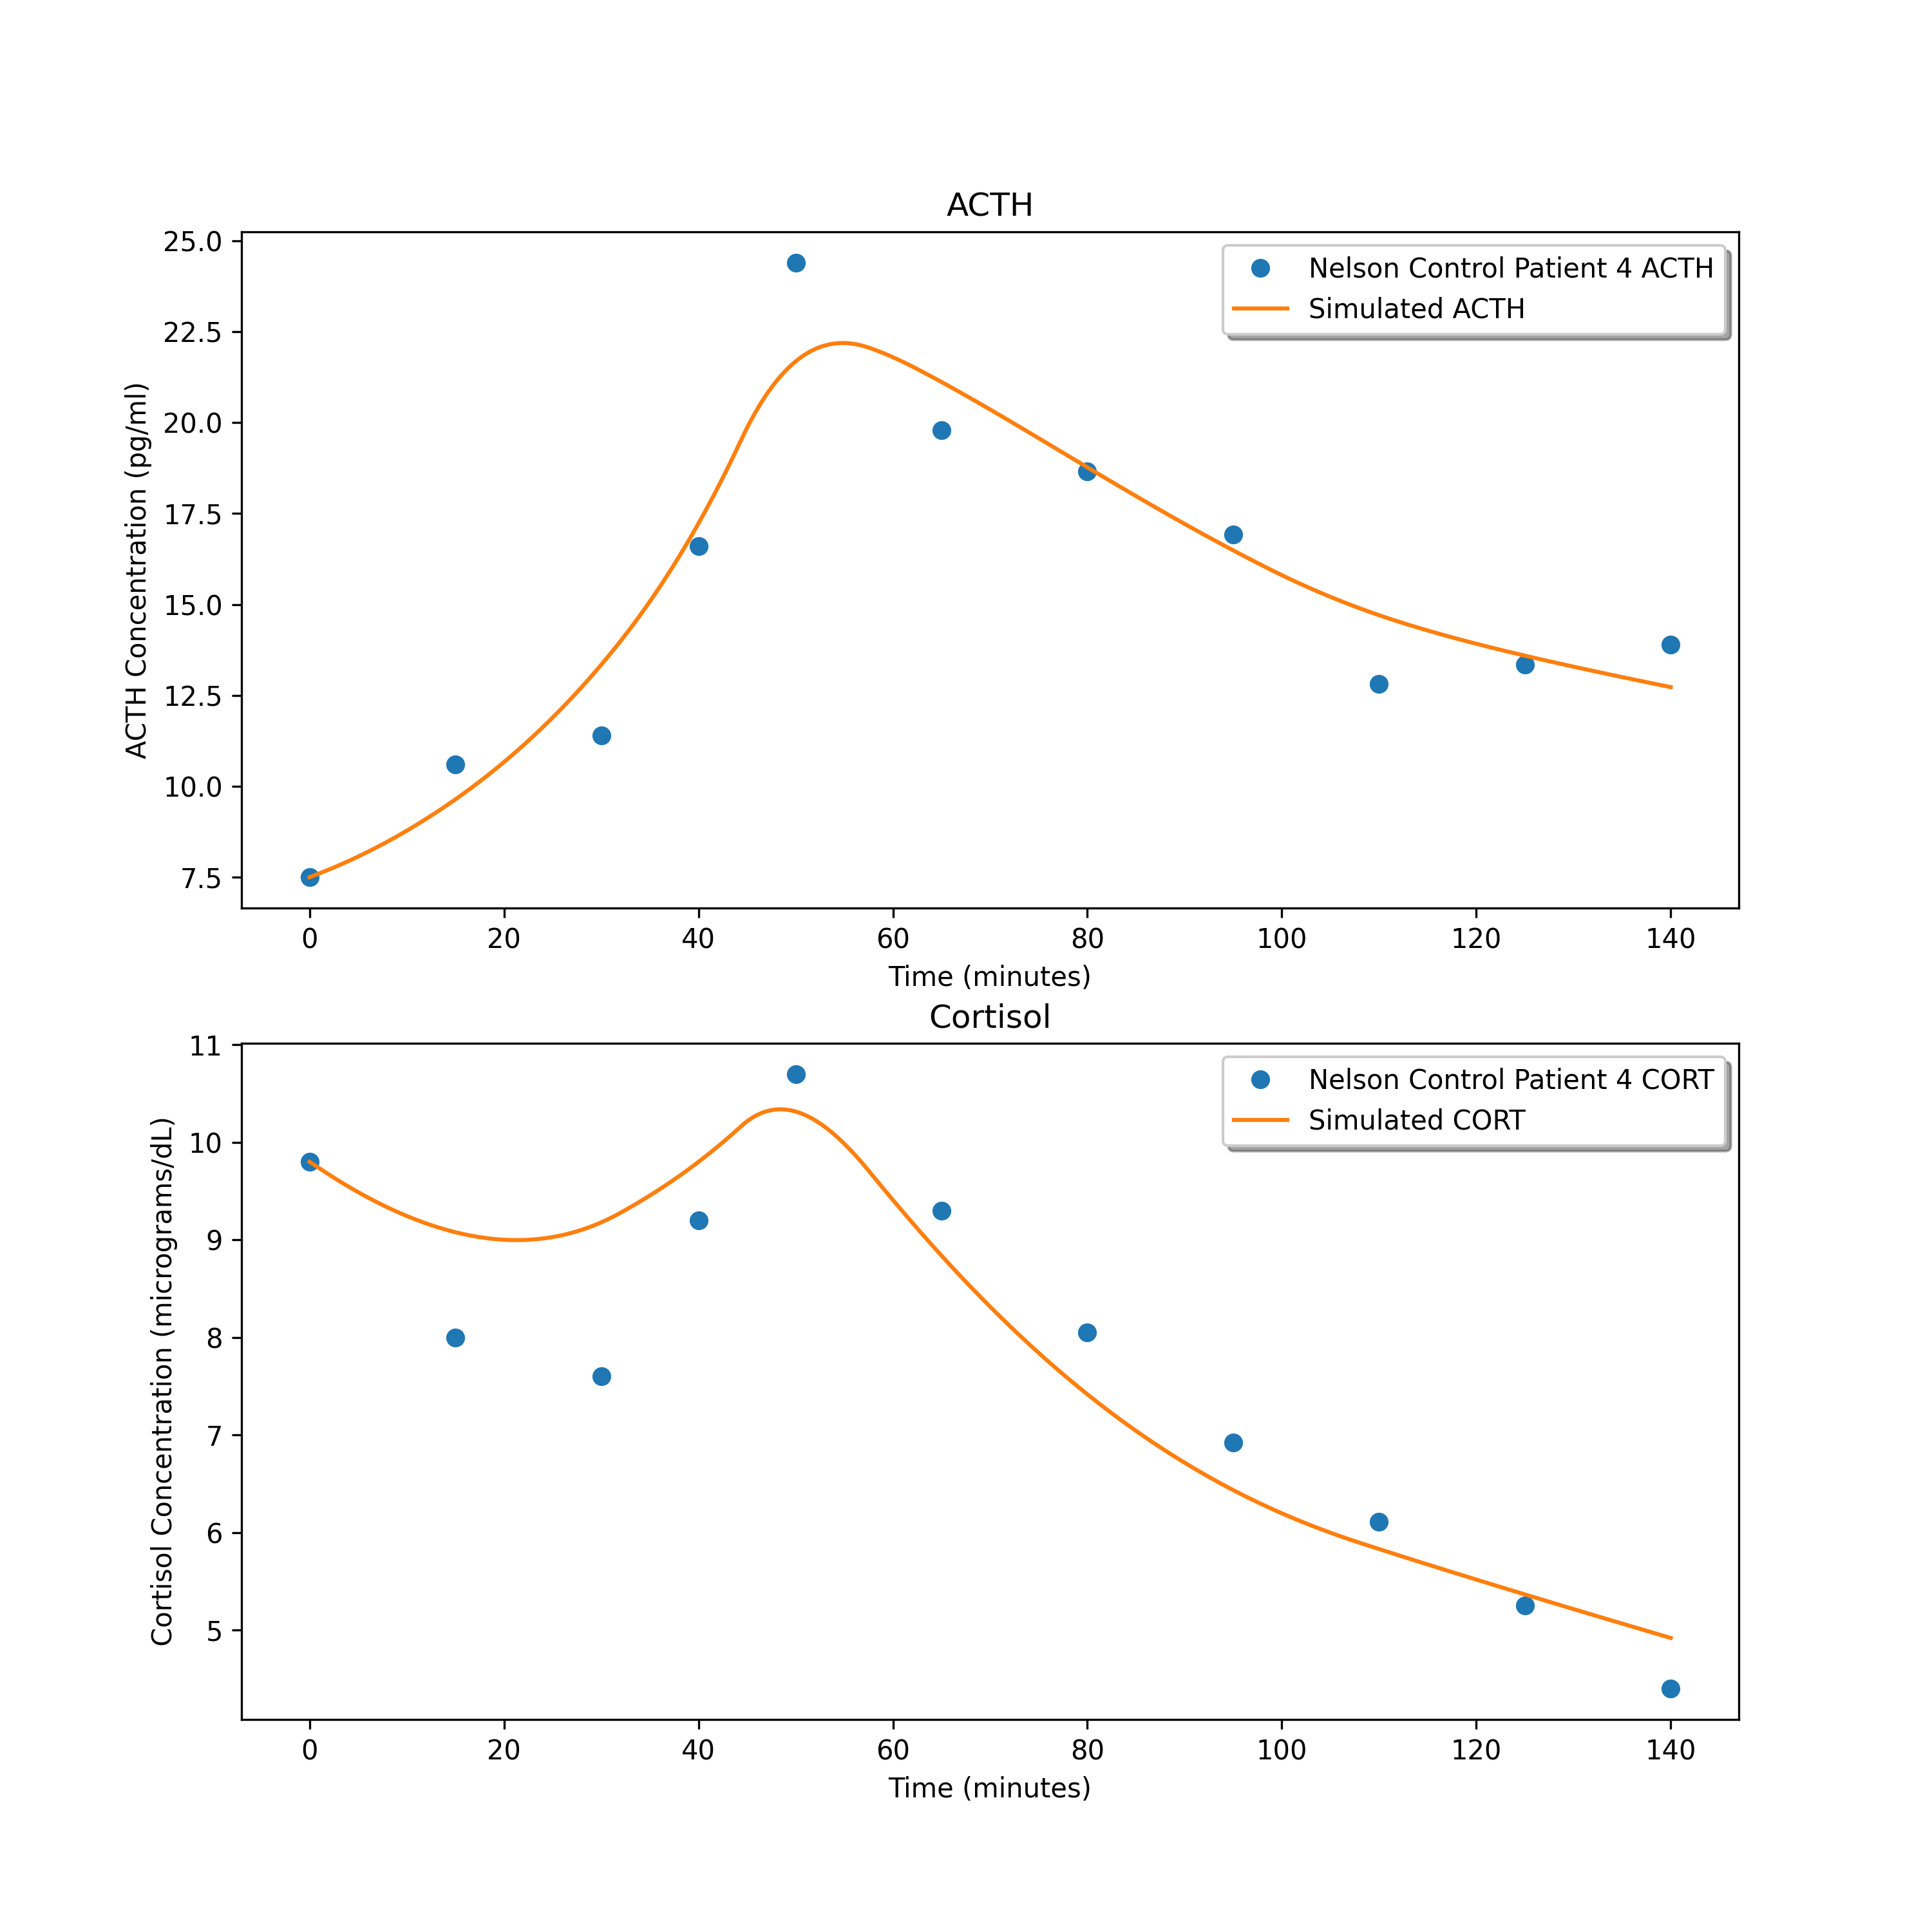
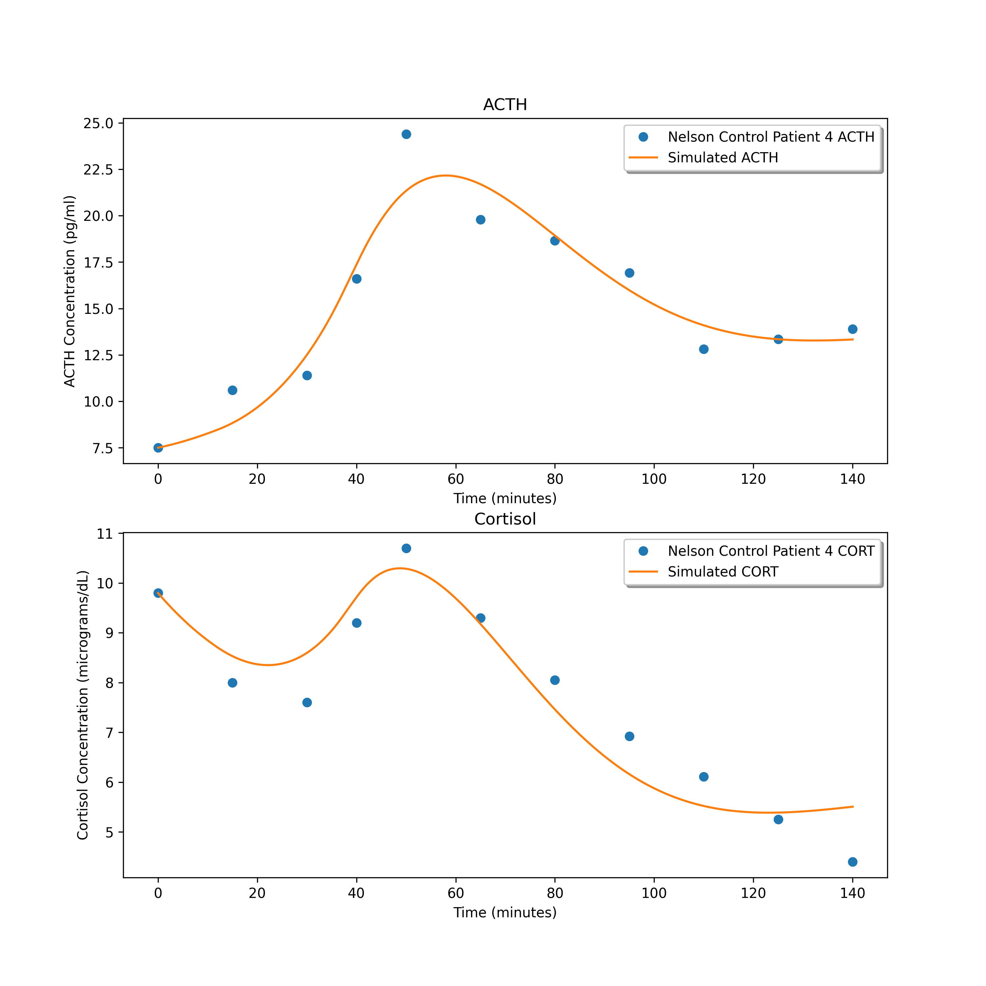
4.991045058689296
1.1271652162785317
1.1398232333507836

Slide 5
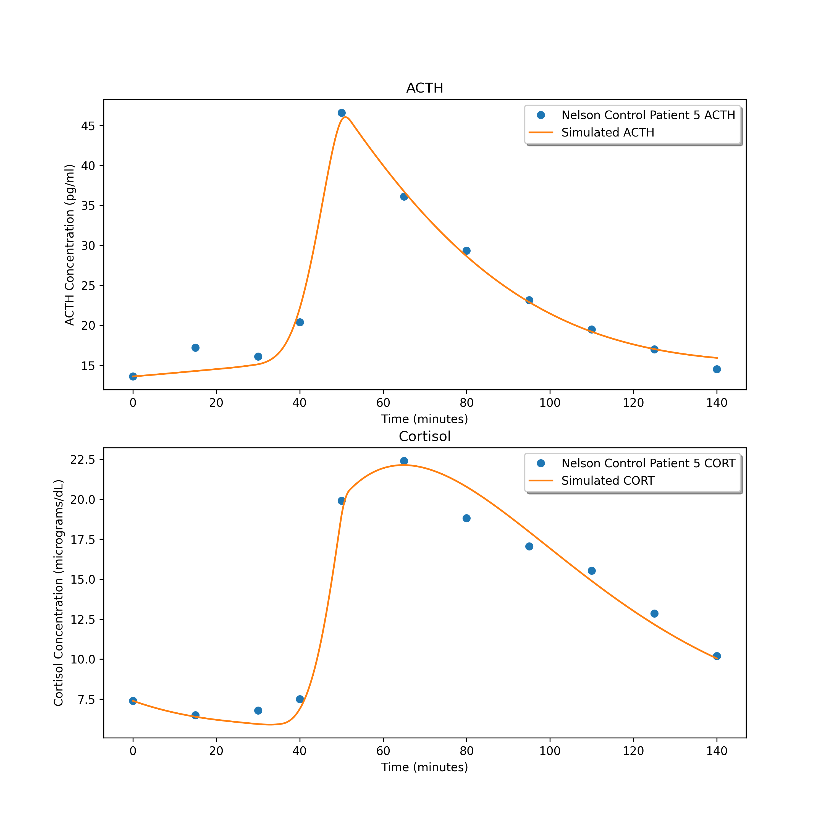
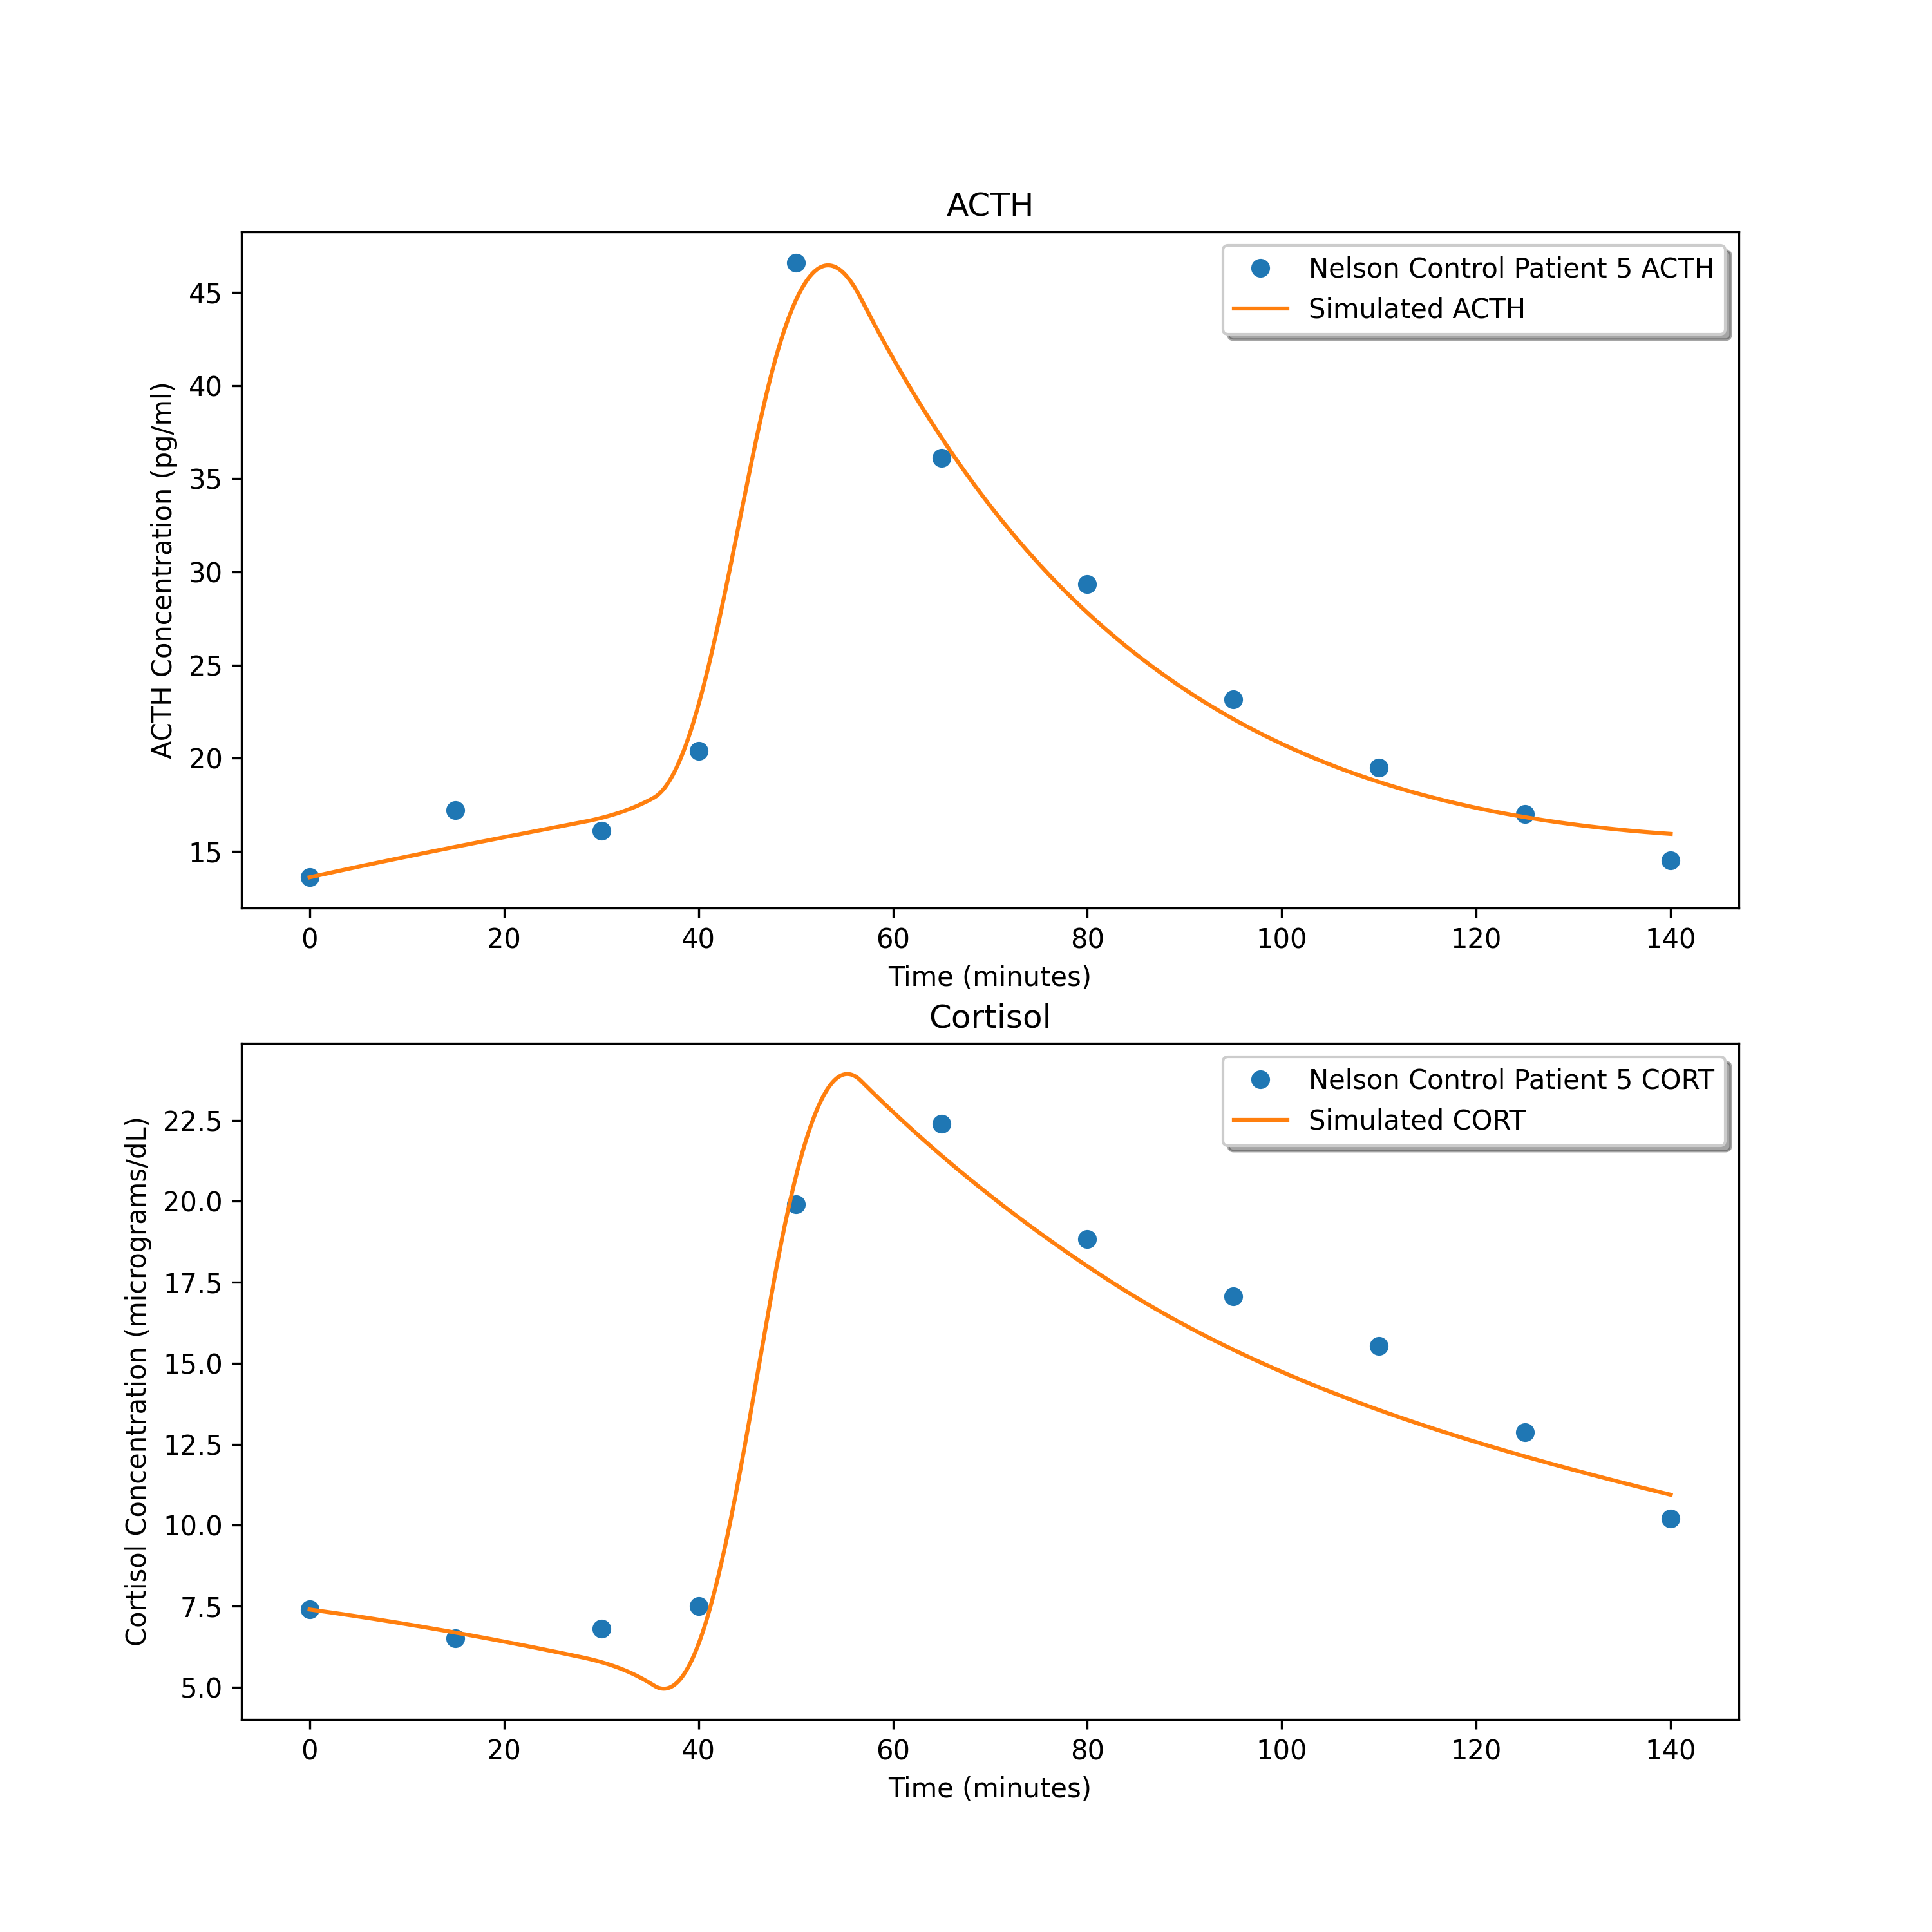
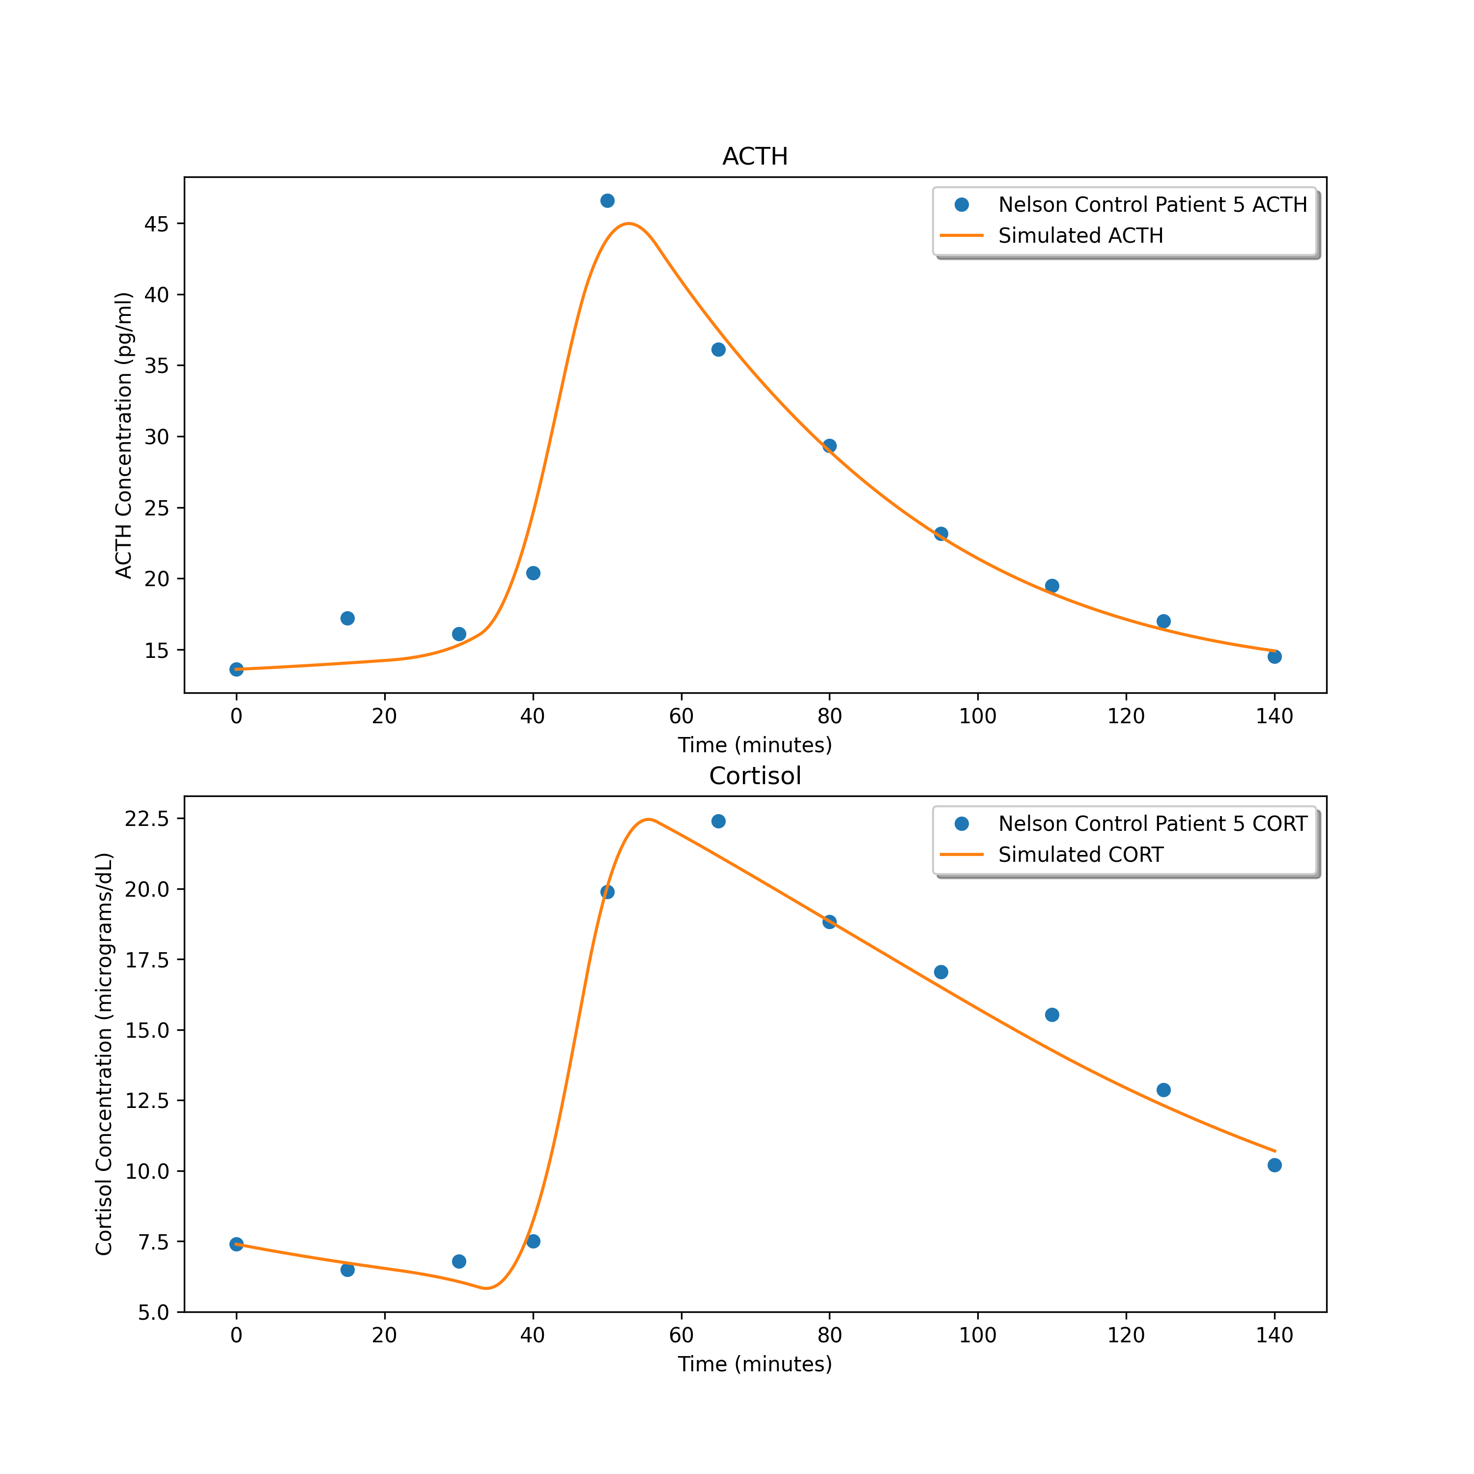
1.0928932415415922
1.5606450701664472
1.969320728960547

Slide 6
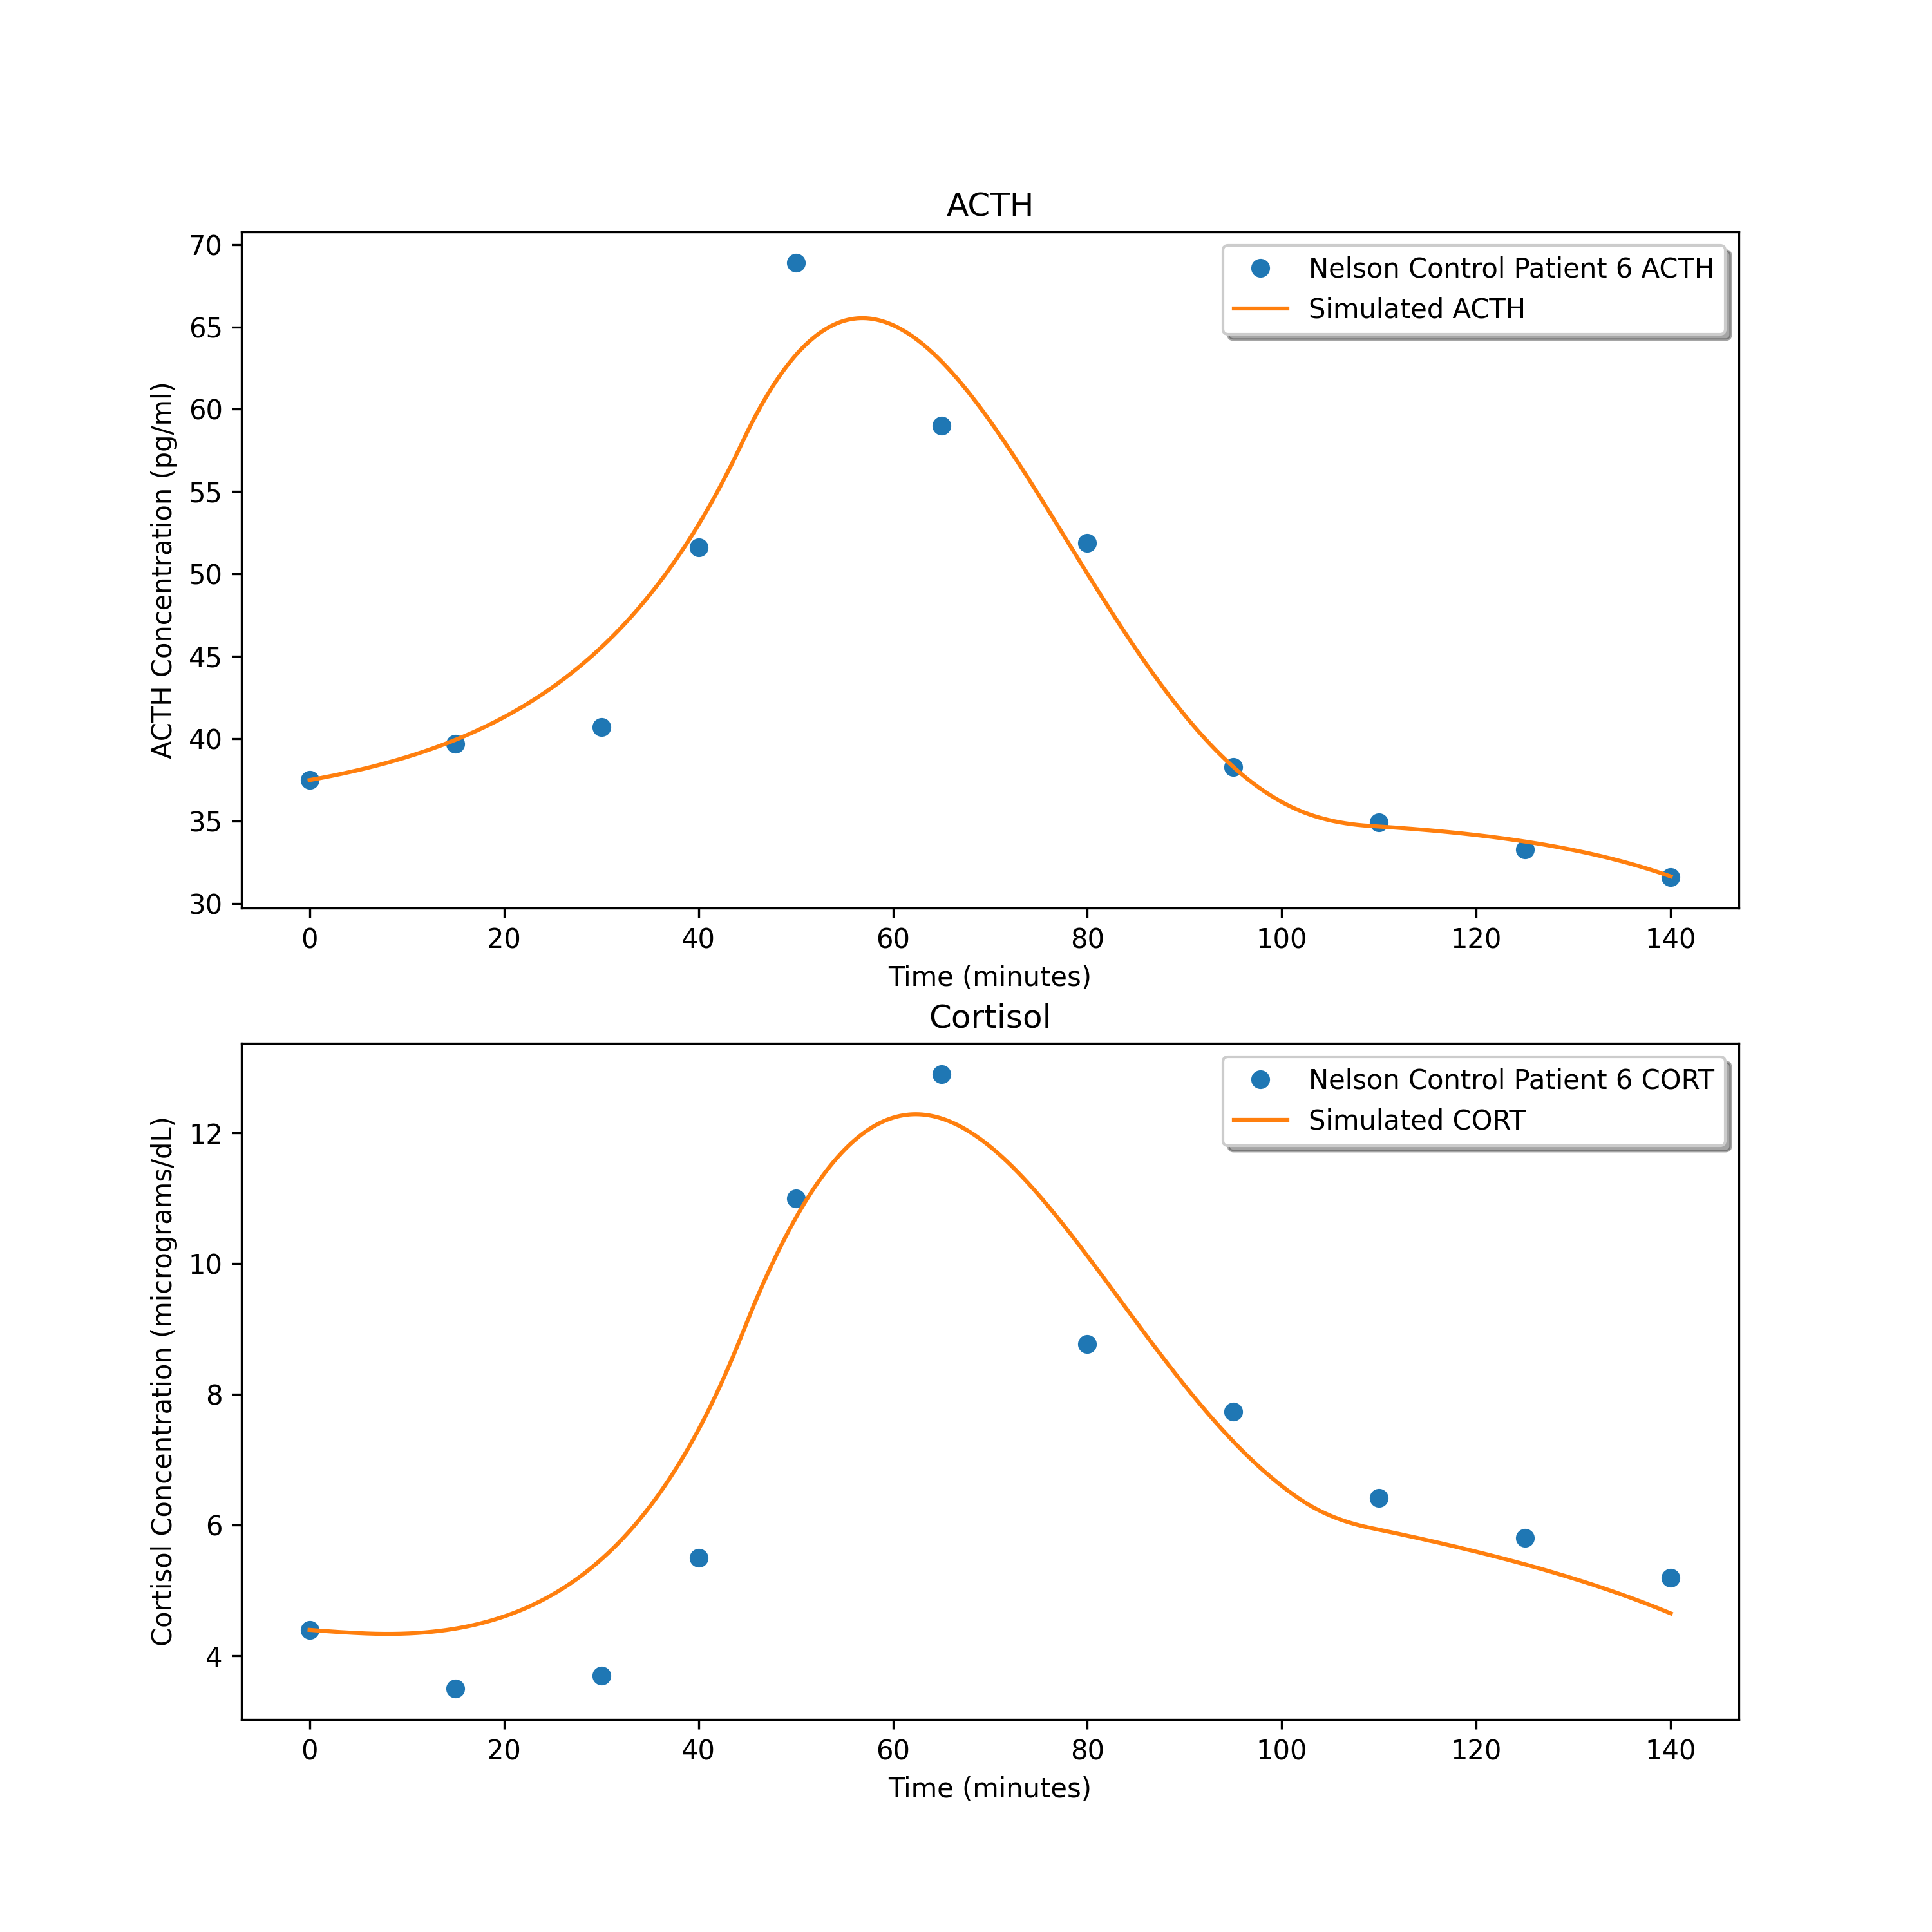
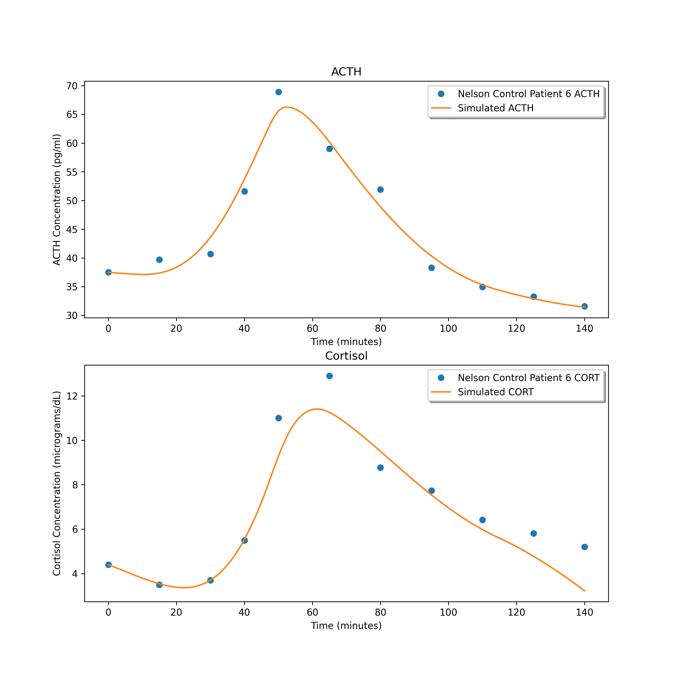
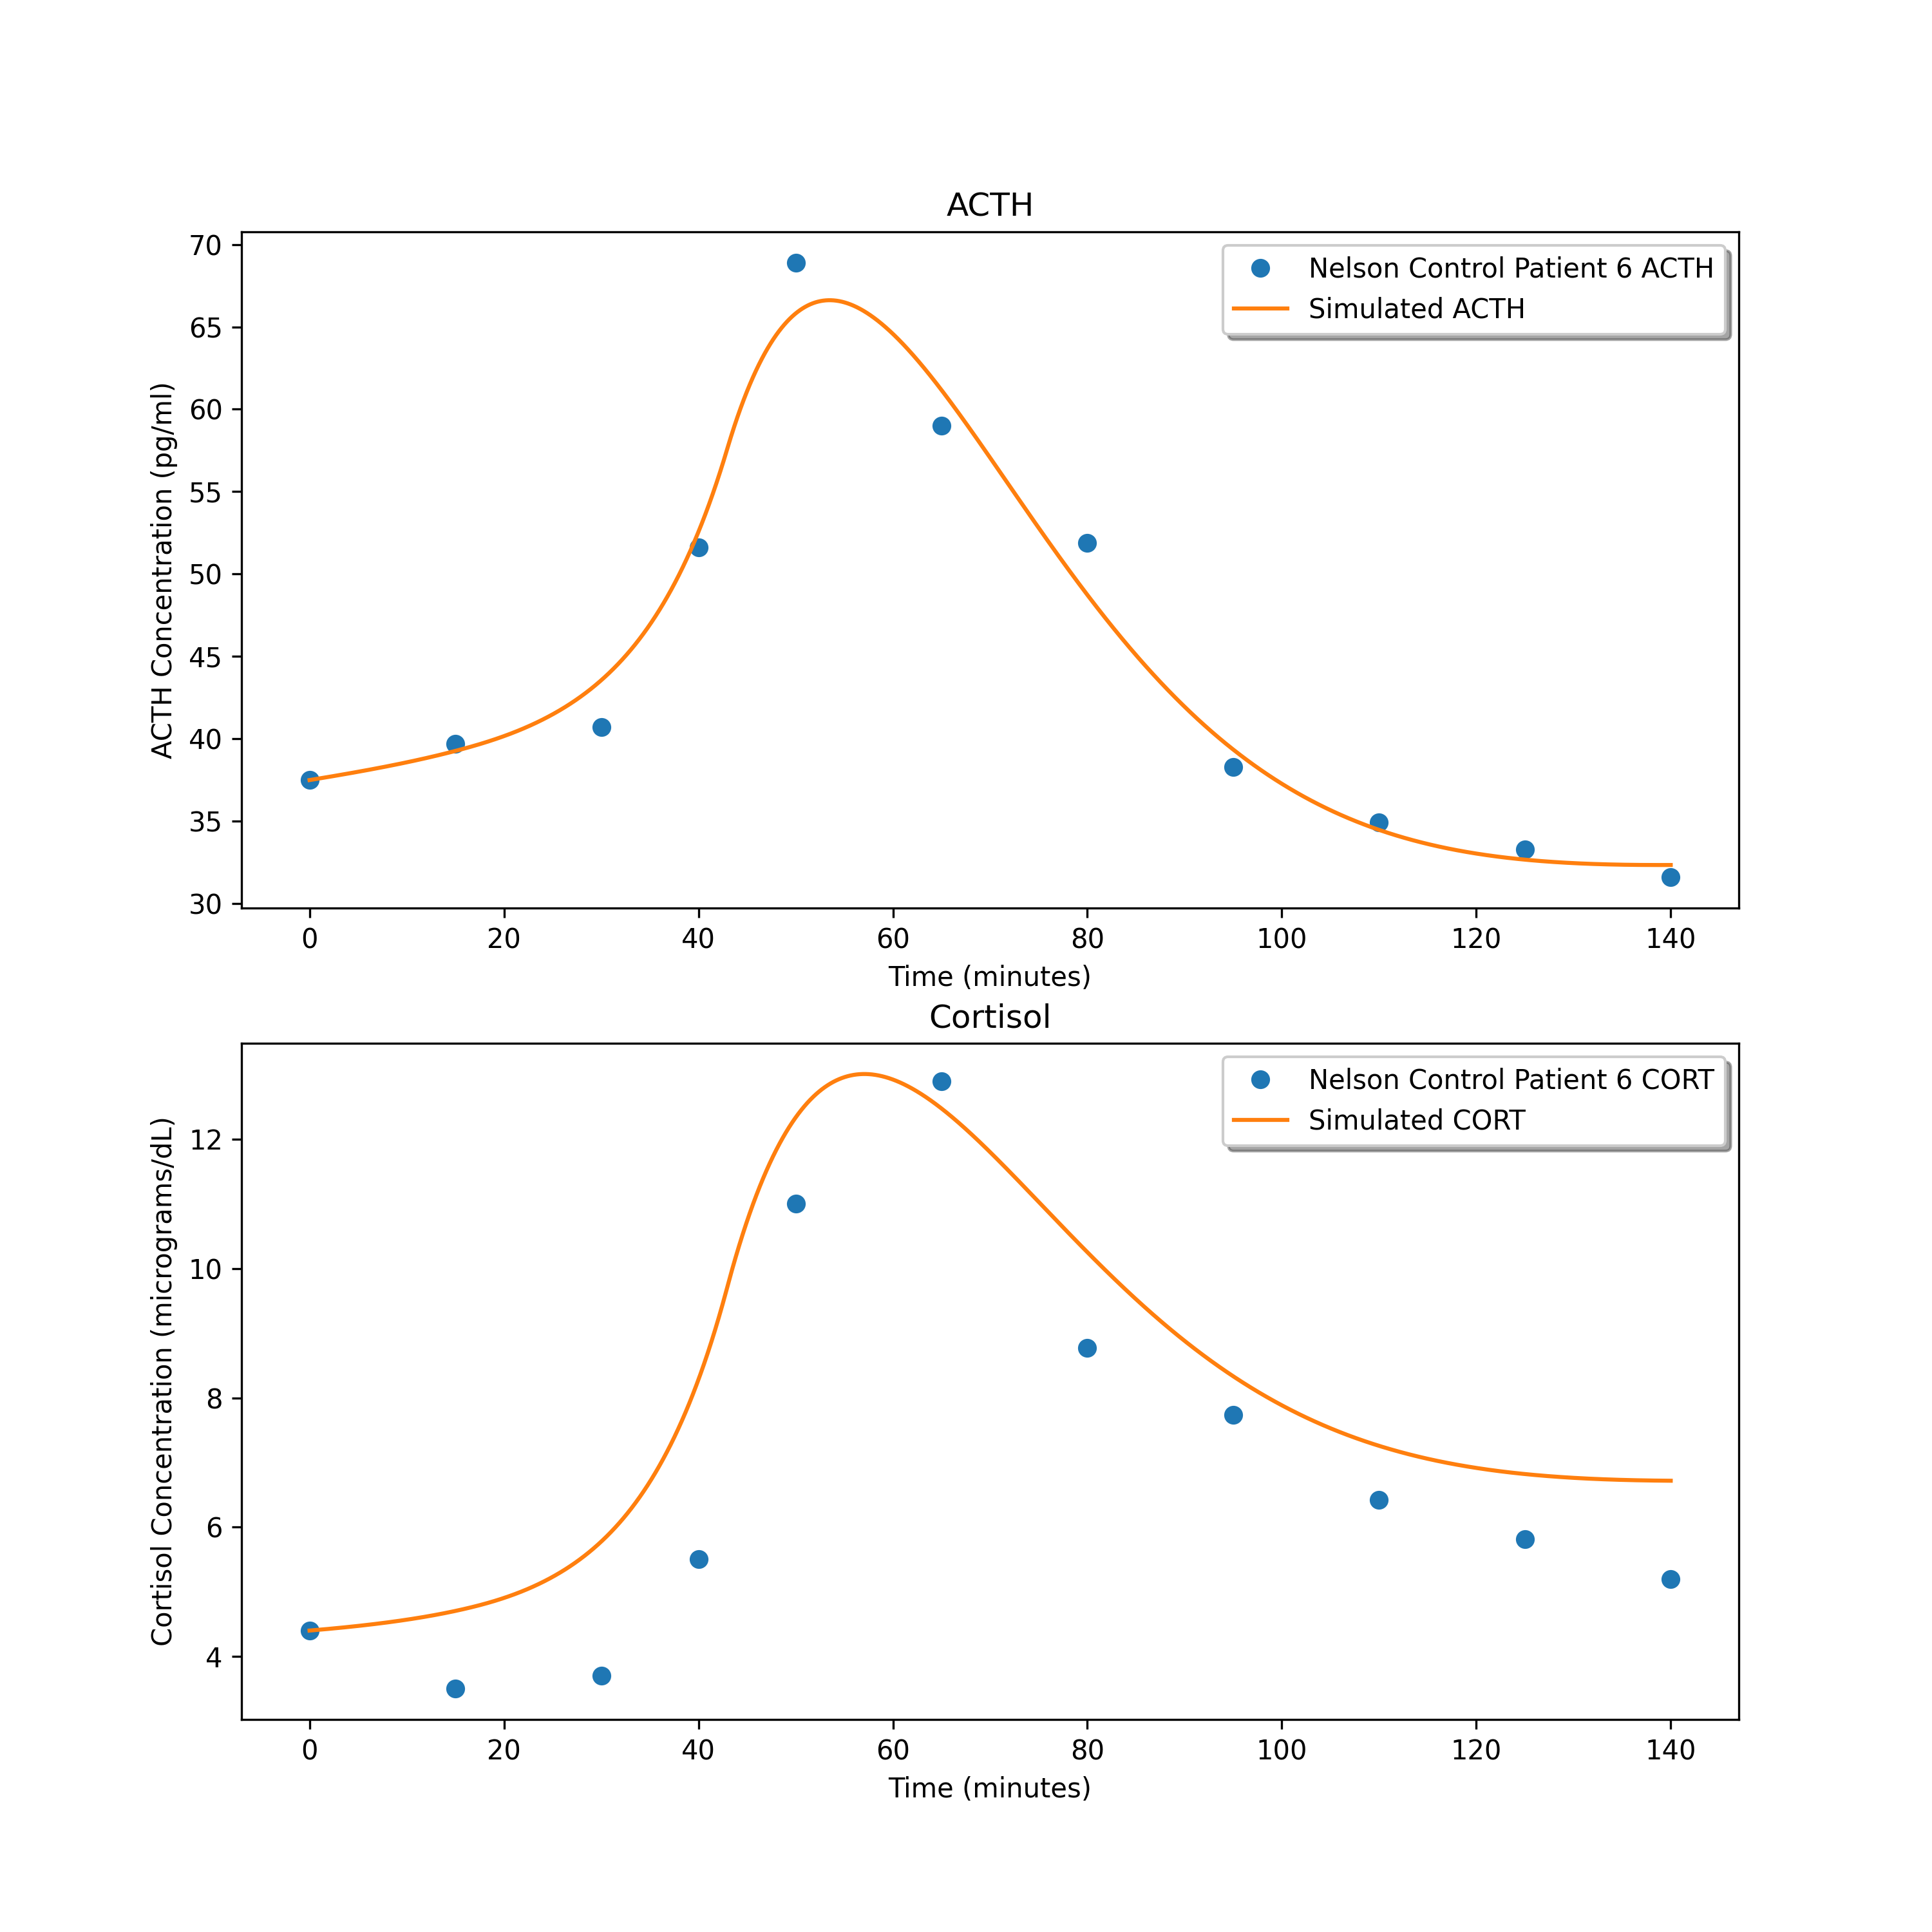
3.967351826188454
2.5245199520752704
2.6267346473050157

Slide 7
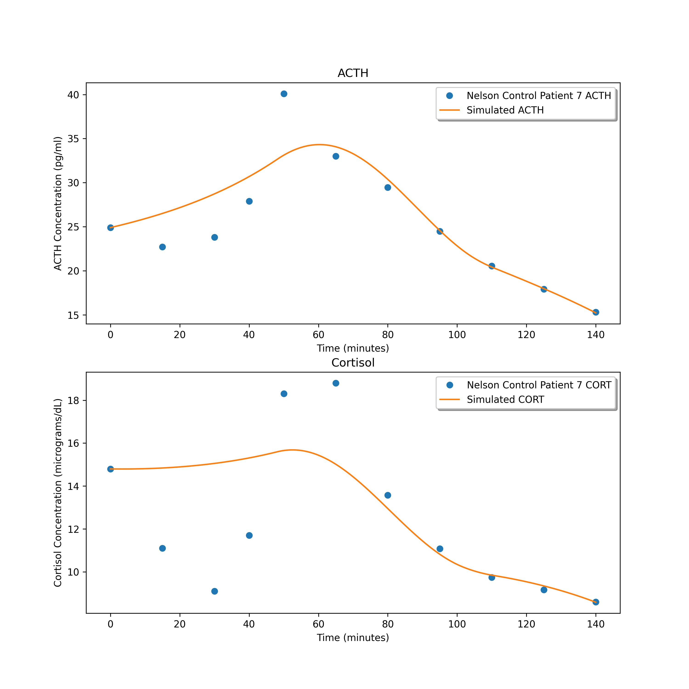
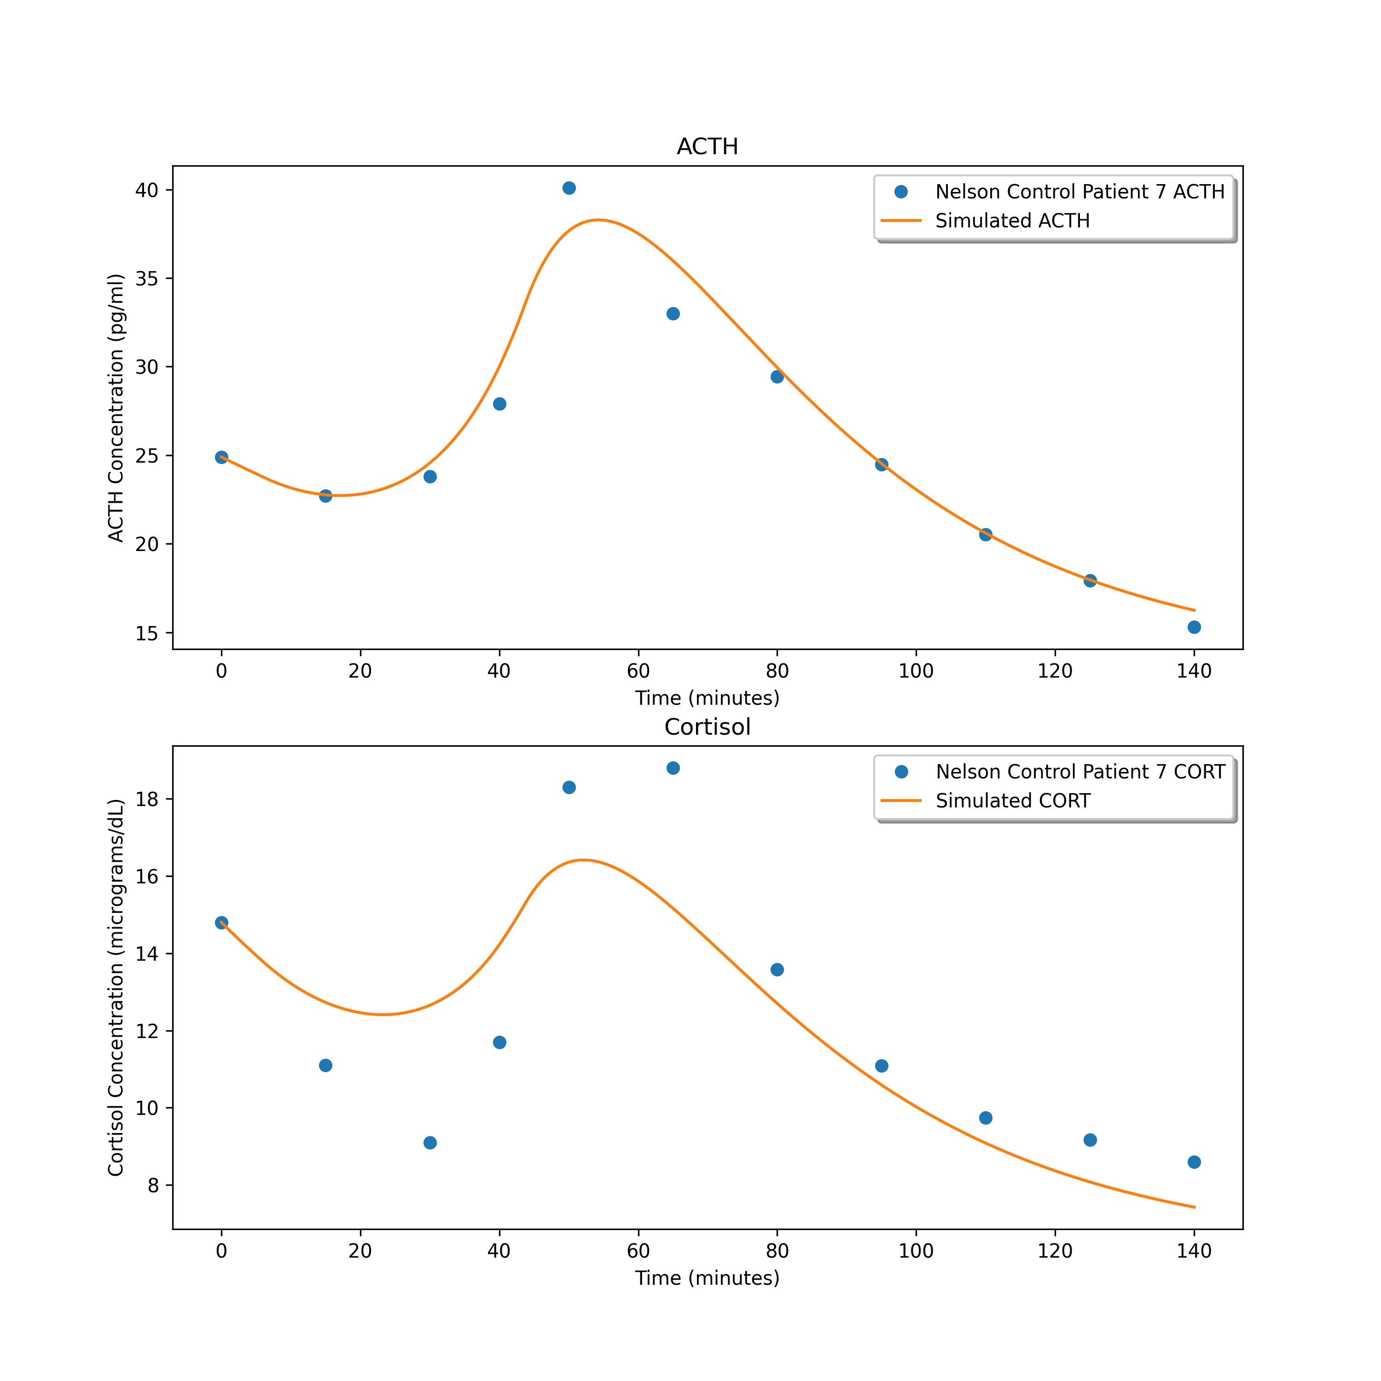
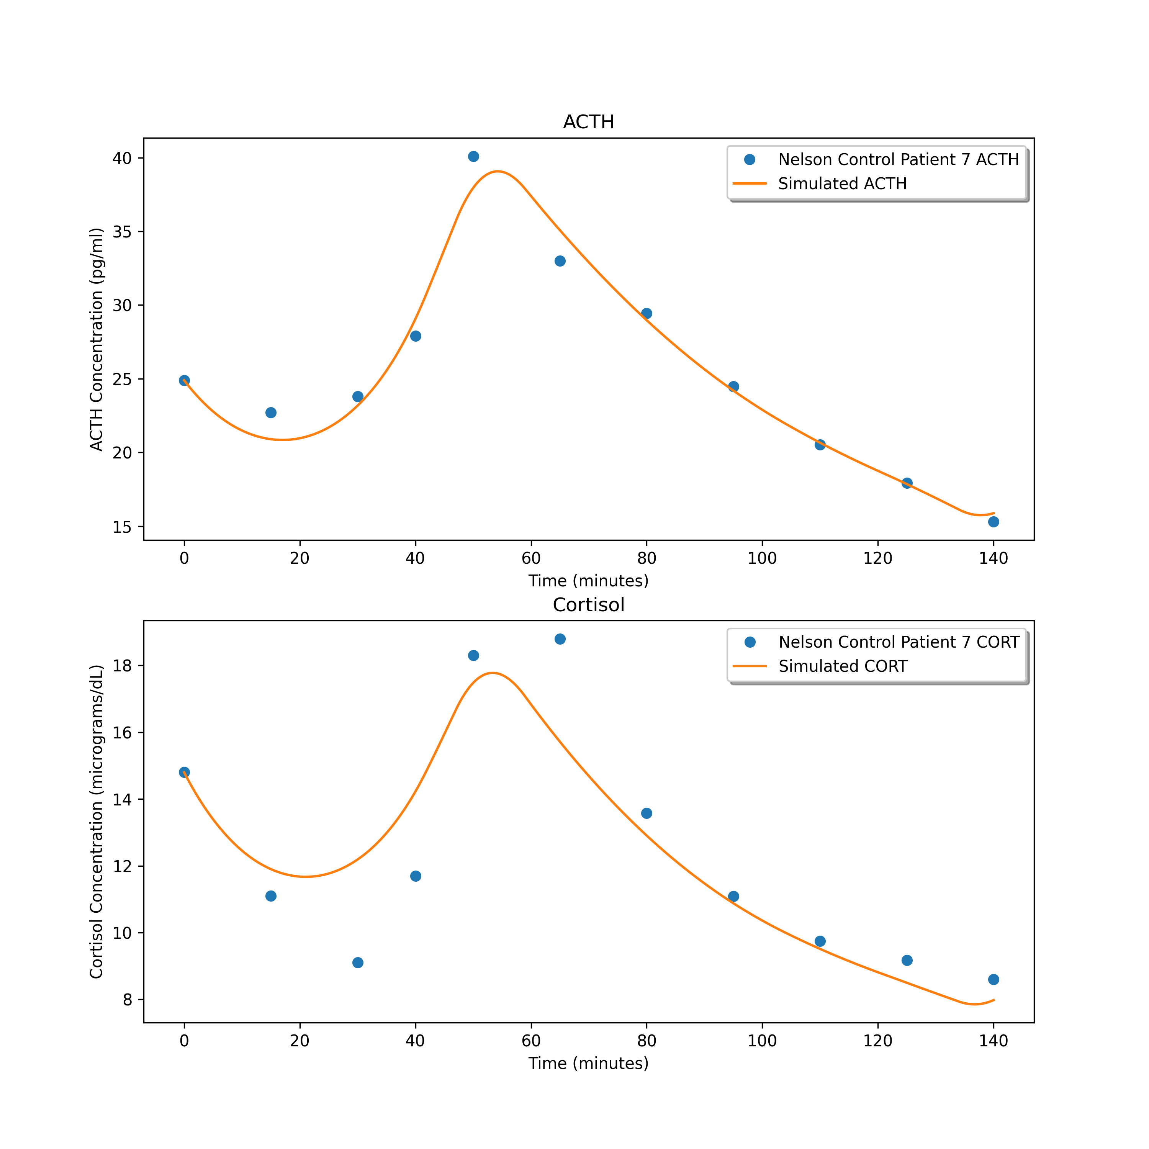
8.256061860391897
2.8906047195078064
1.9409342665444598

Slide 8
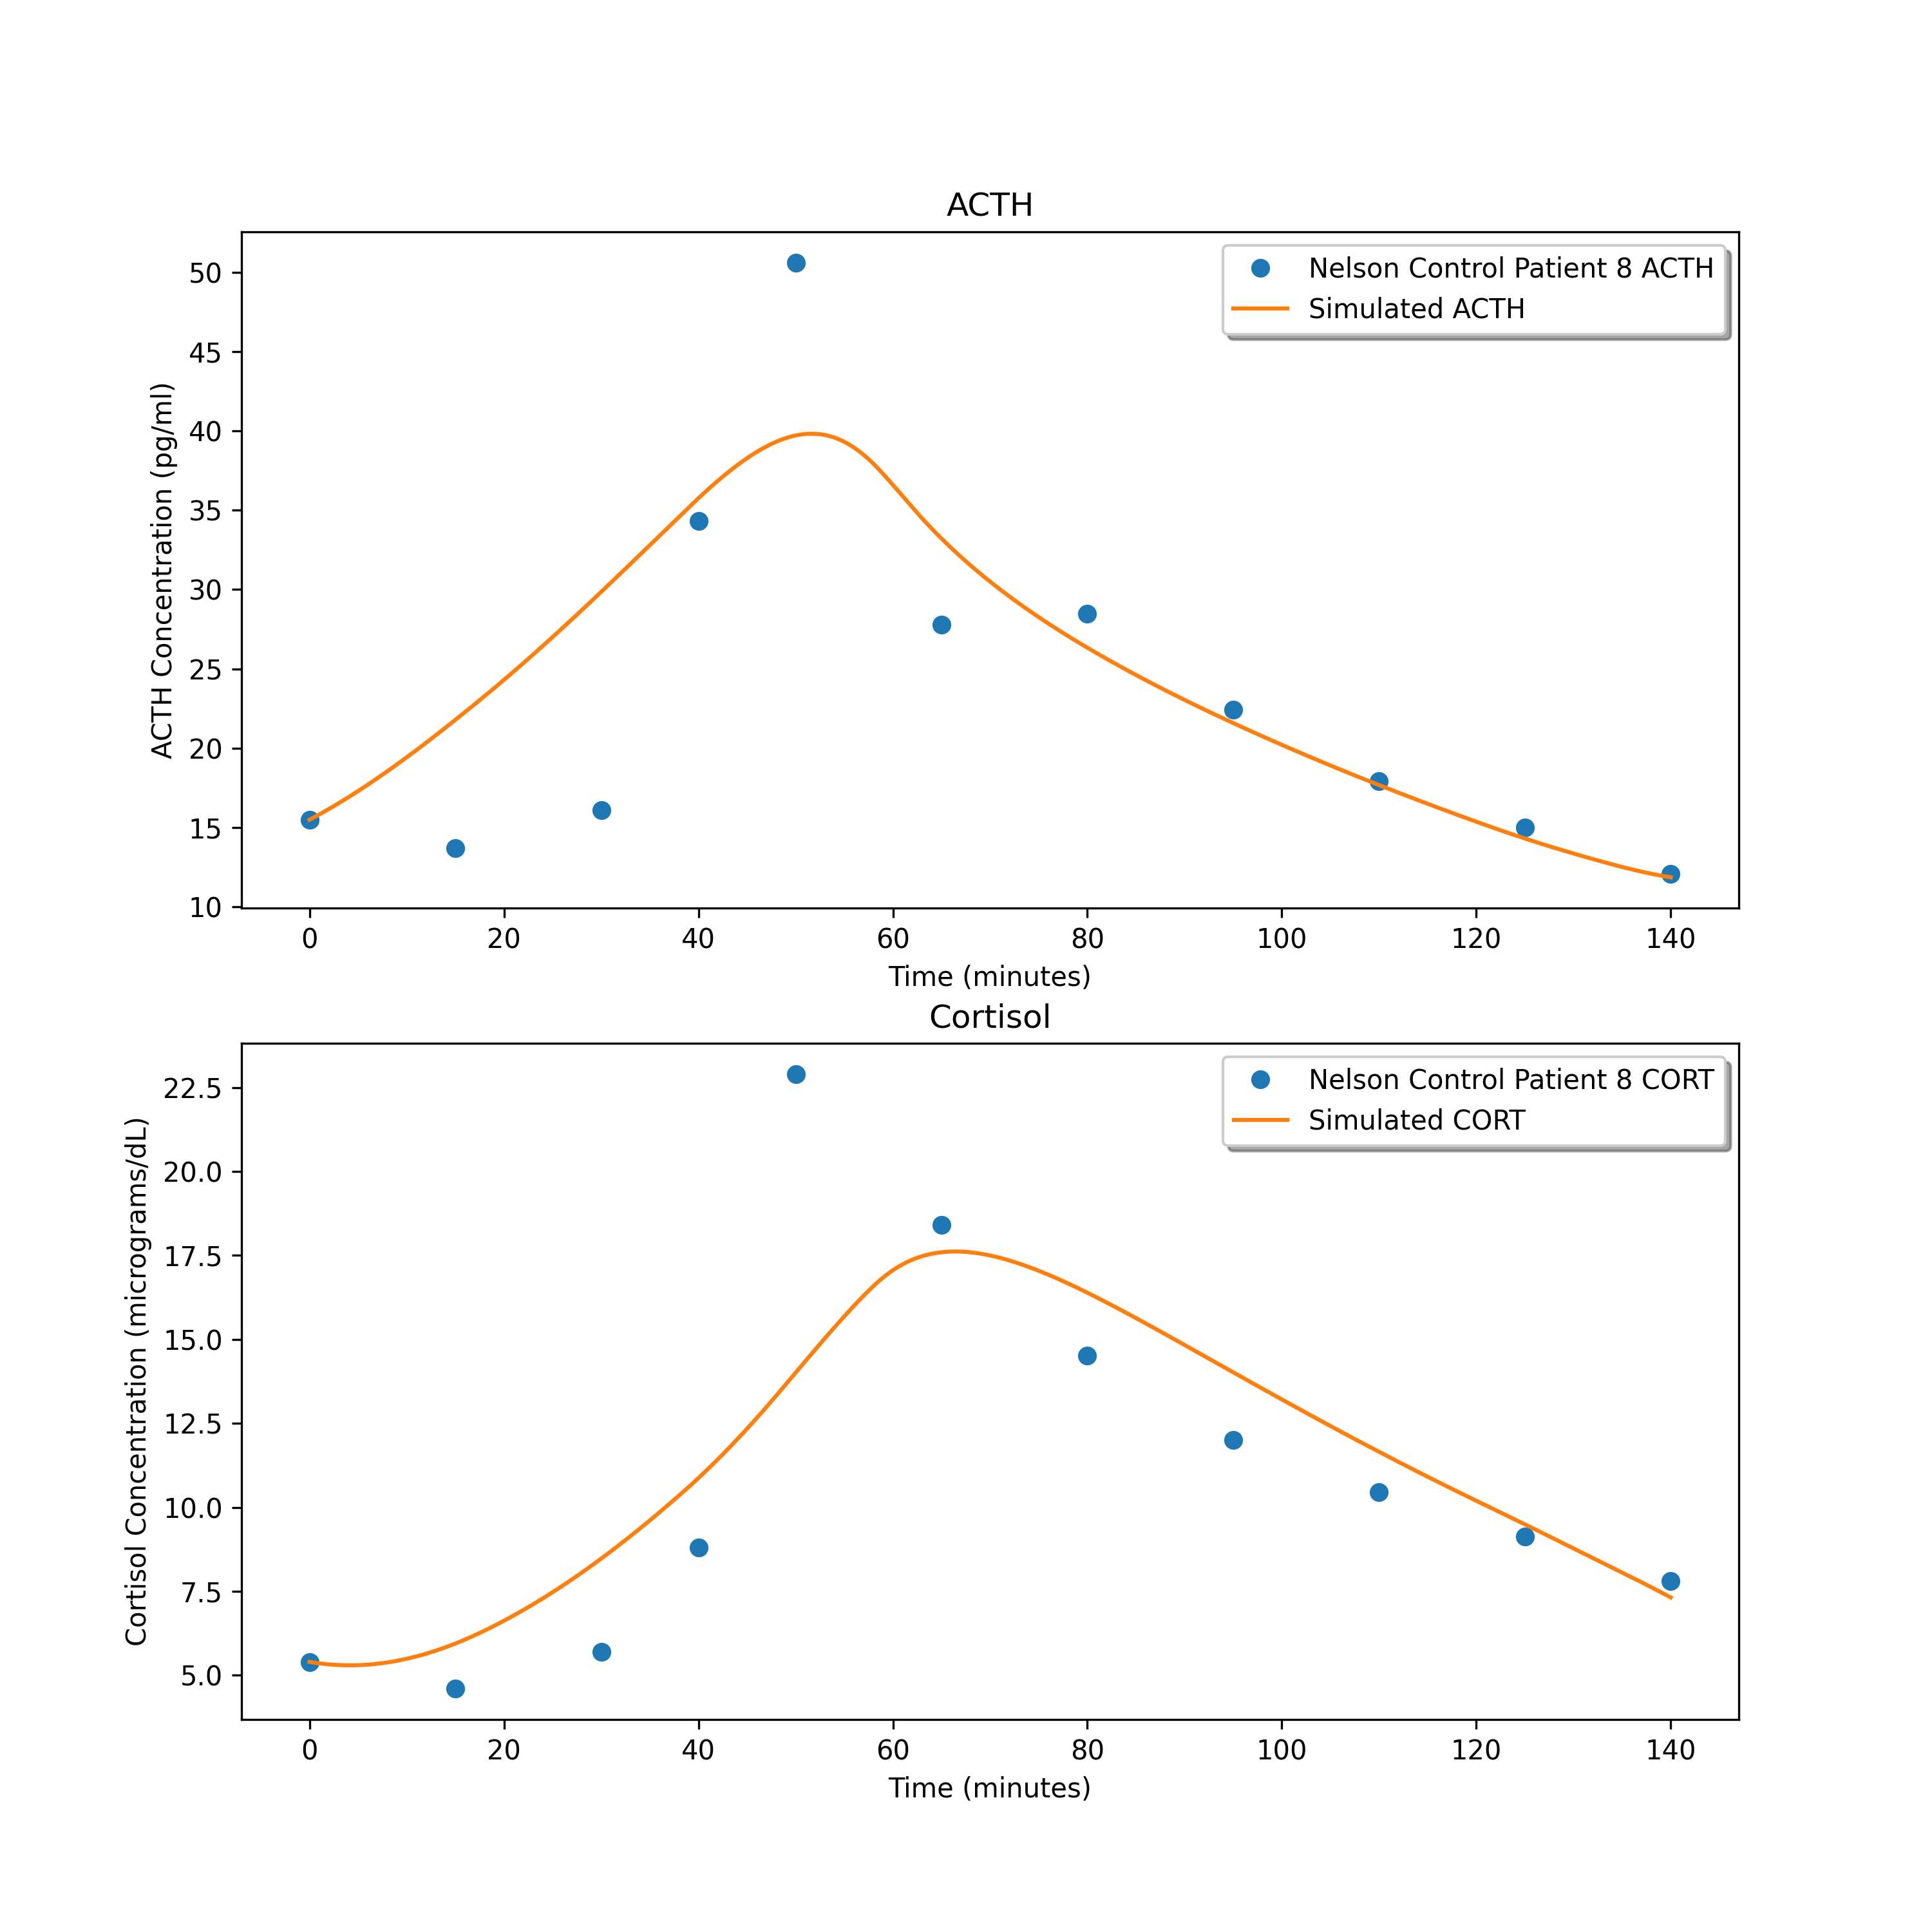
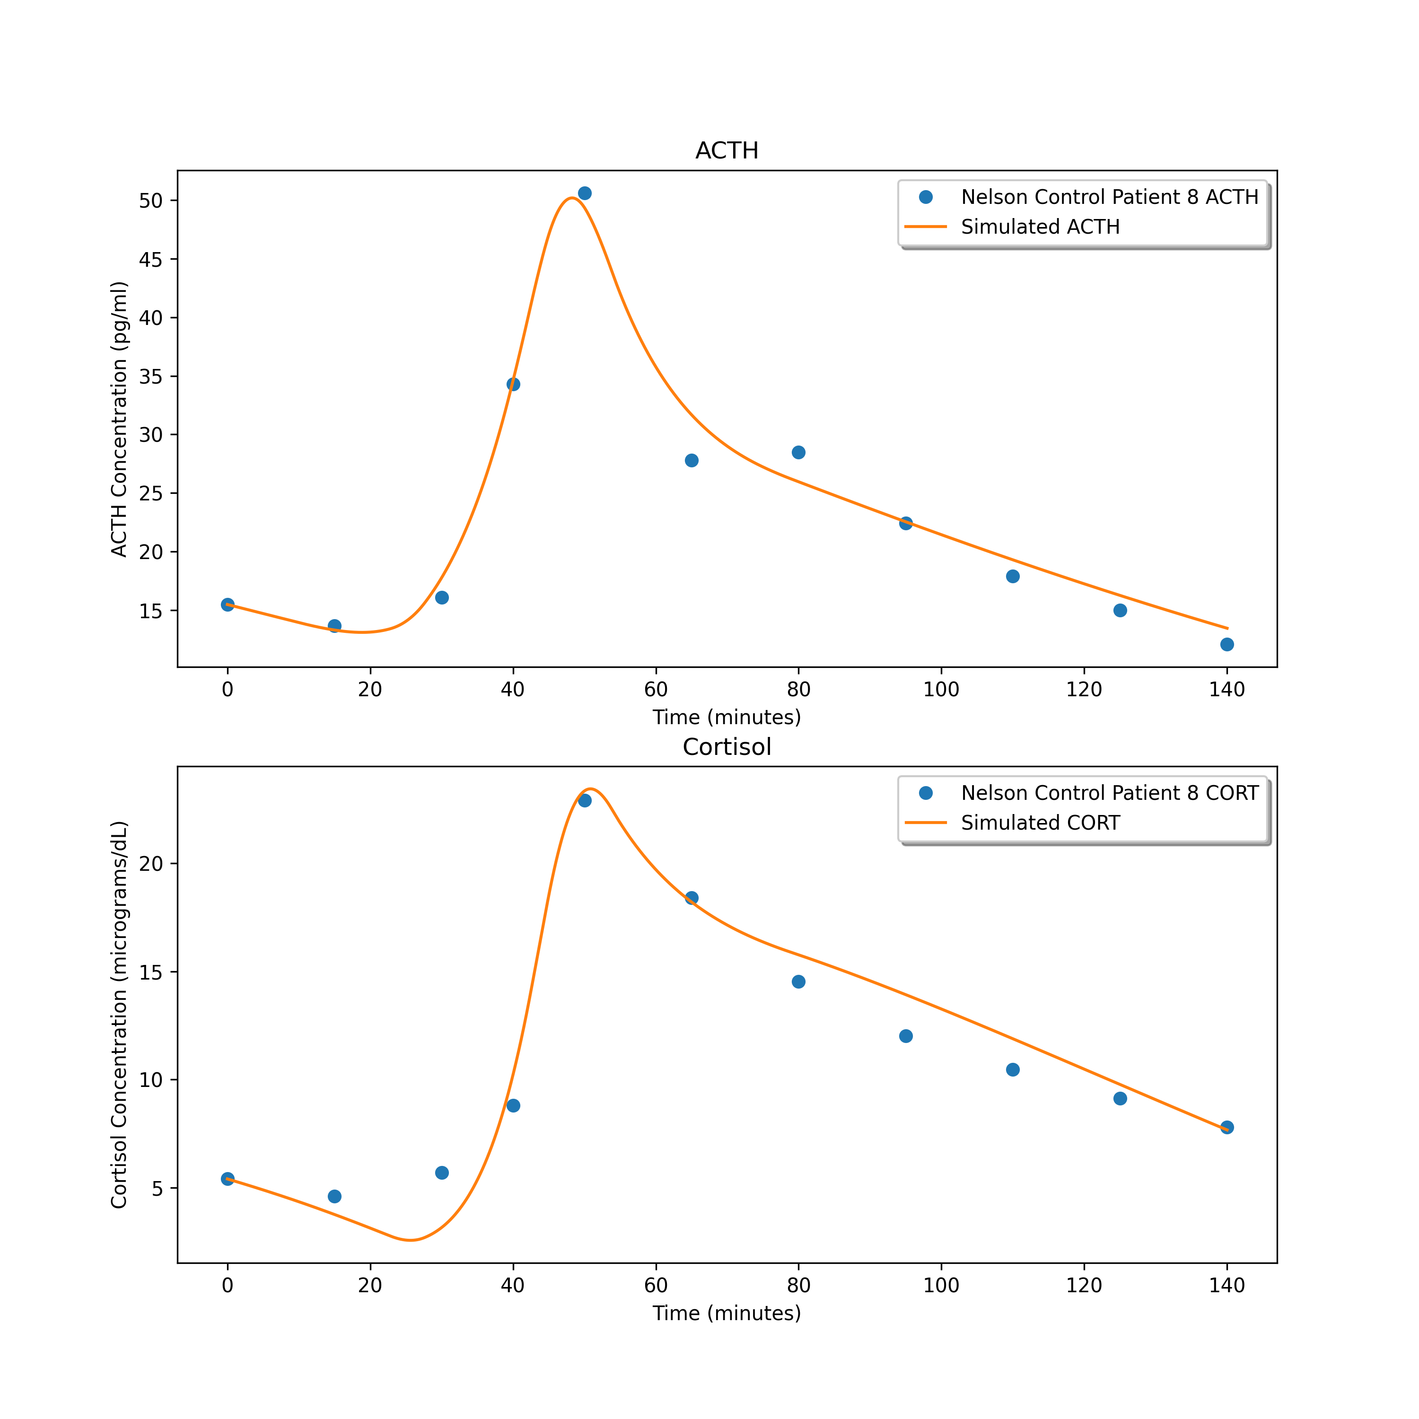
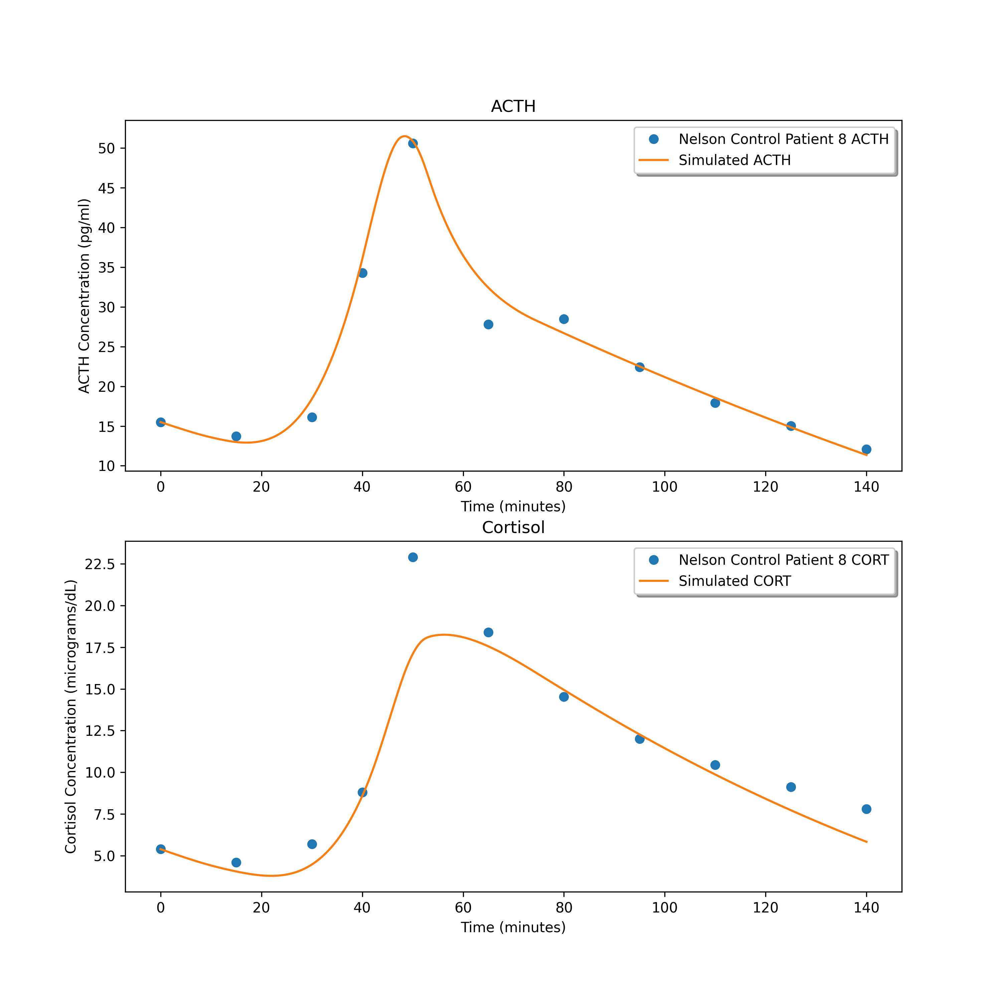
23.339761004578147
2.2029032735391167
3.508008702477808

Slide 9
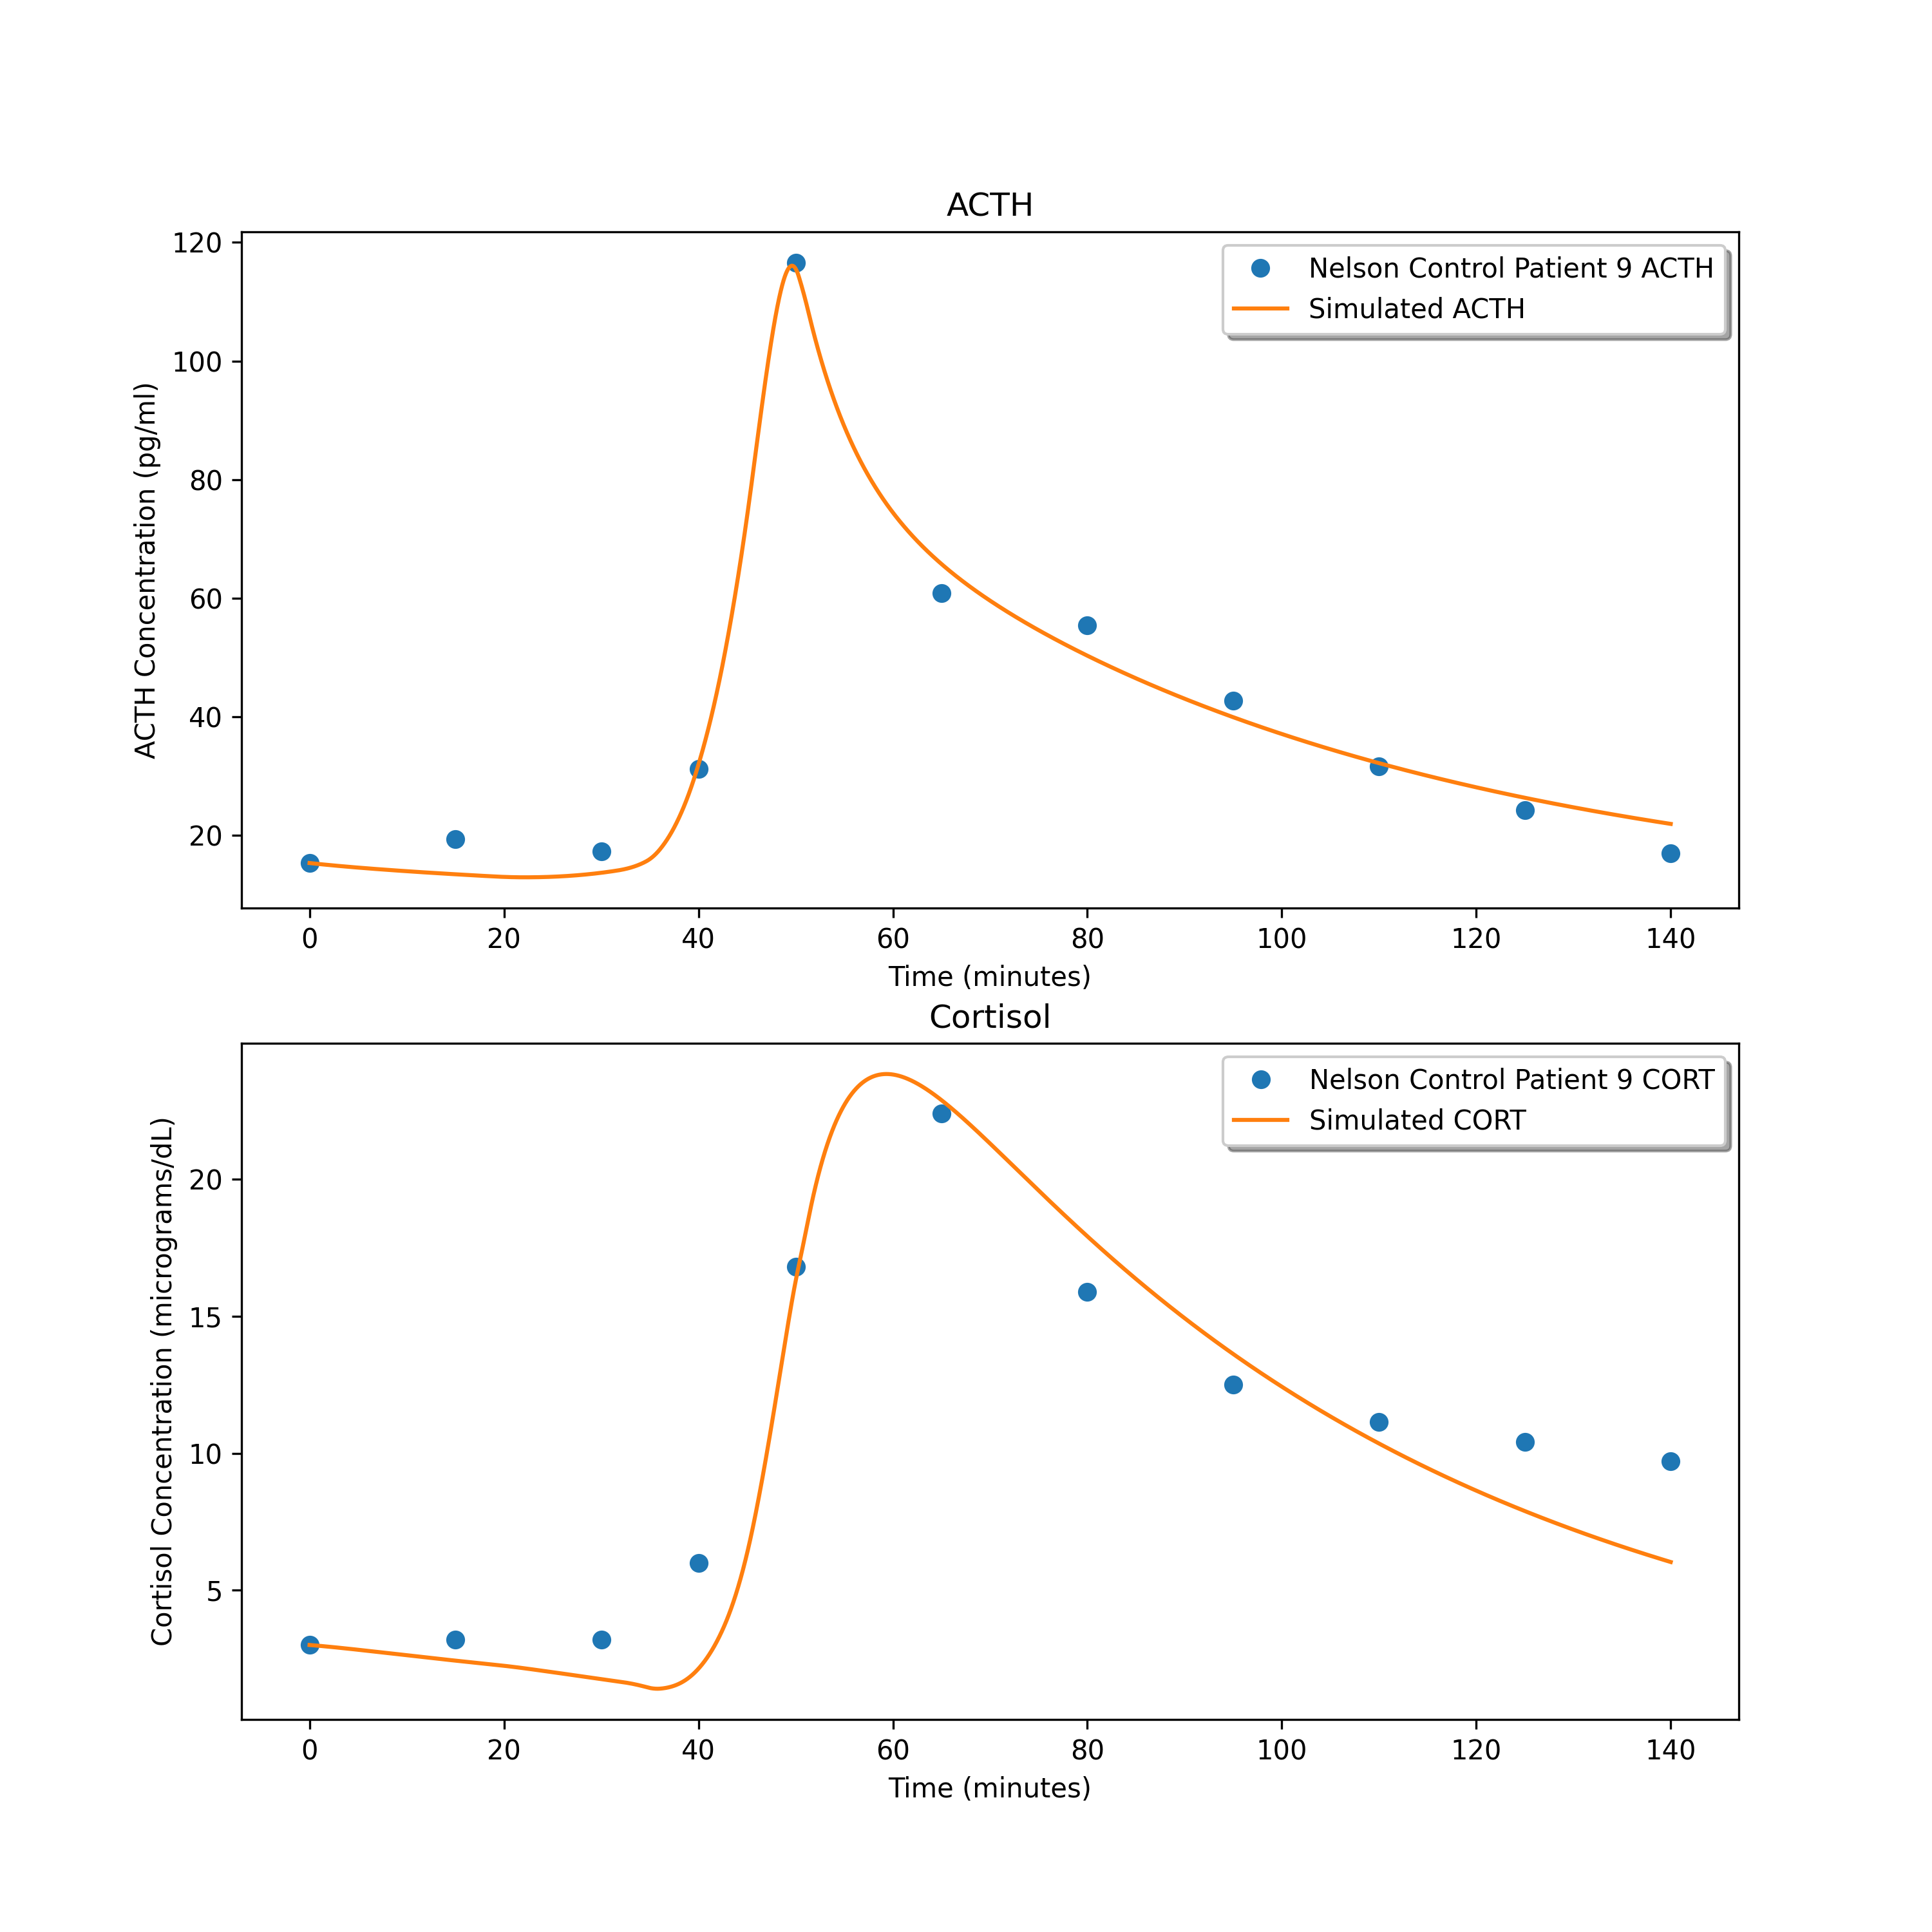
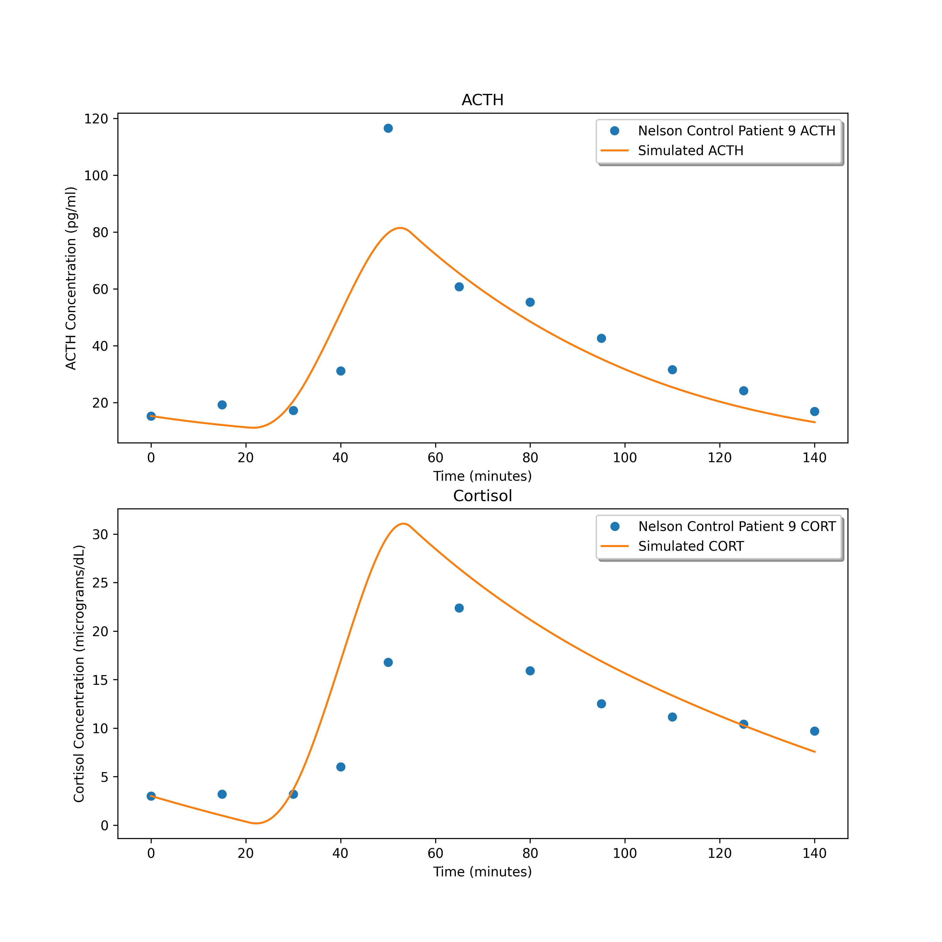
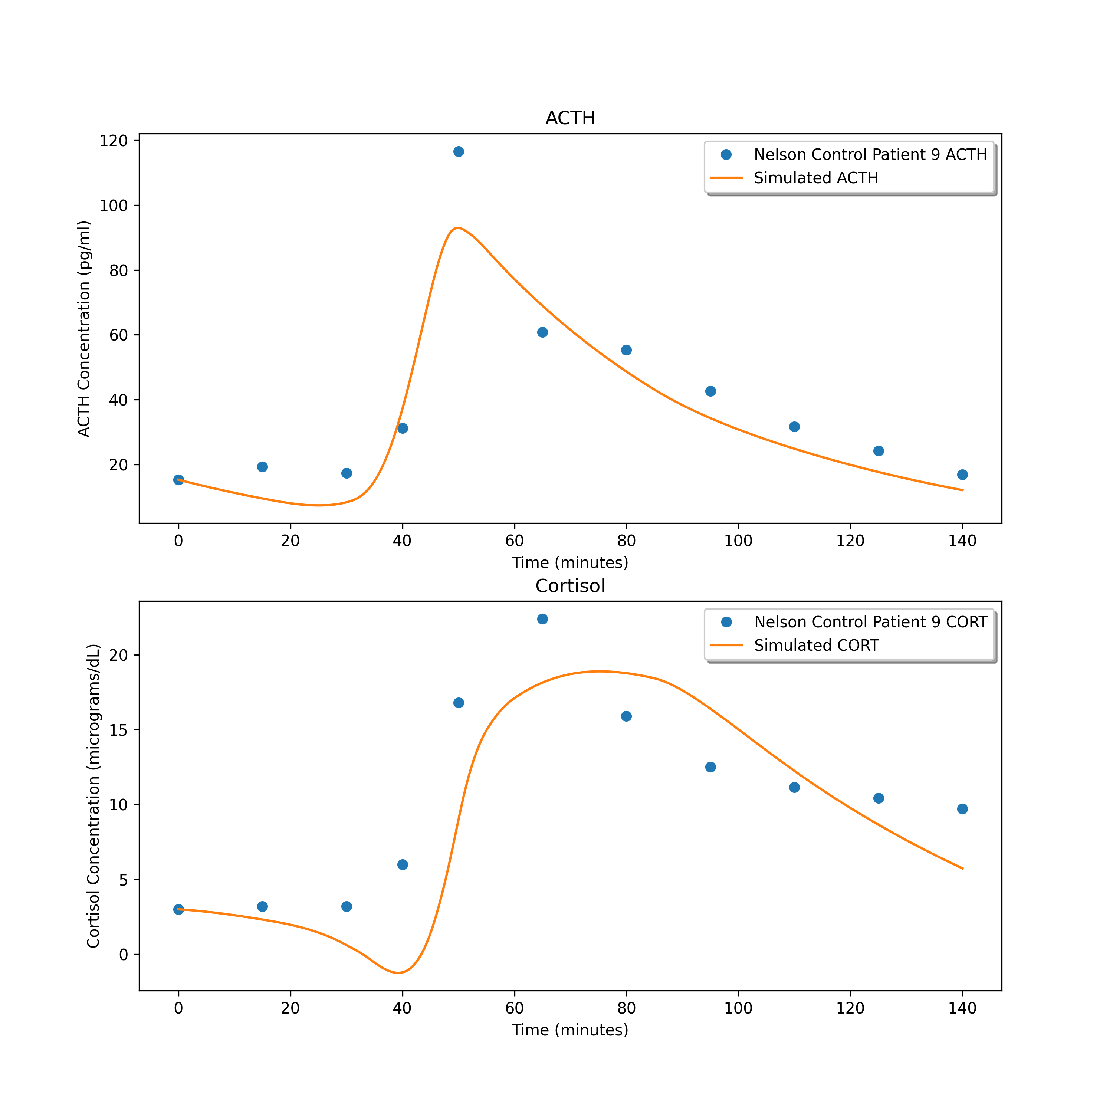
8.22377165720662
110.10705855979826
56.743814030564245

Slide 10
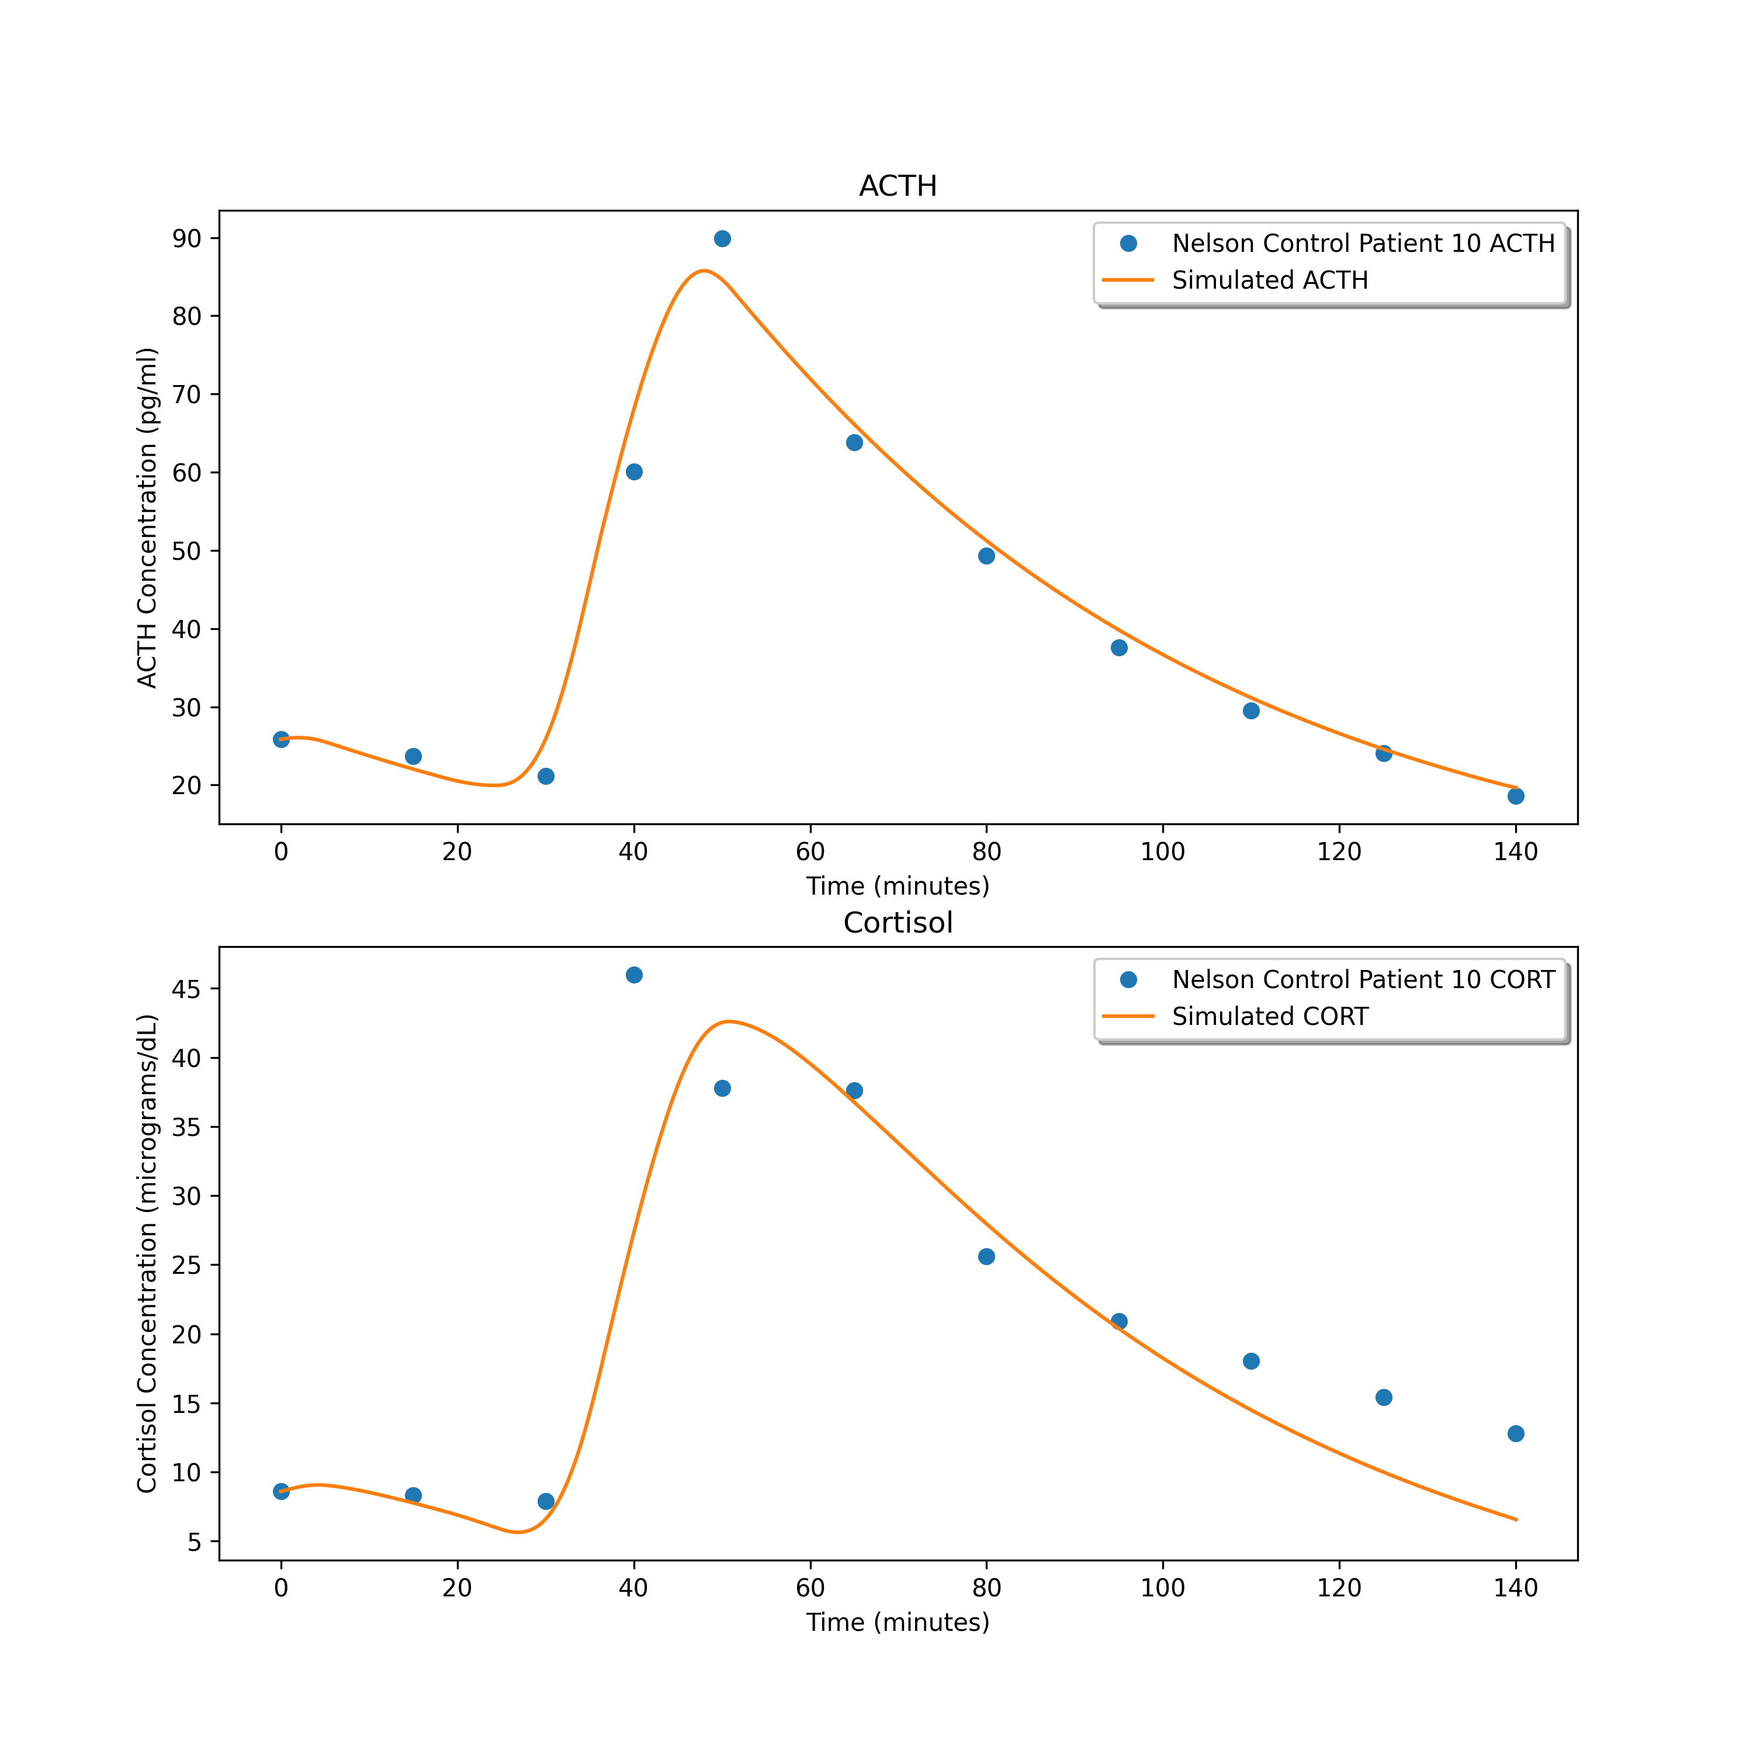
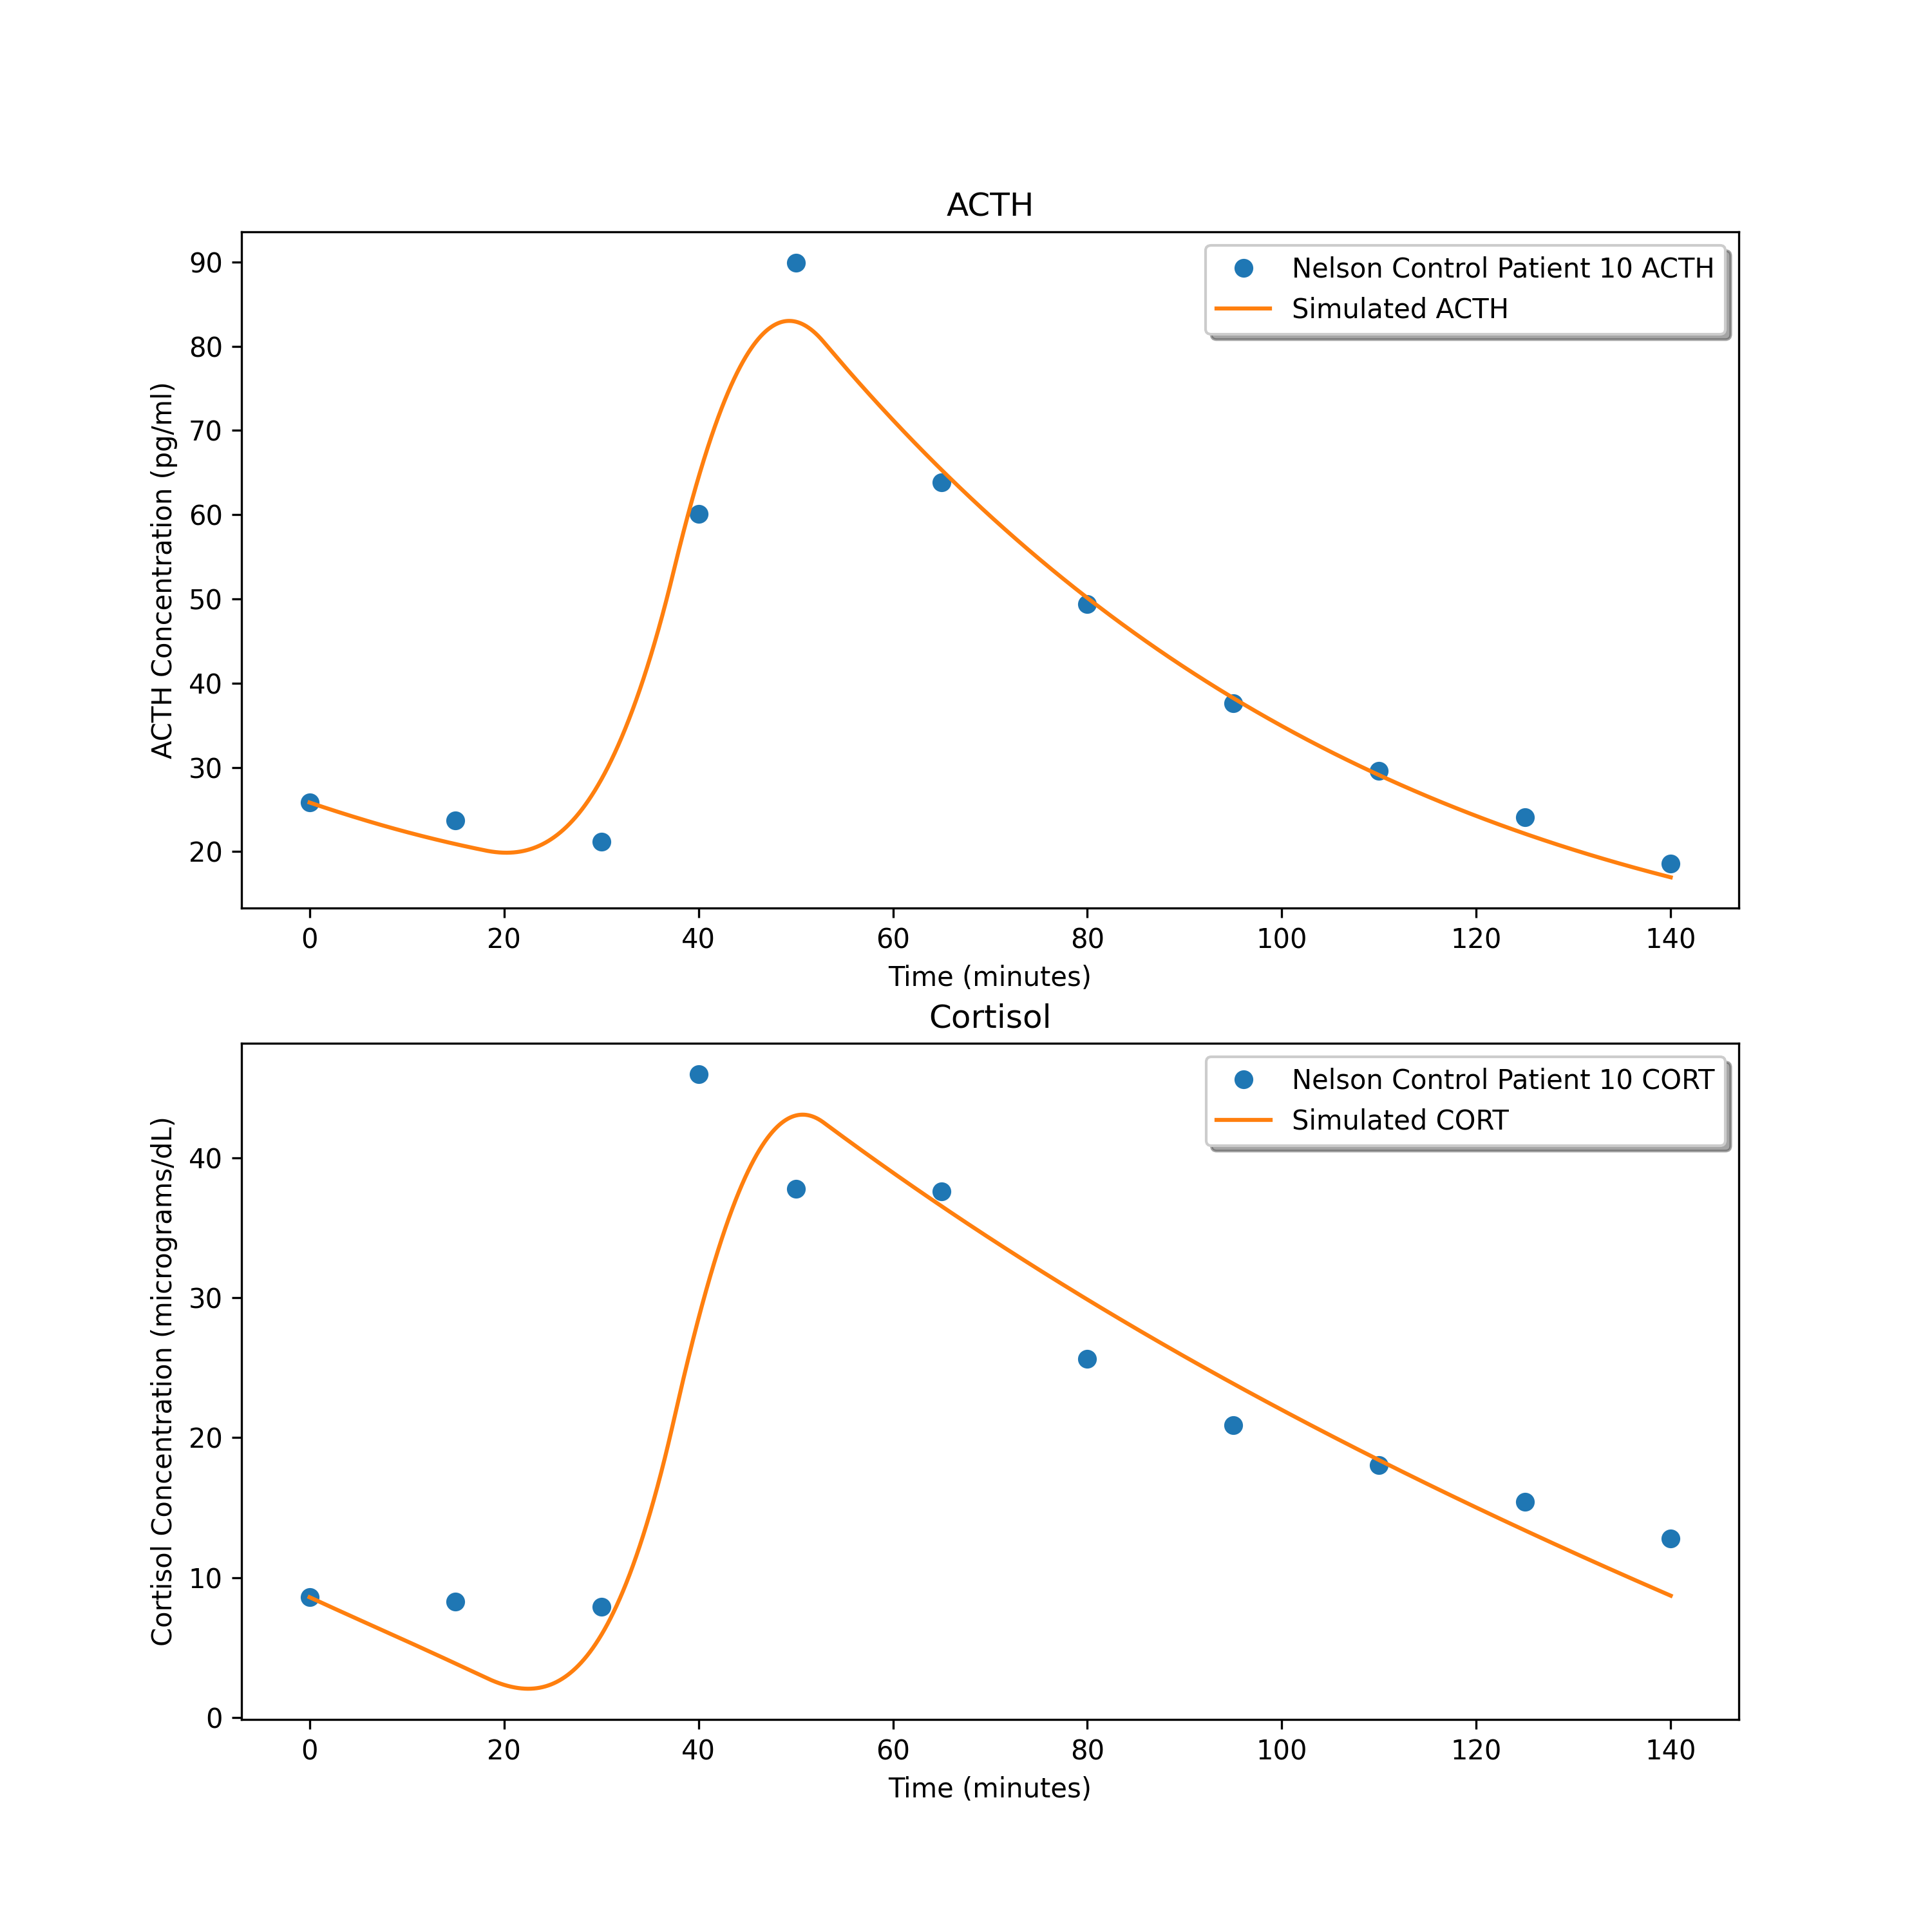
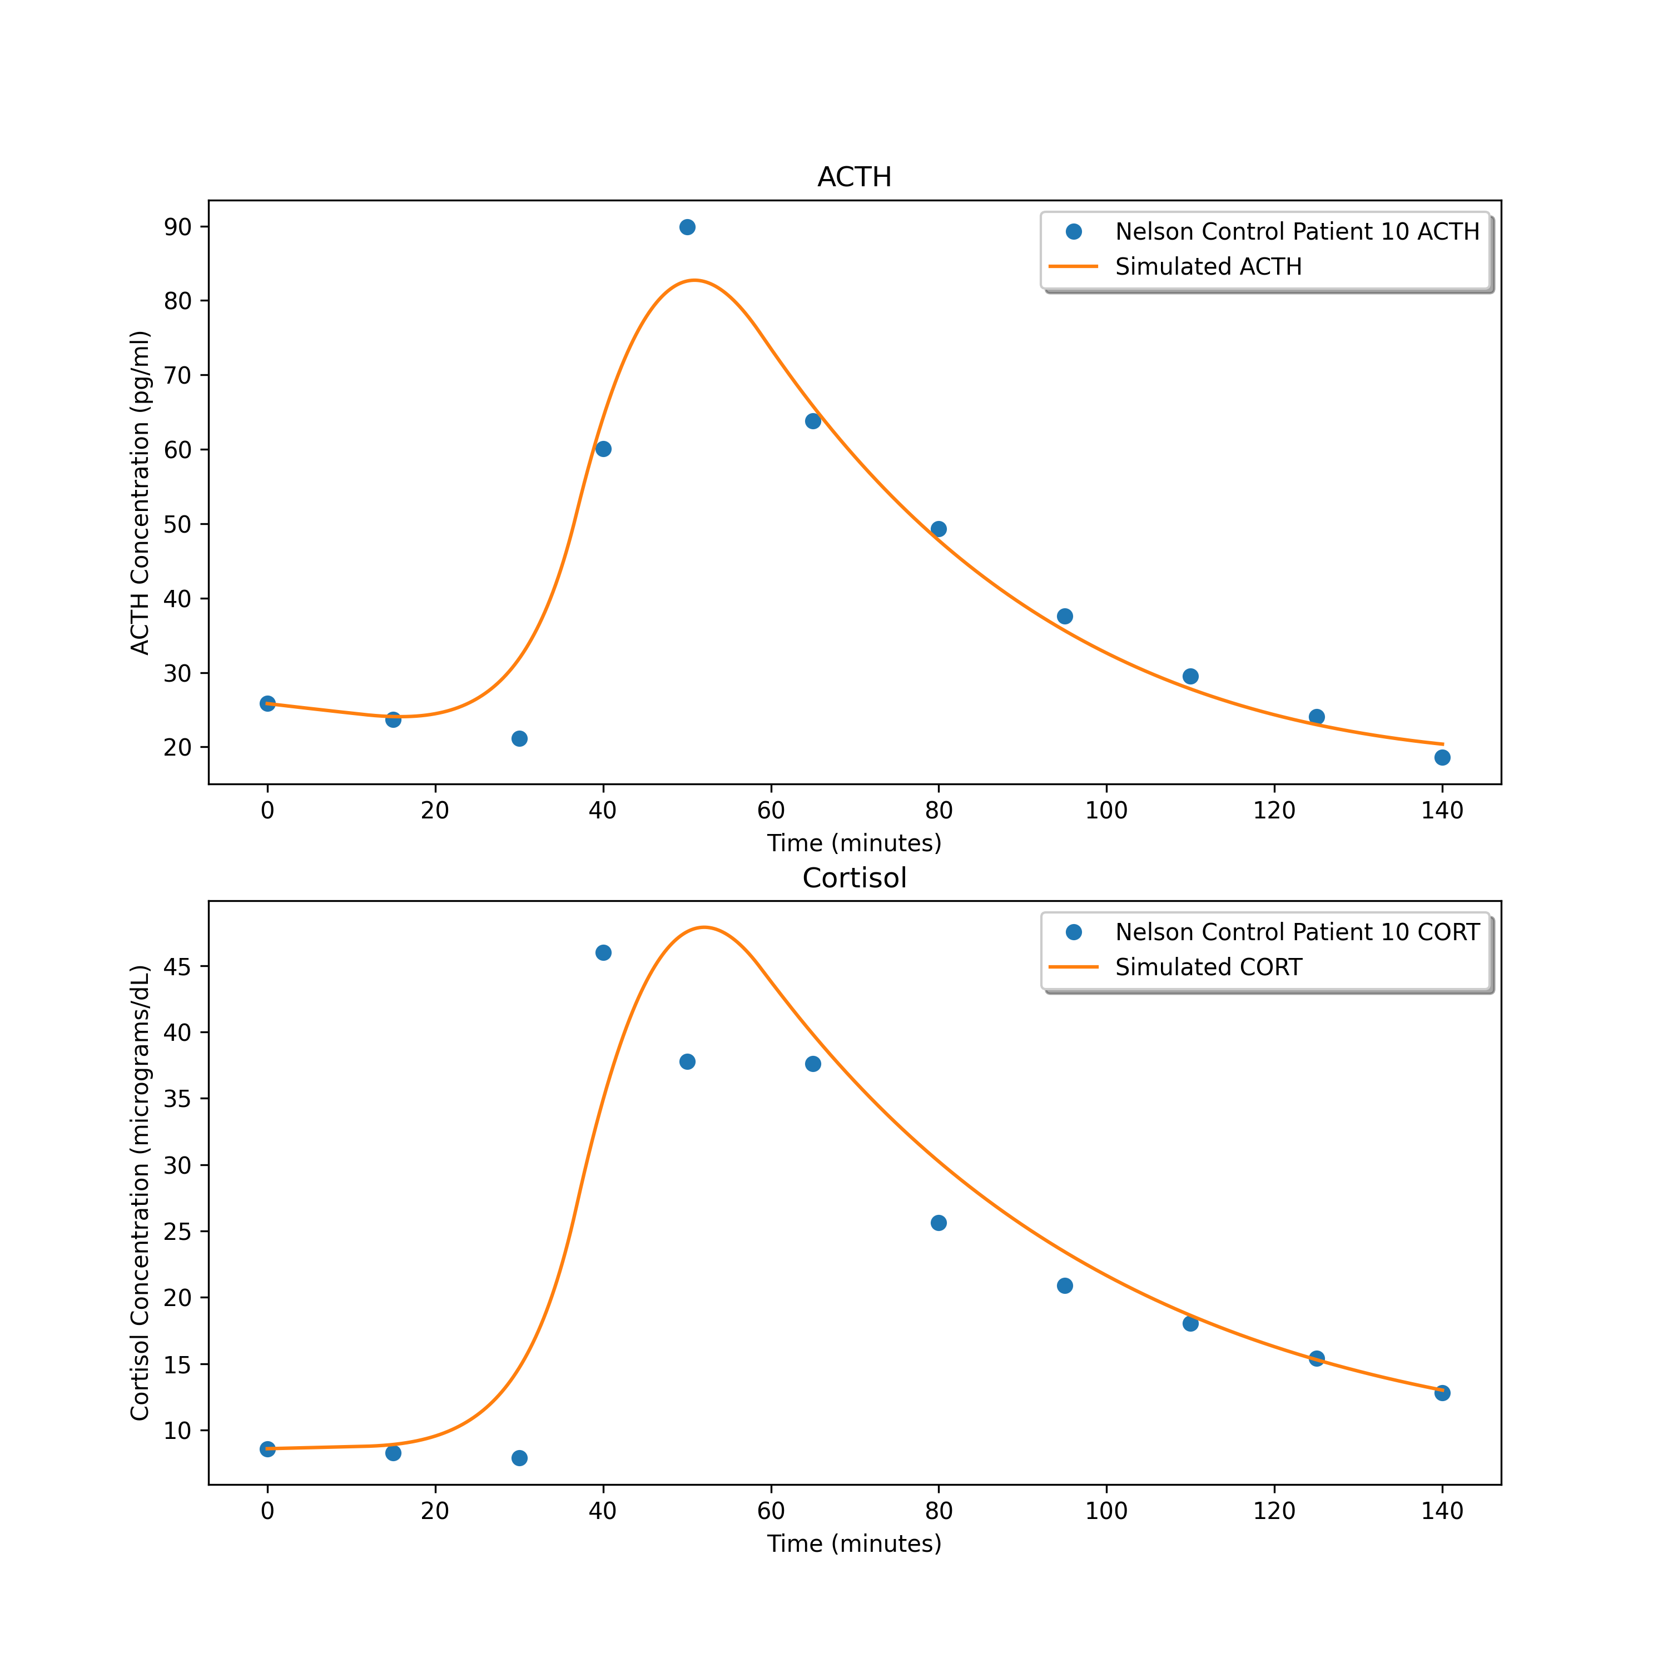
26.999611390596034
24.787202773425086
22.745494404339127

Slide 11
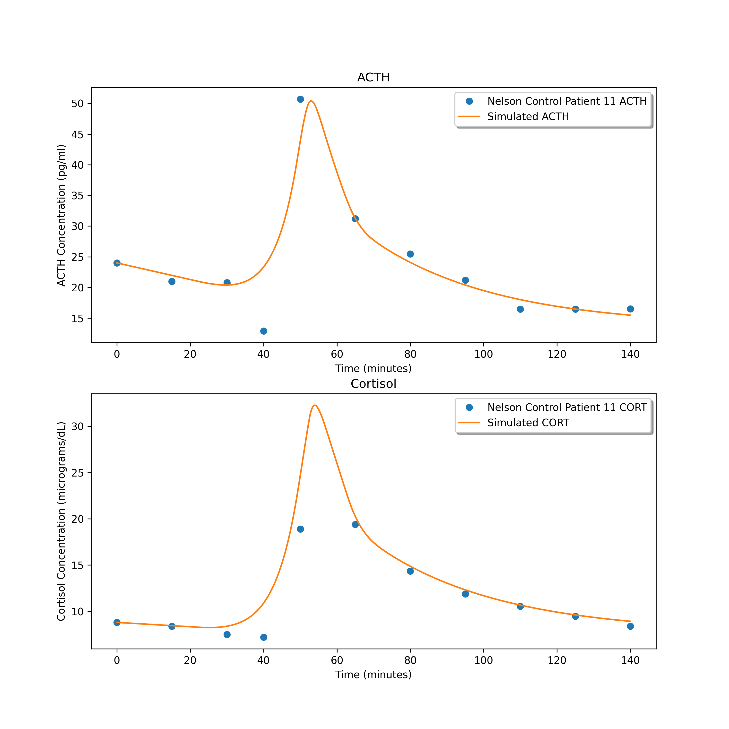
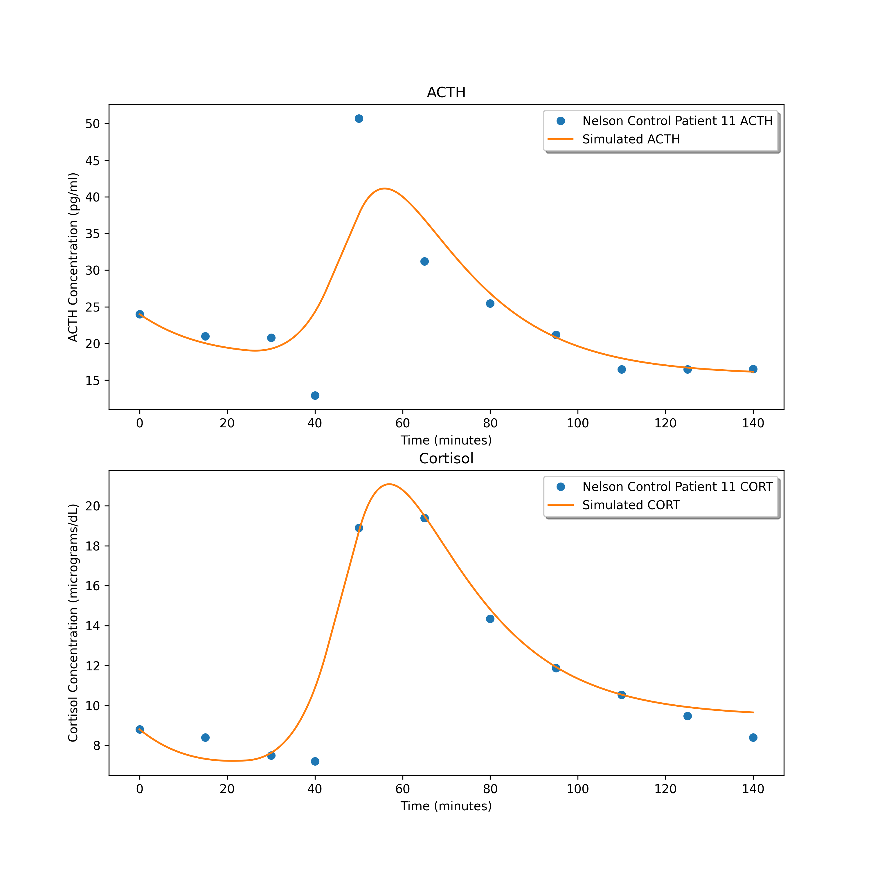
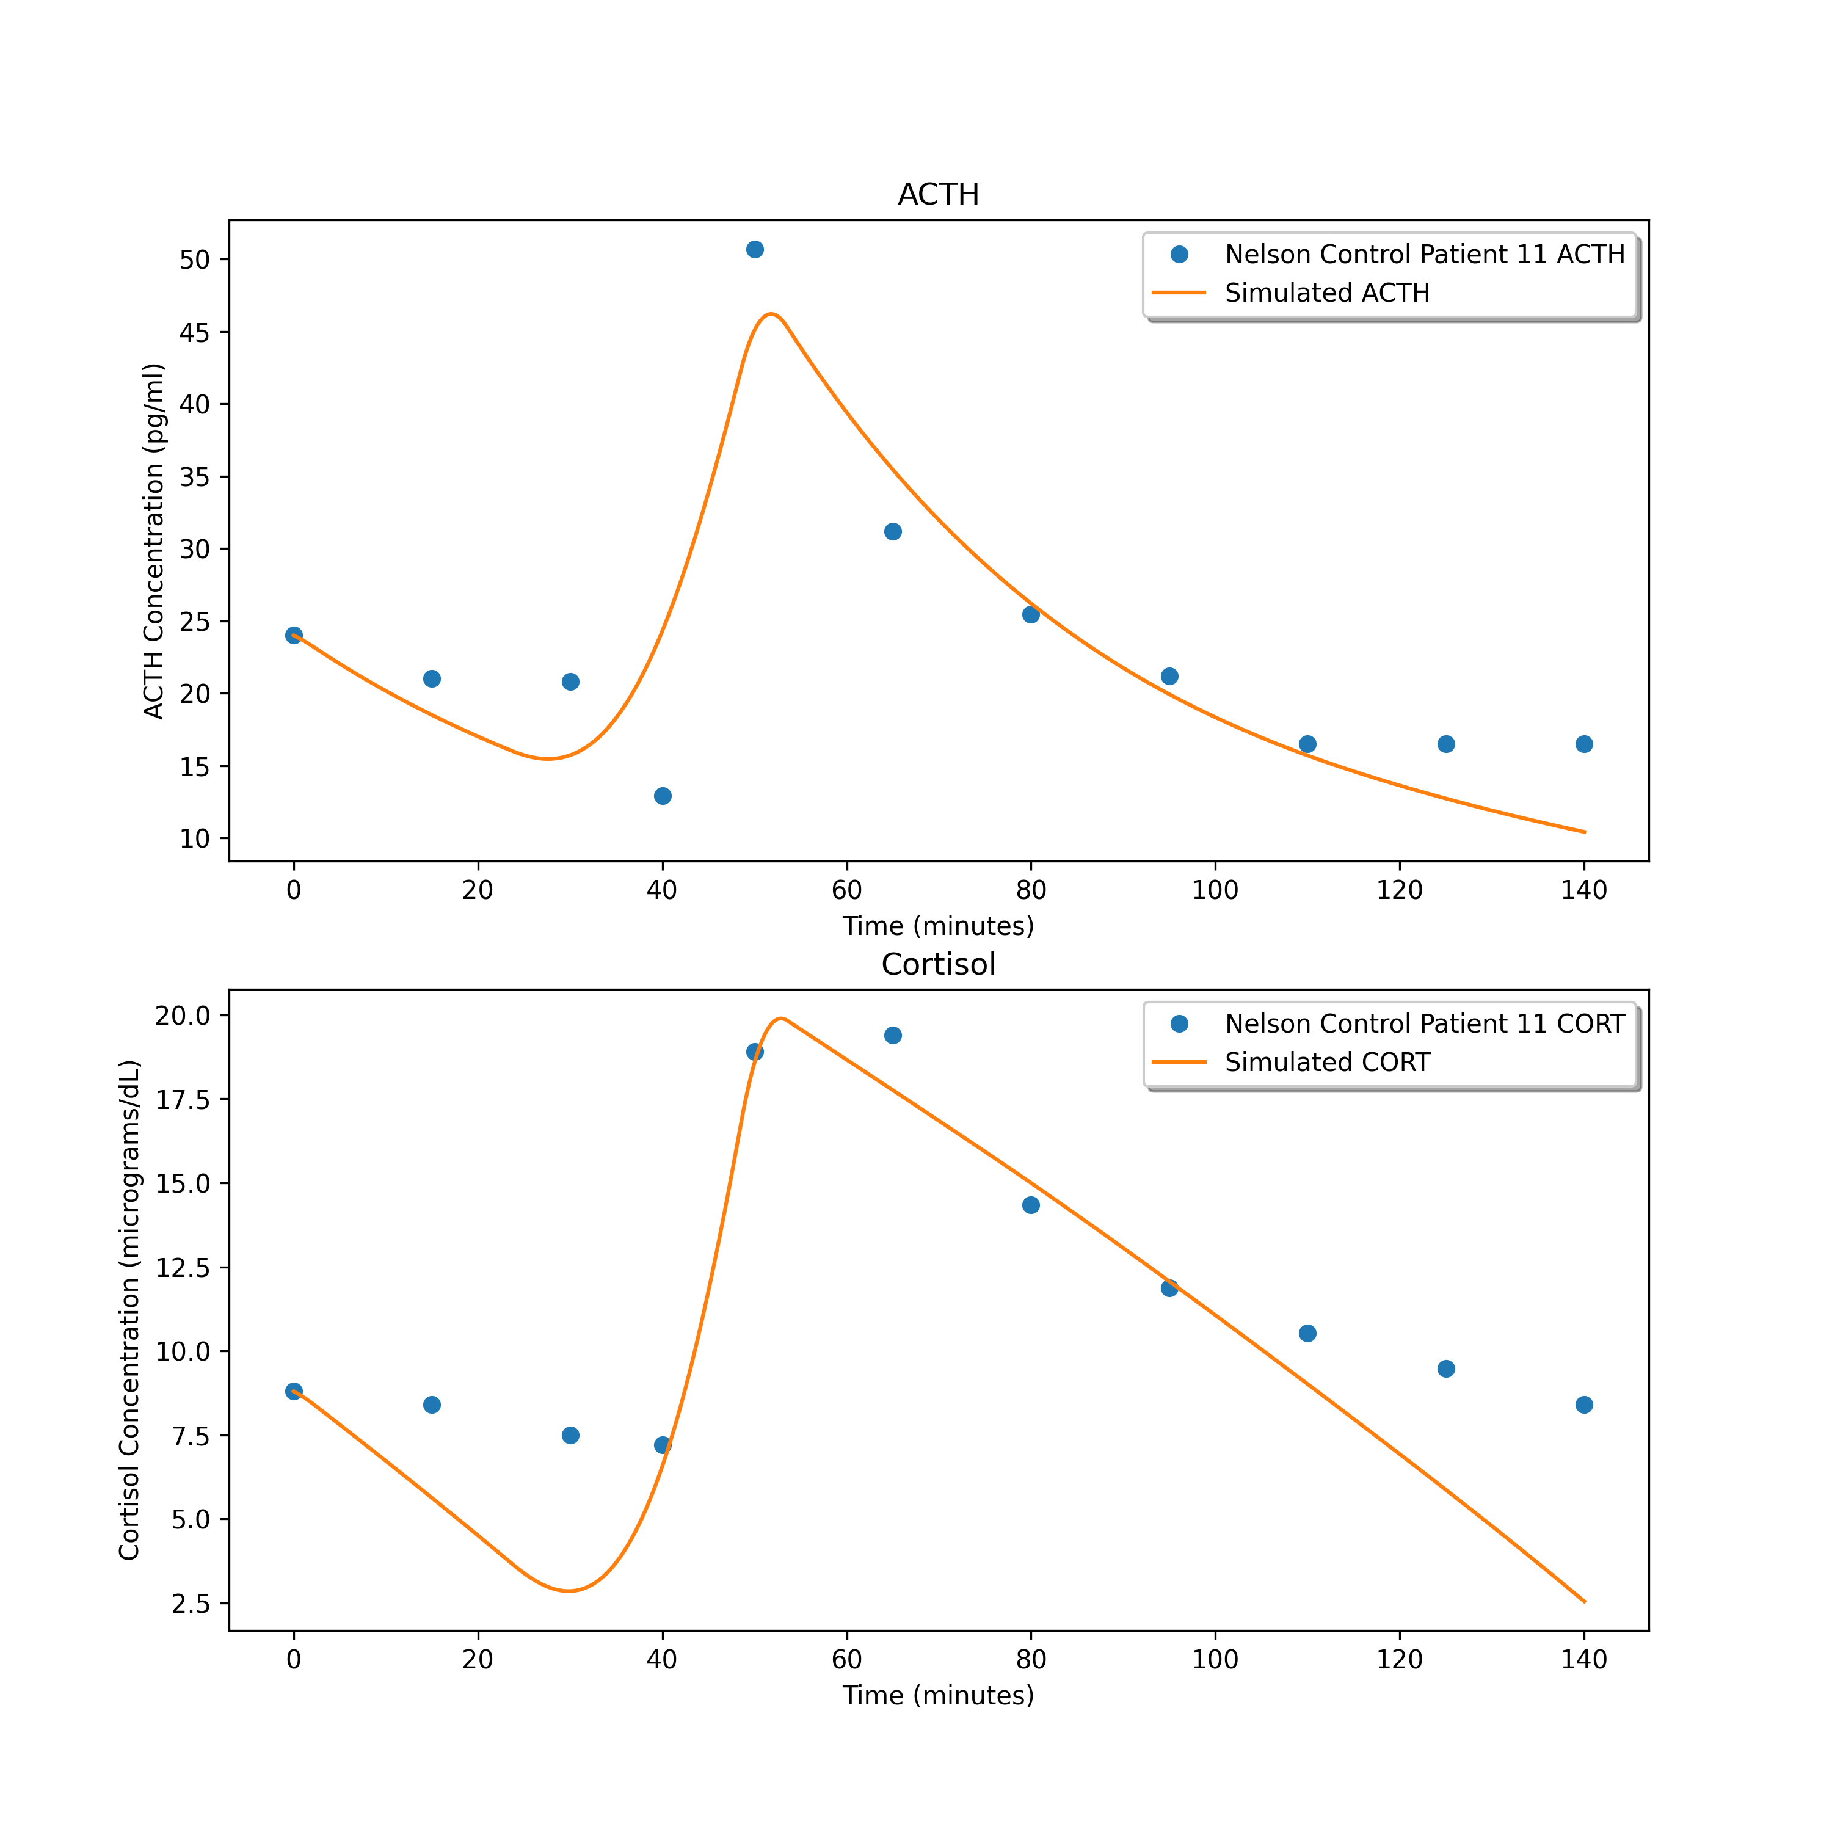
9.626425907608722
16.286714481739455
15.833324700487724

Slide 12
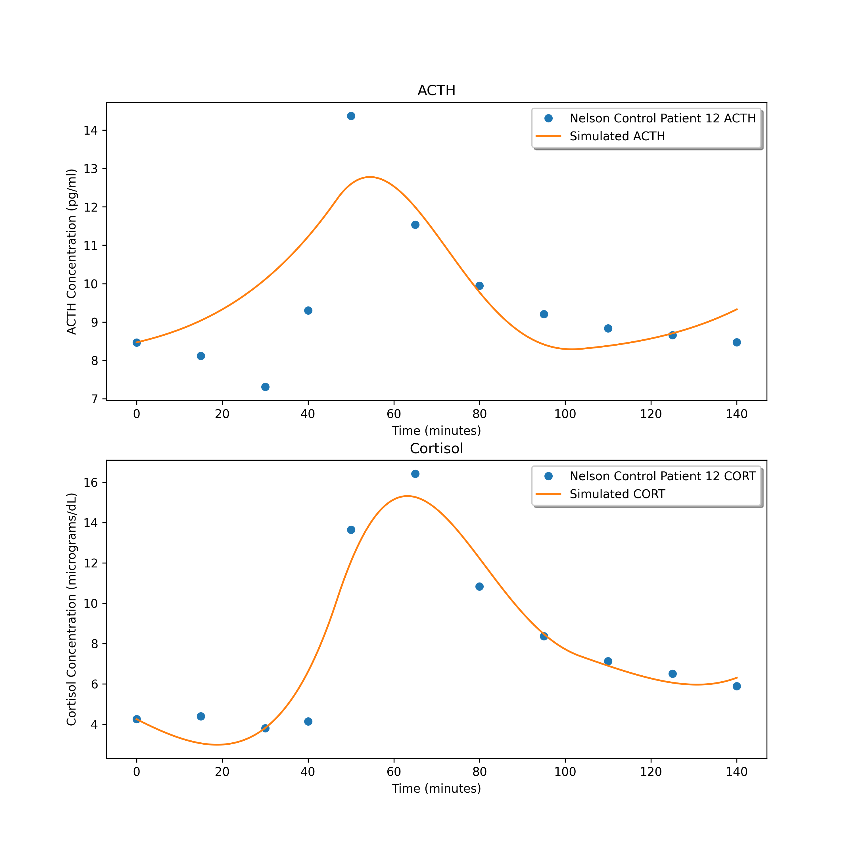
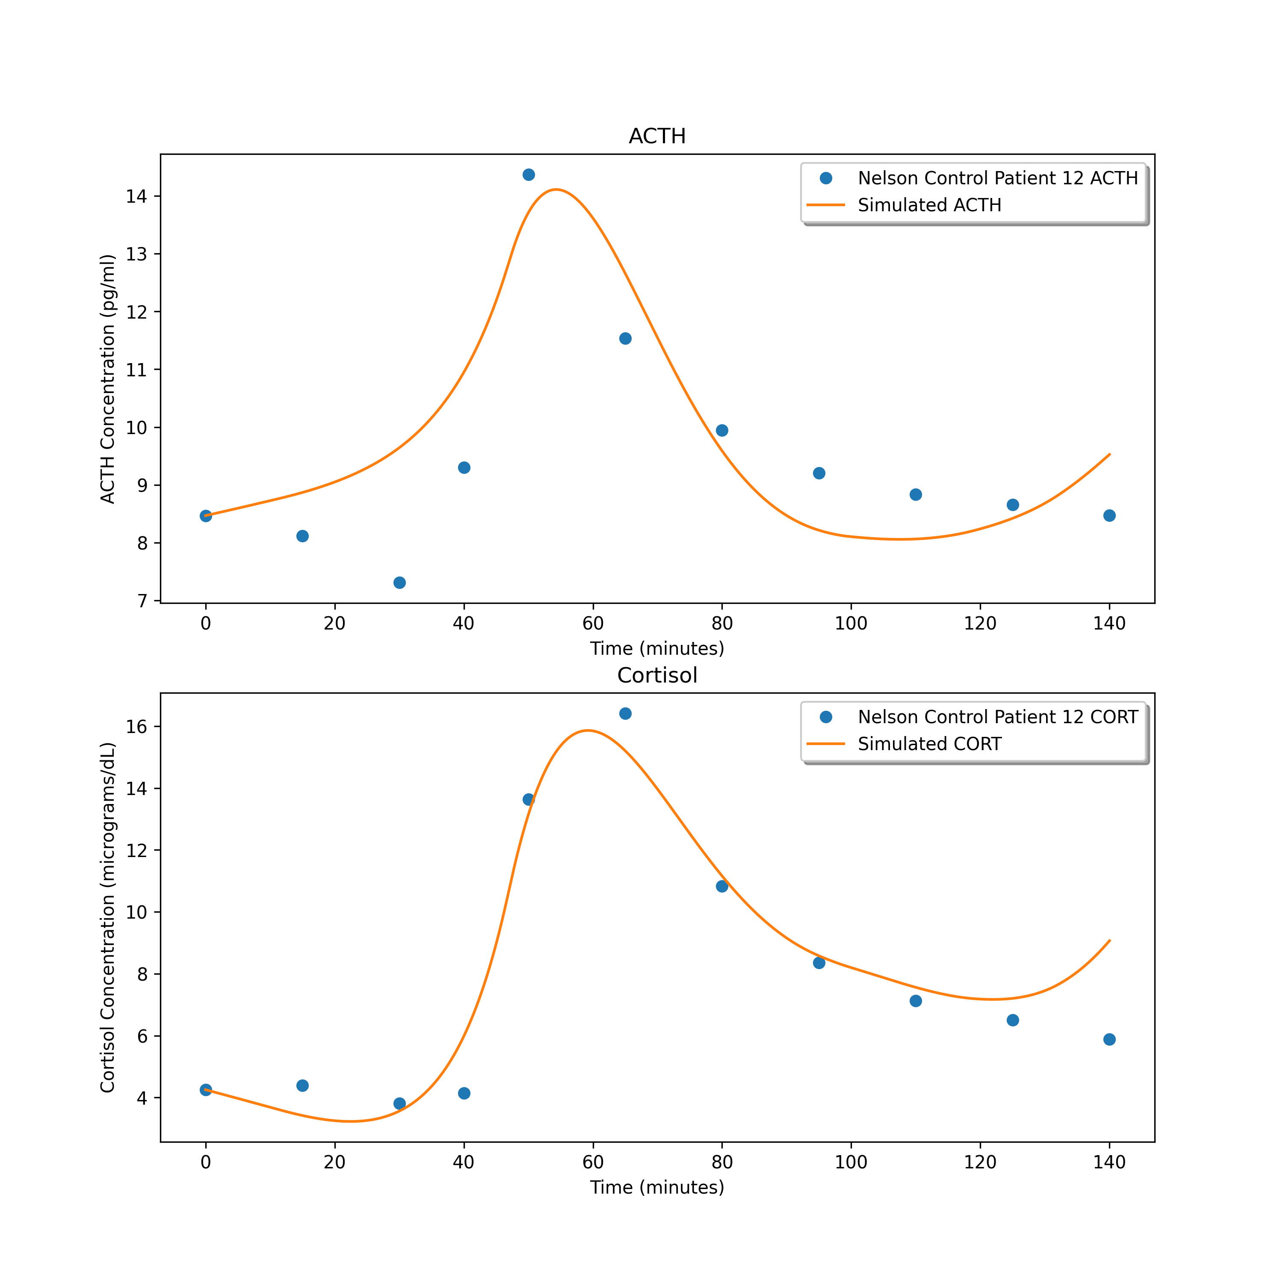
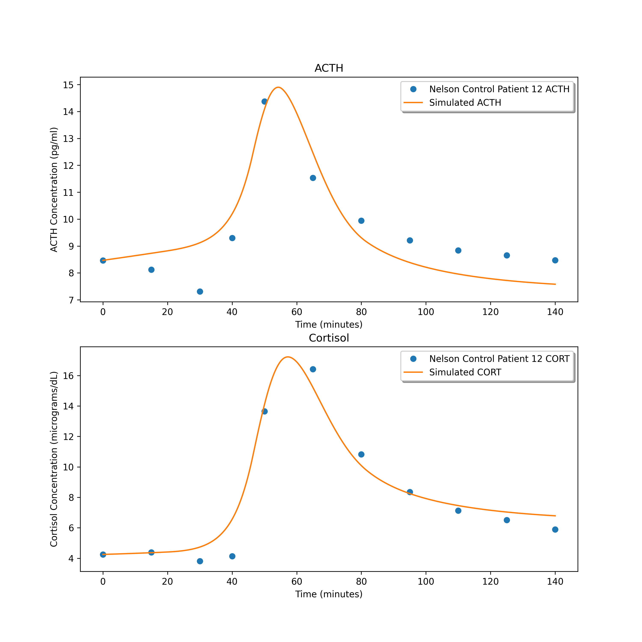
1.4316280718600387
1.3815563912066424
0.8647827672342174

Slide 13
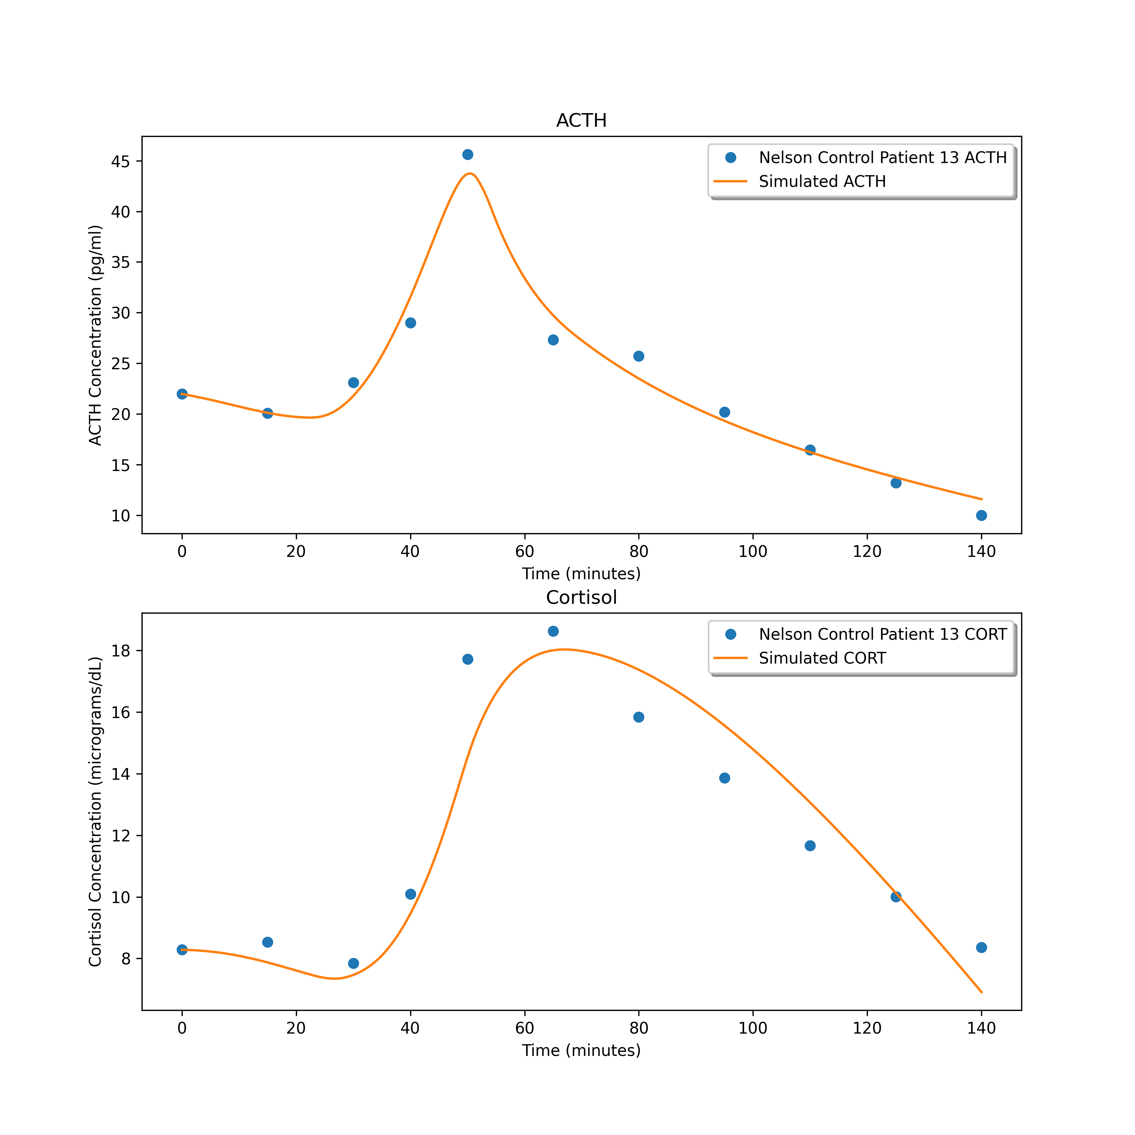
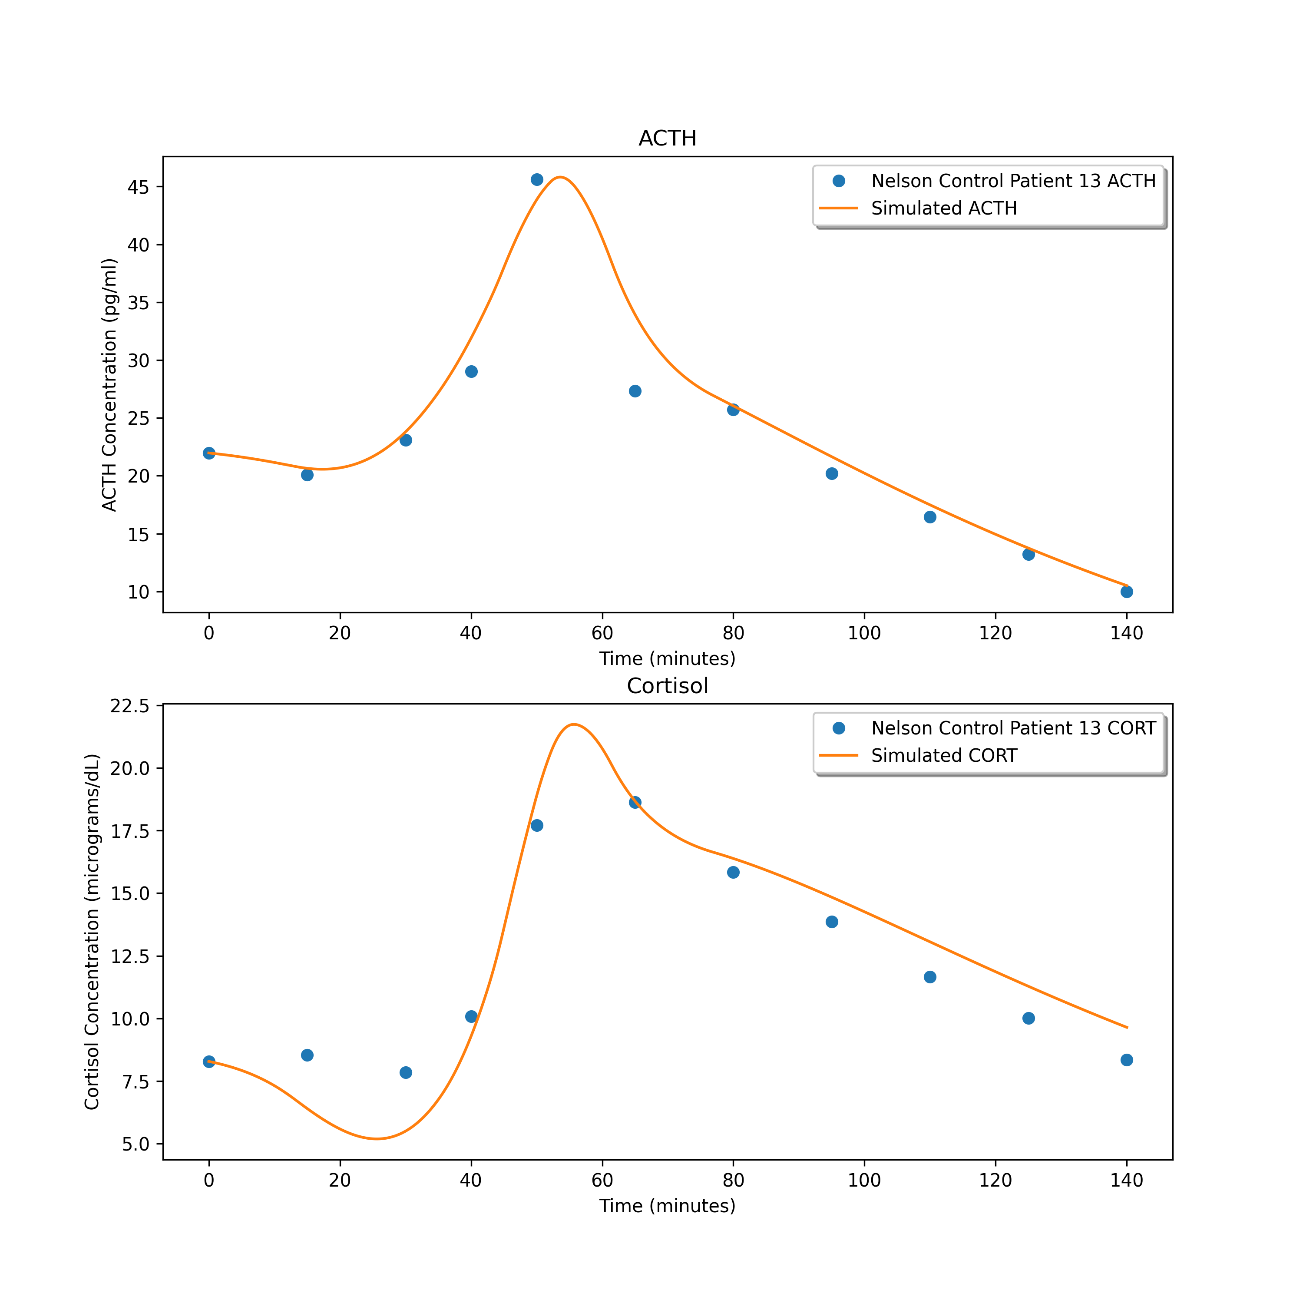
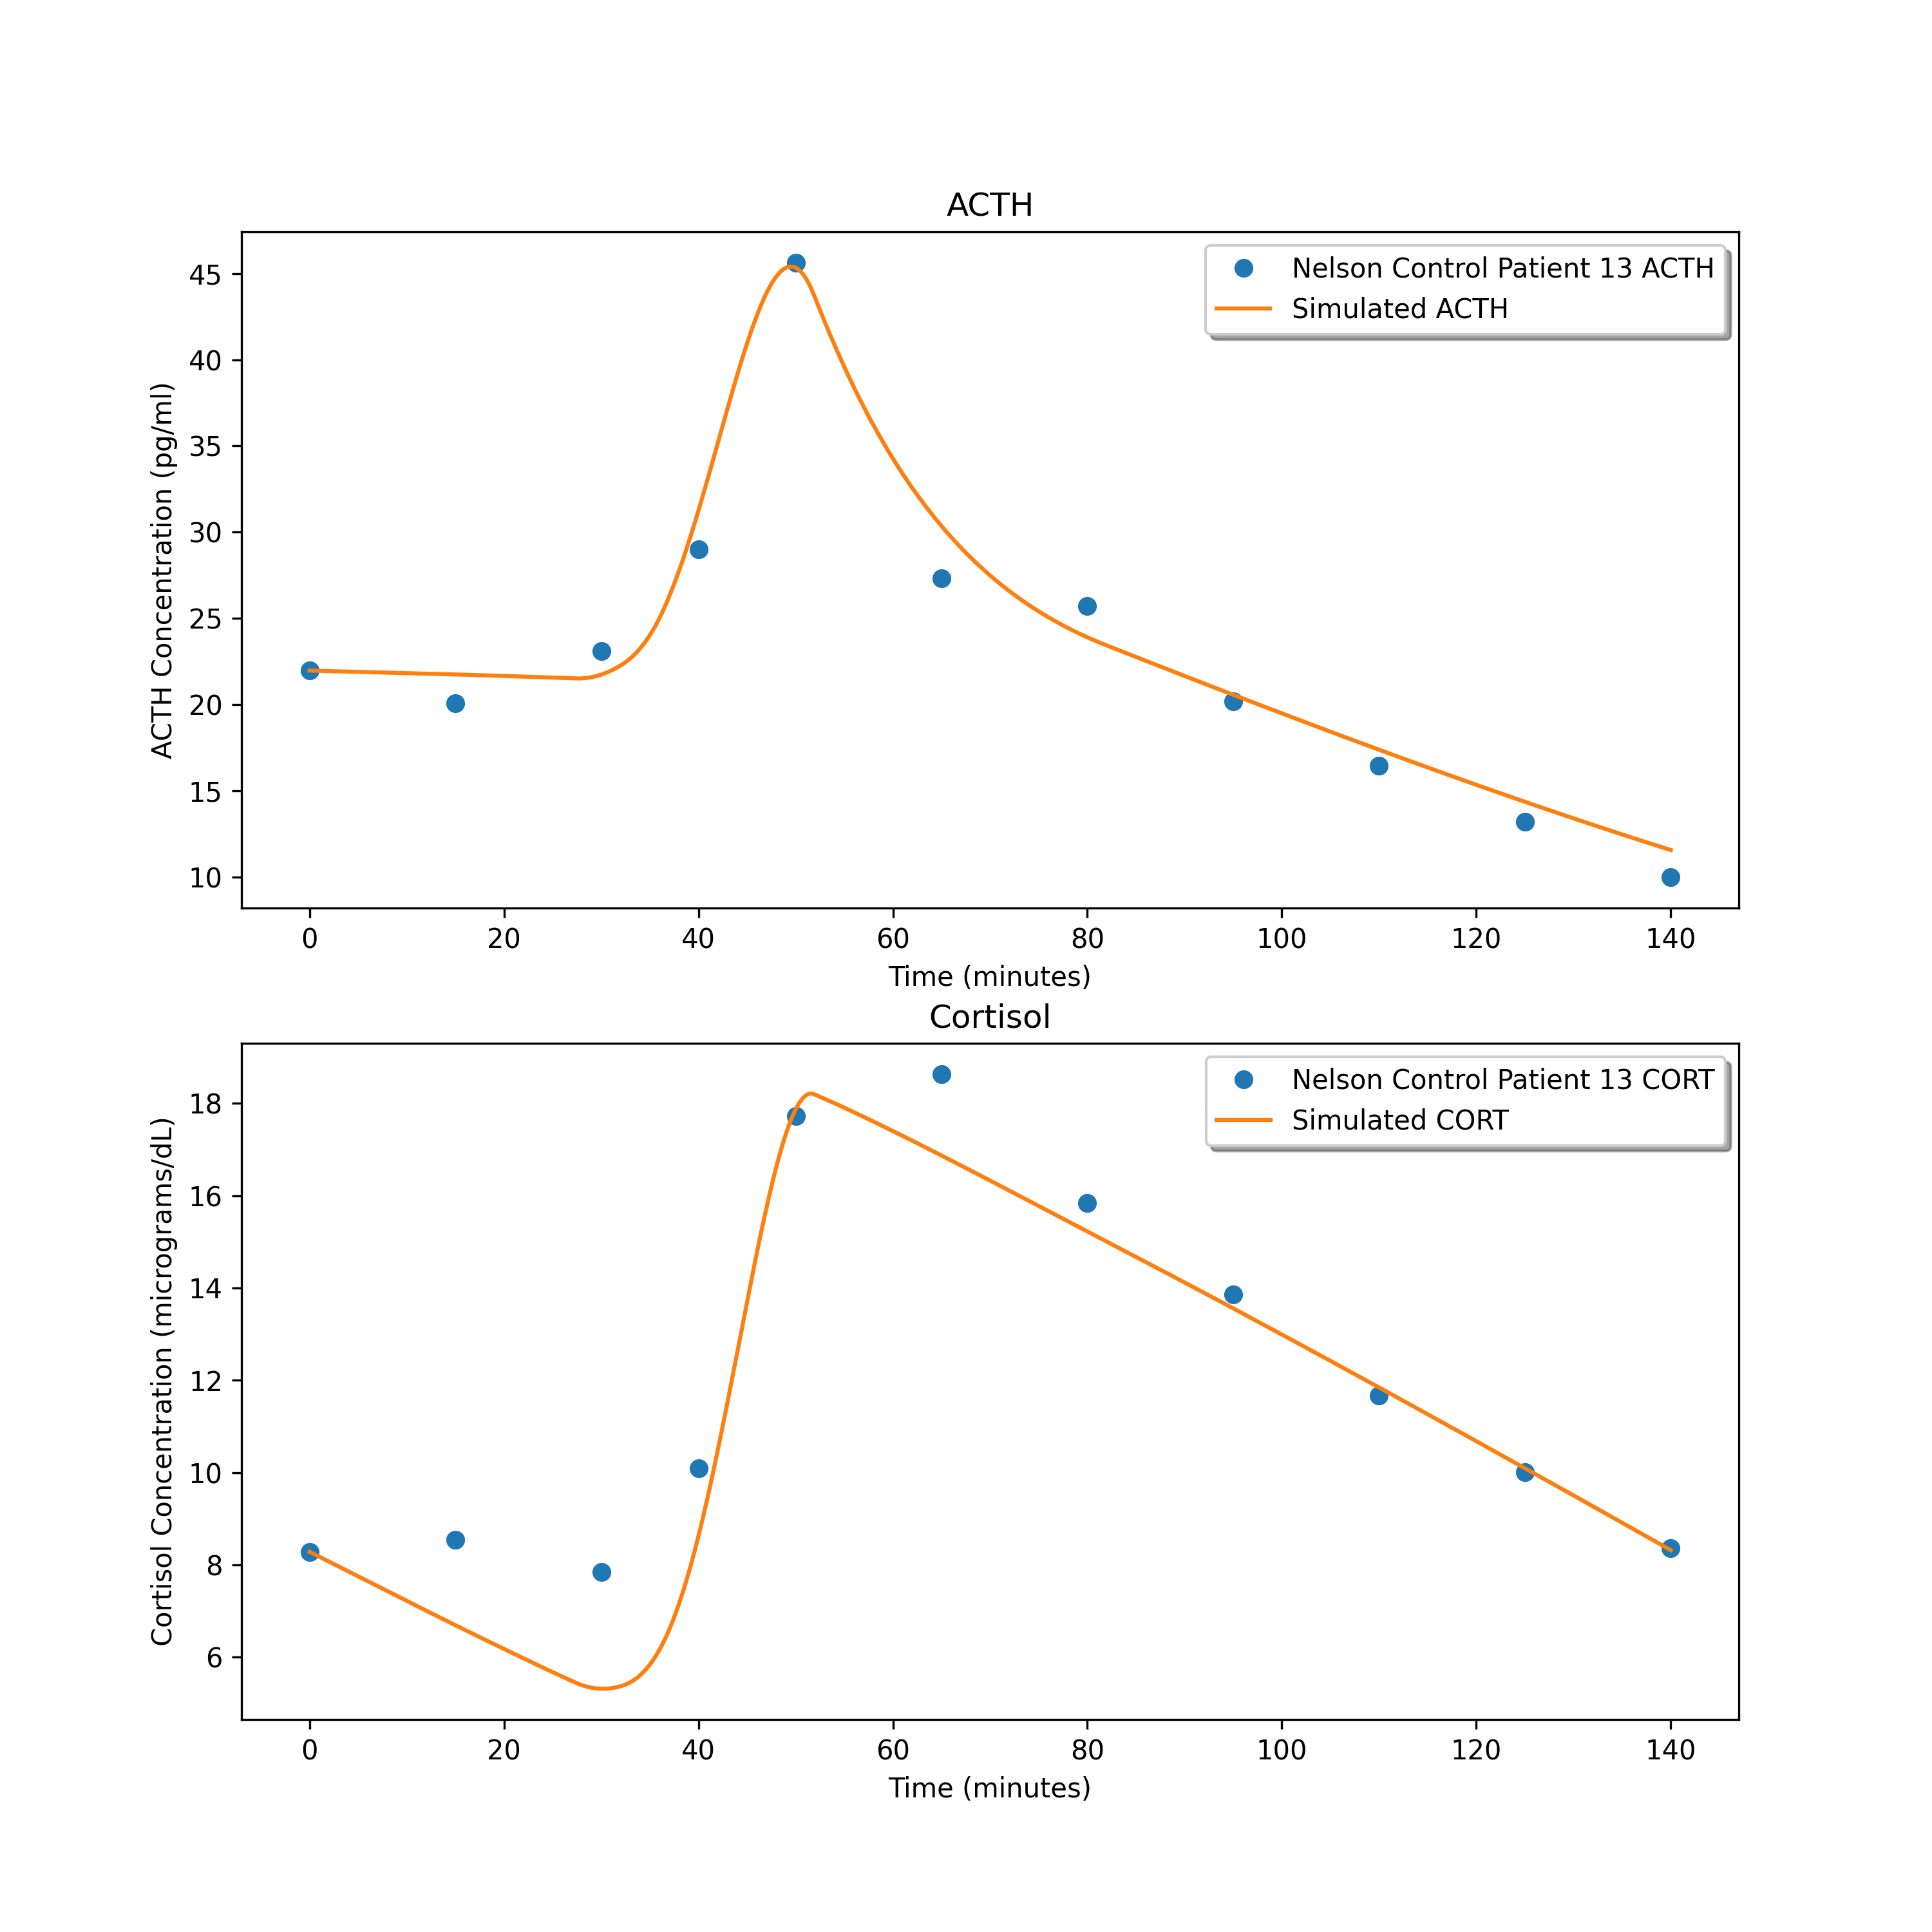
2.142321578212289
3.558779344924524
1.9286573850317146

Slide 14
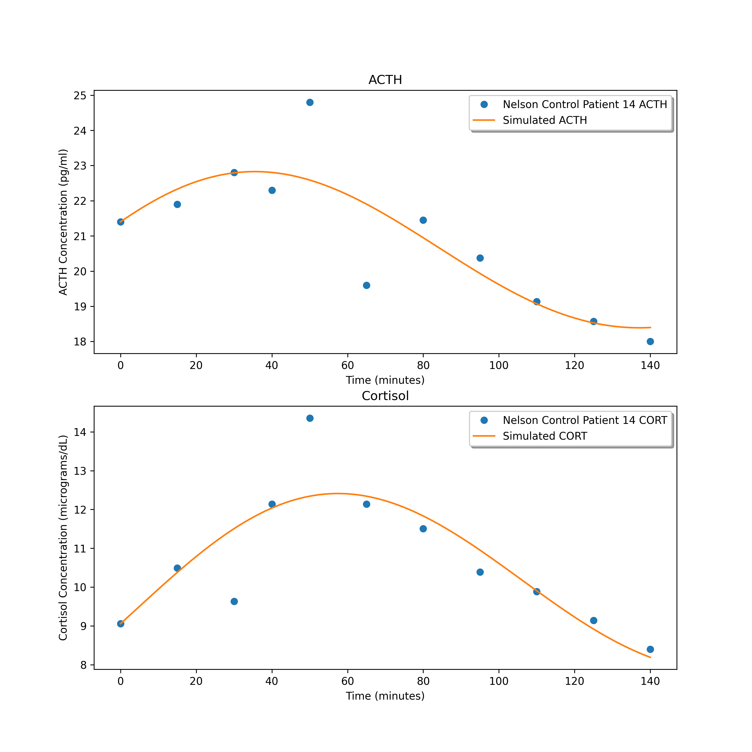
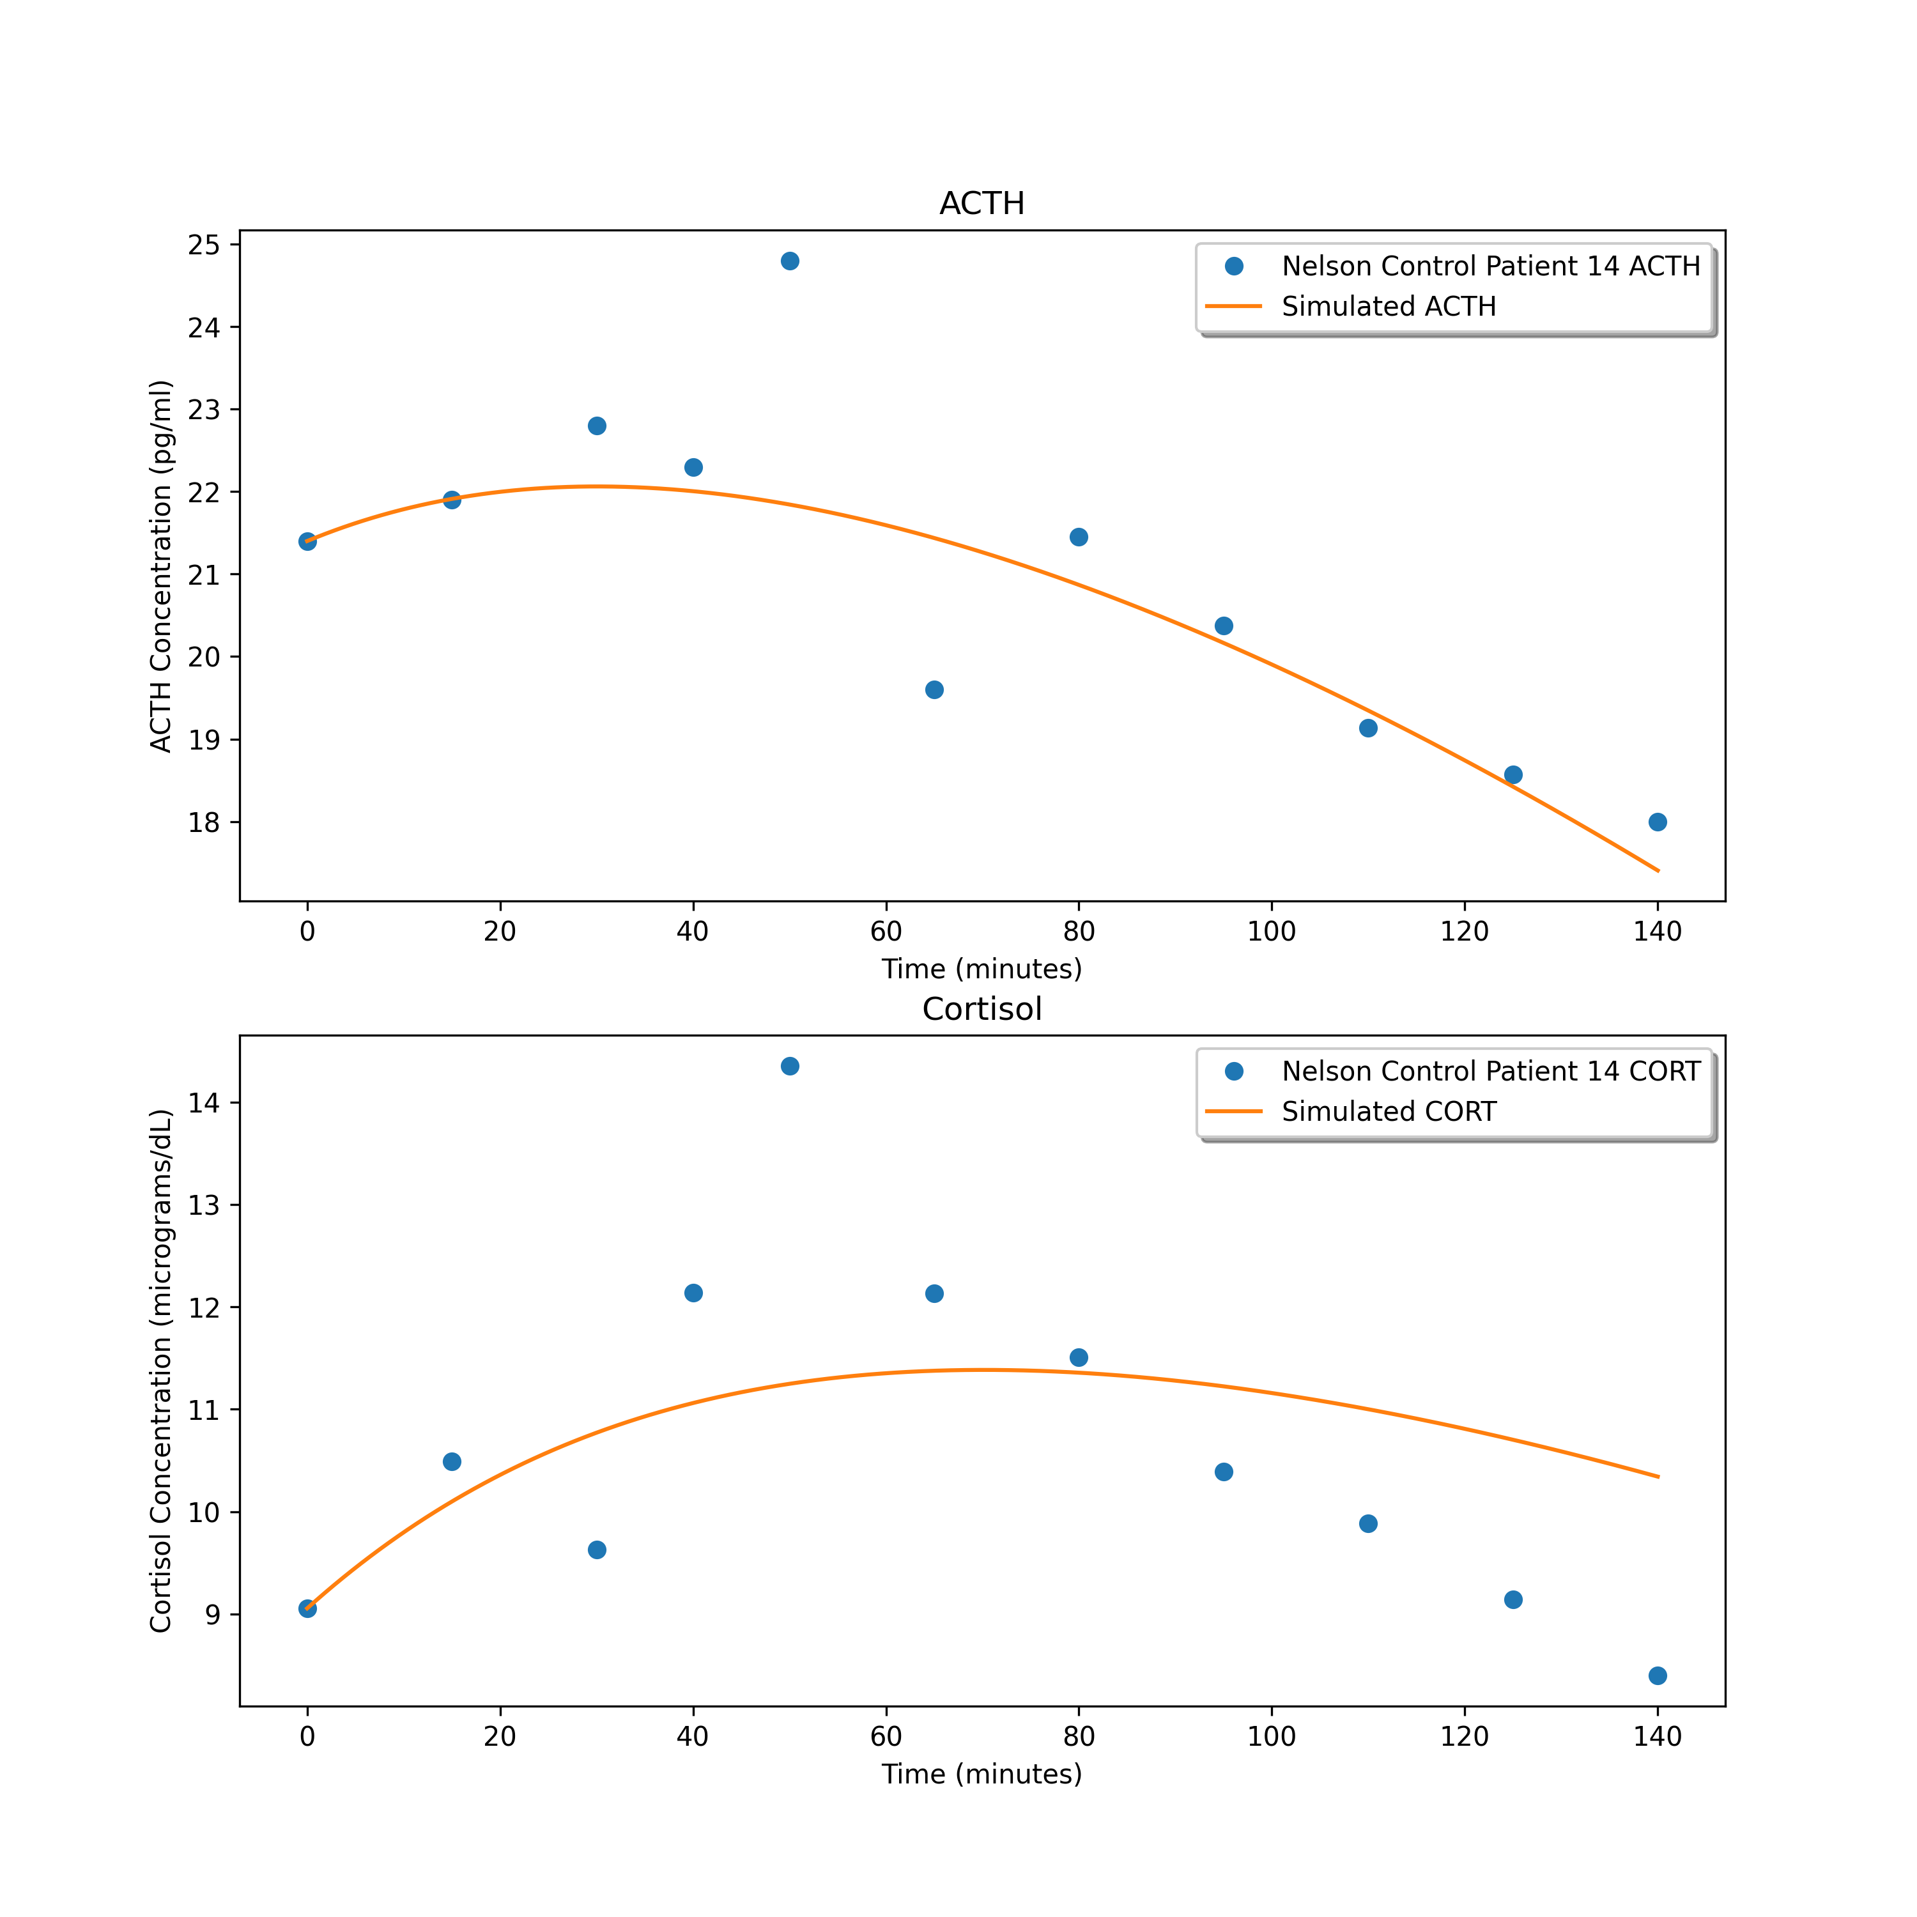
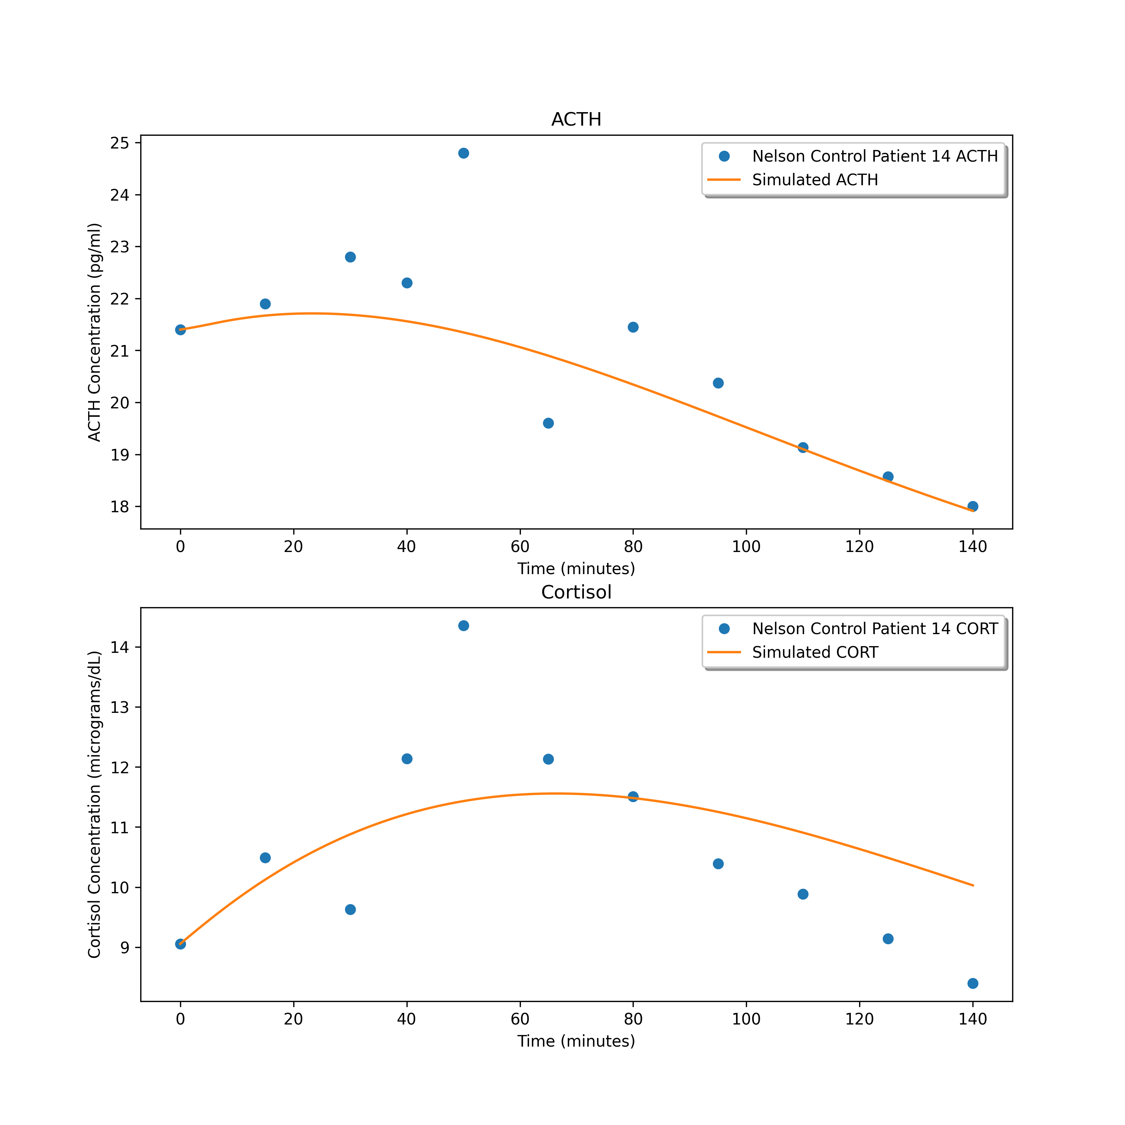
0.8818495379327367
1.57135709184995
1.5815111565728275

Slide 15
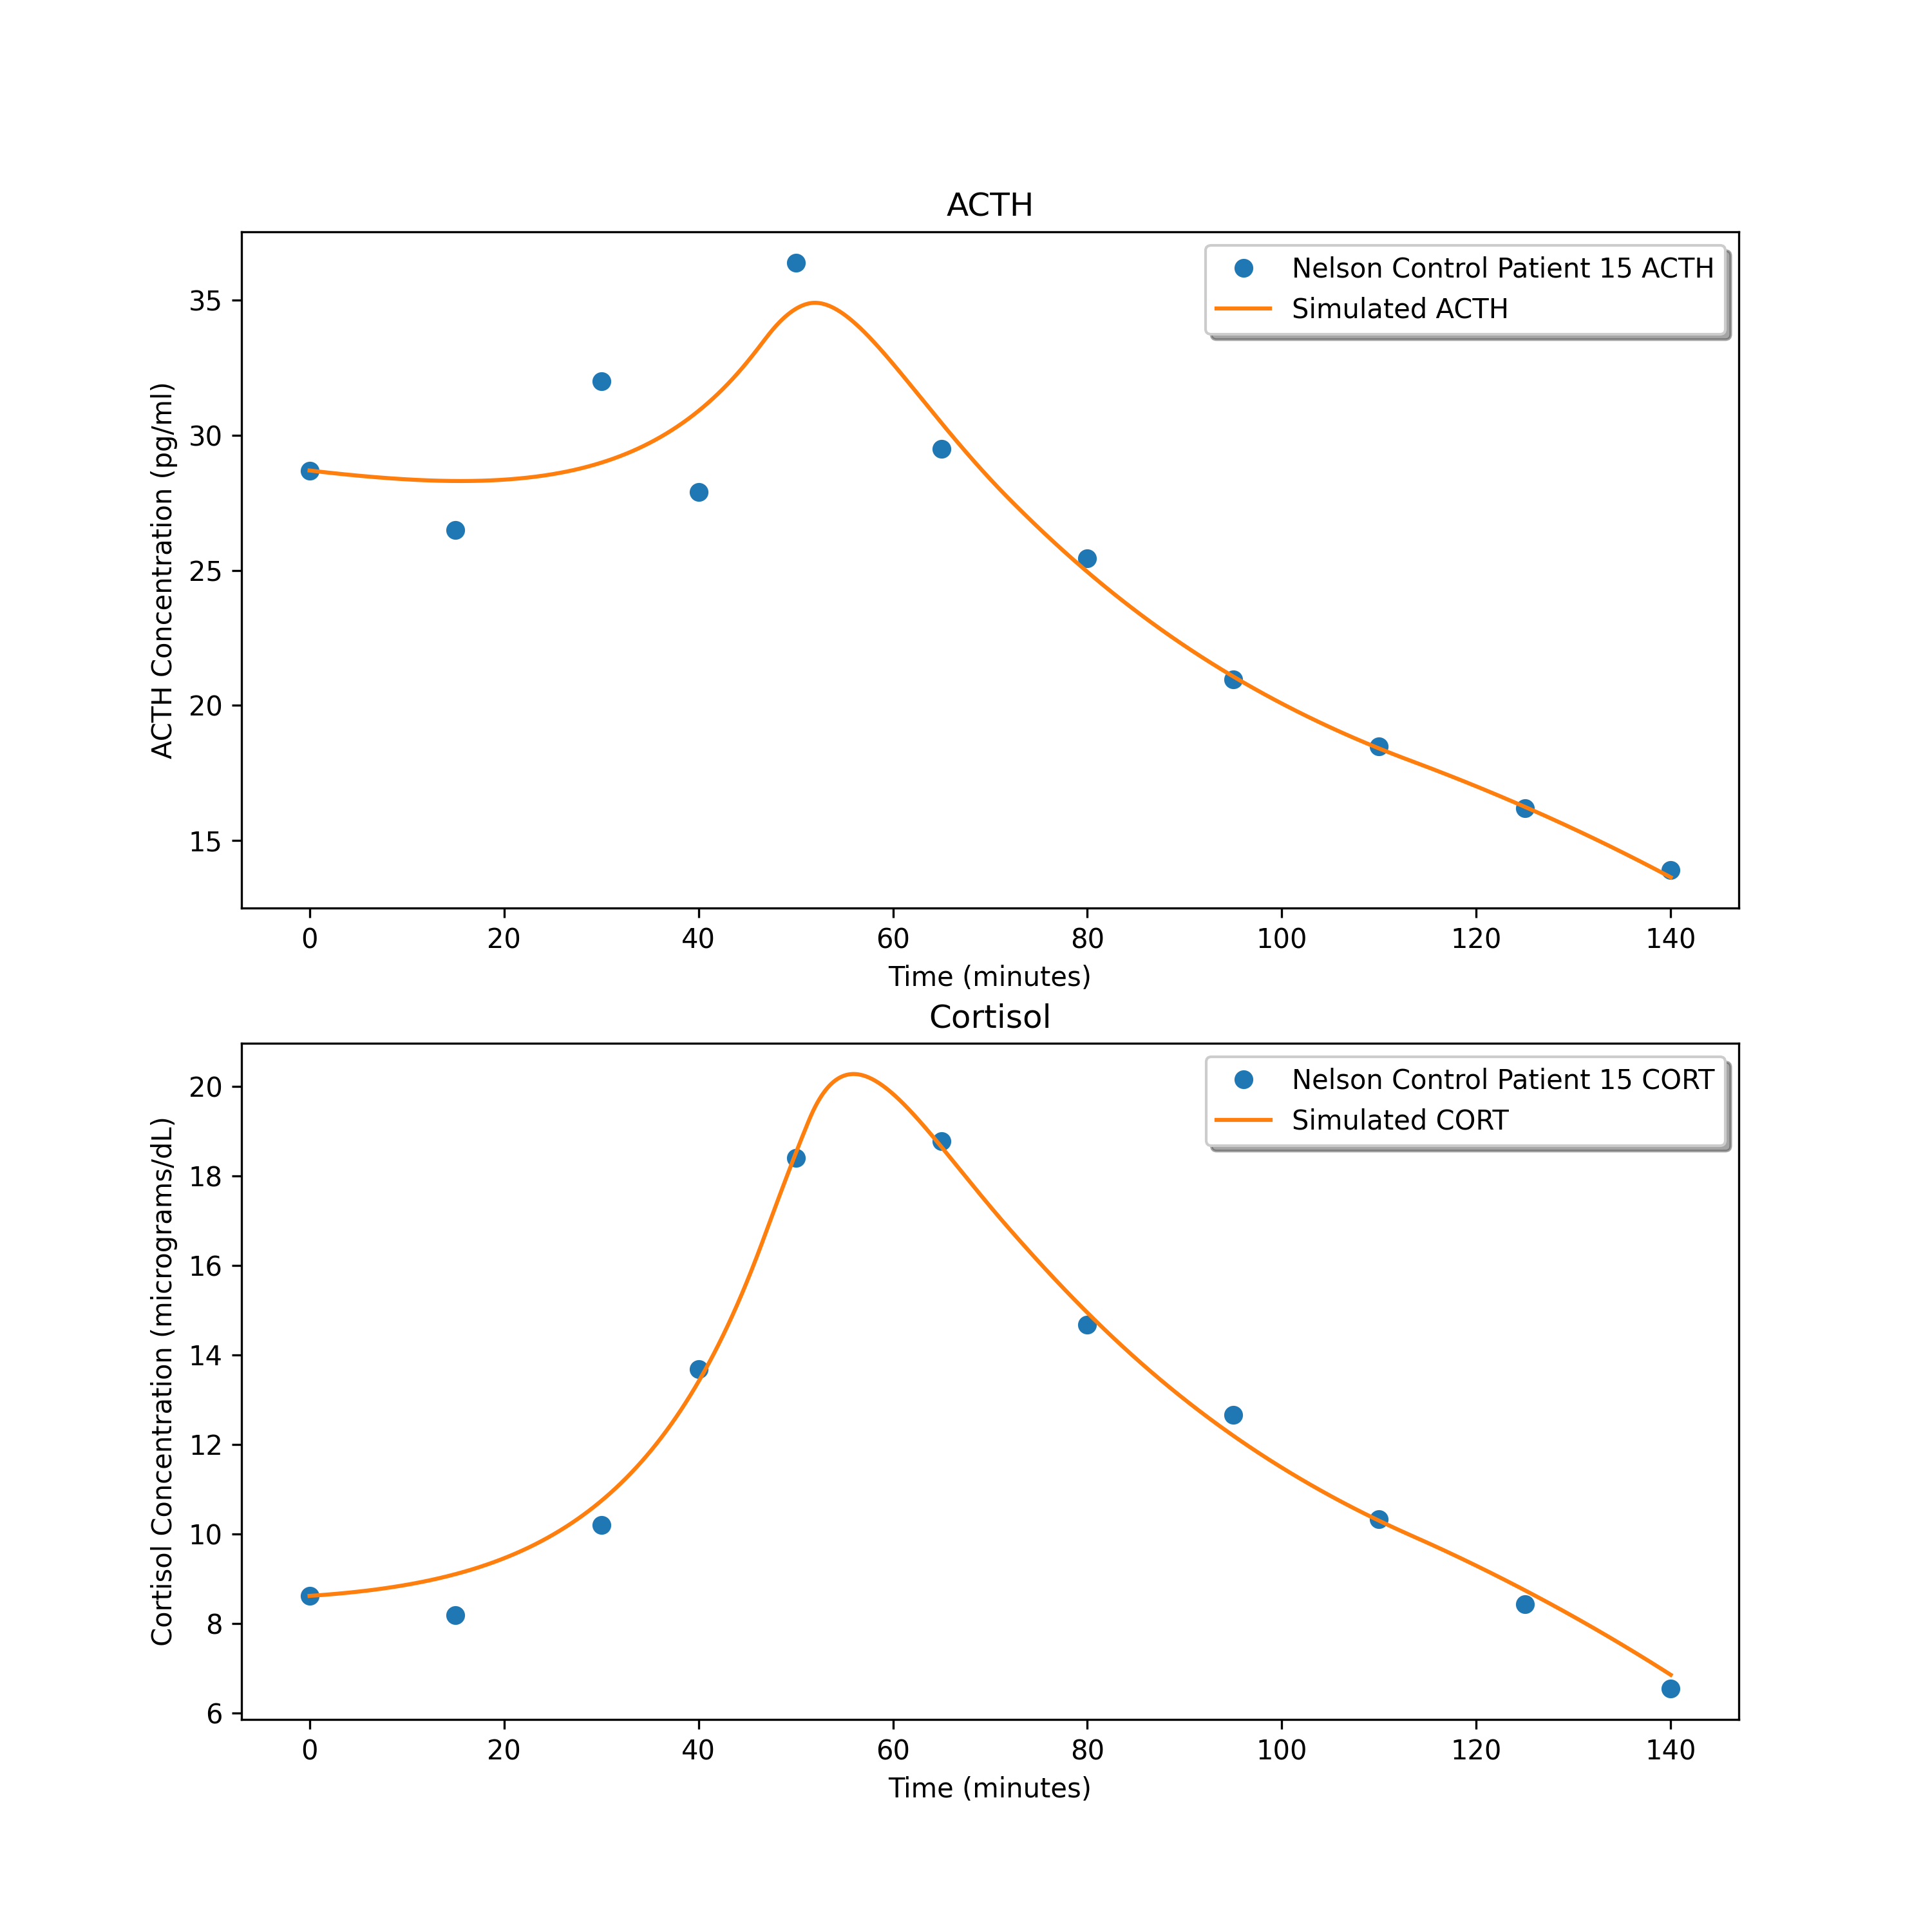
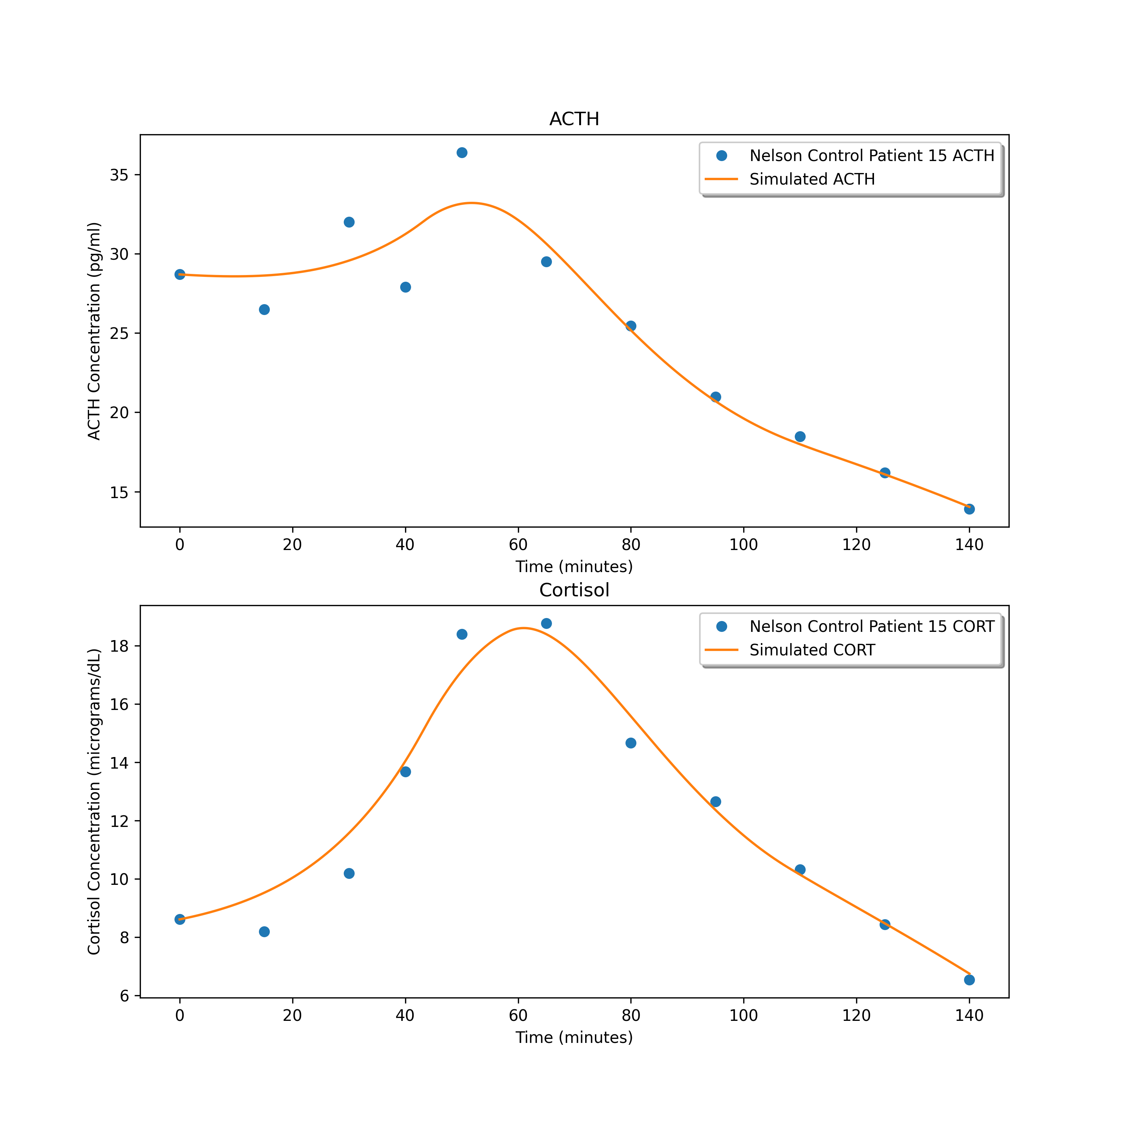

1.240213799762701
1.8361064855294529
1.8561511957487908

Slide 16
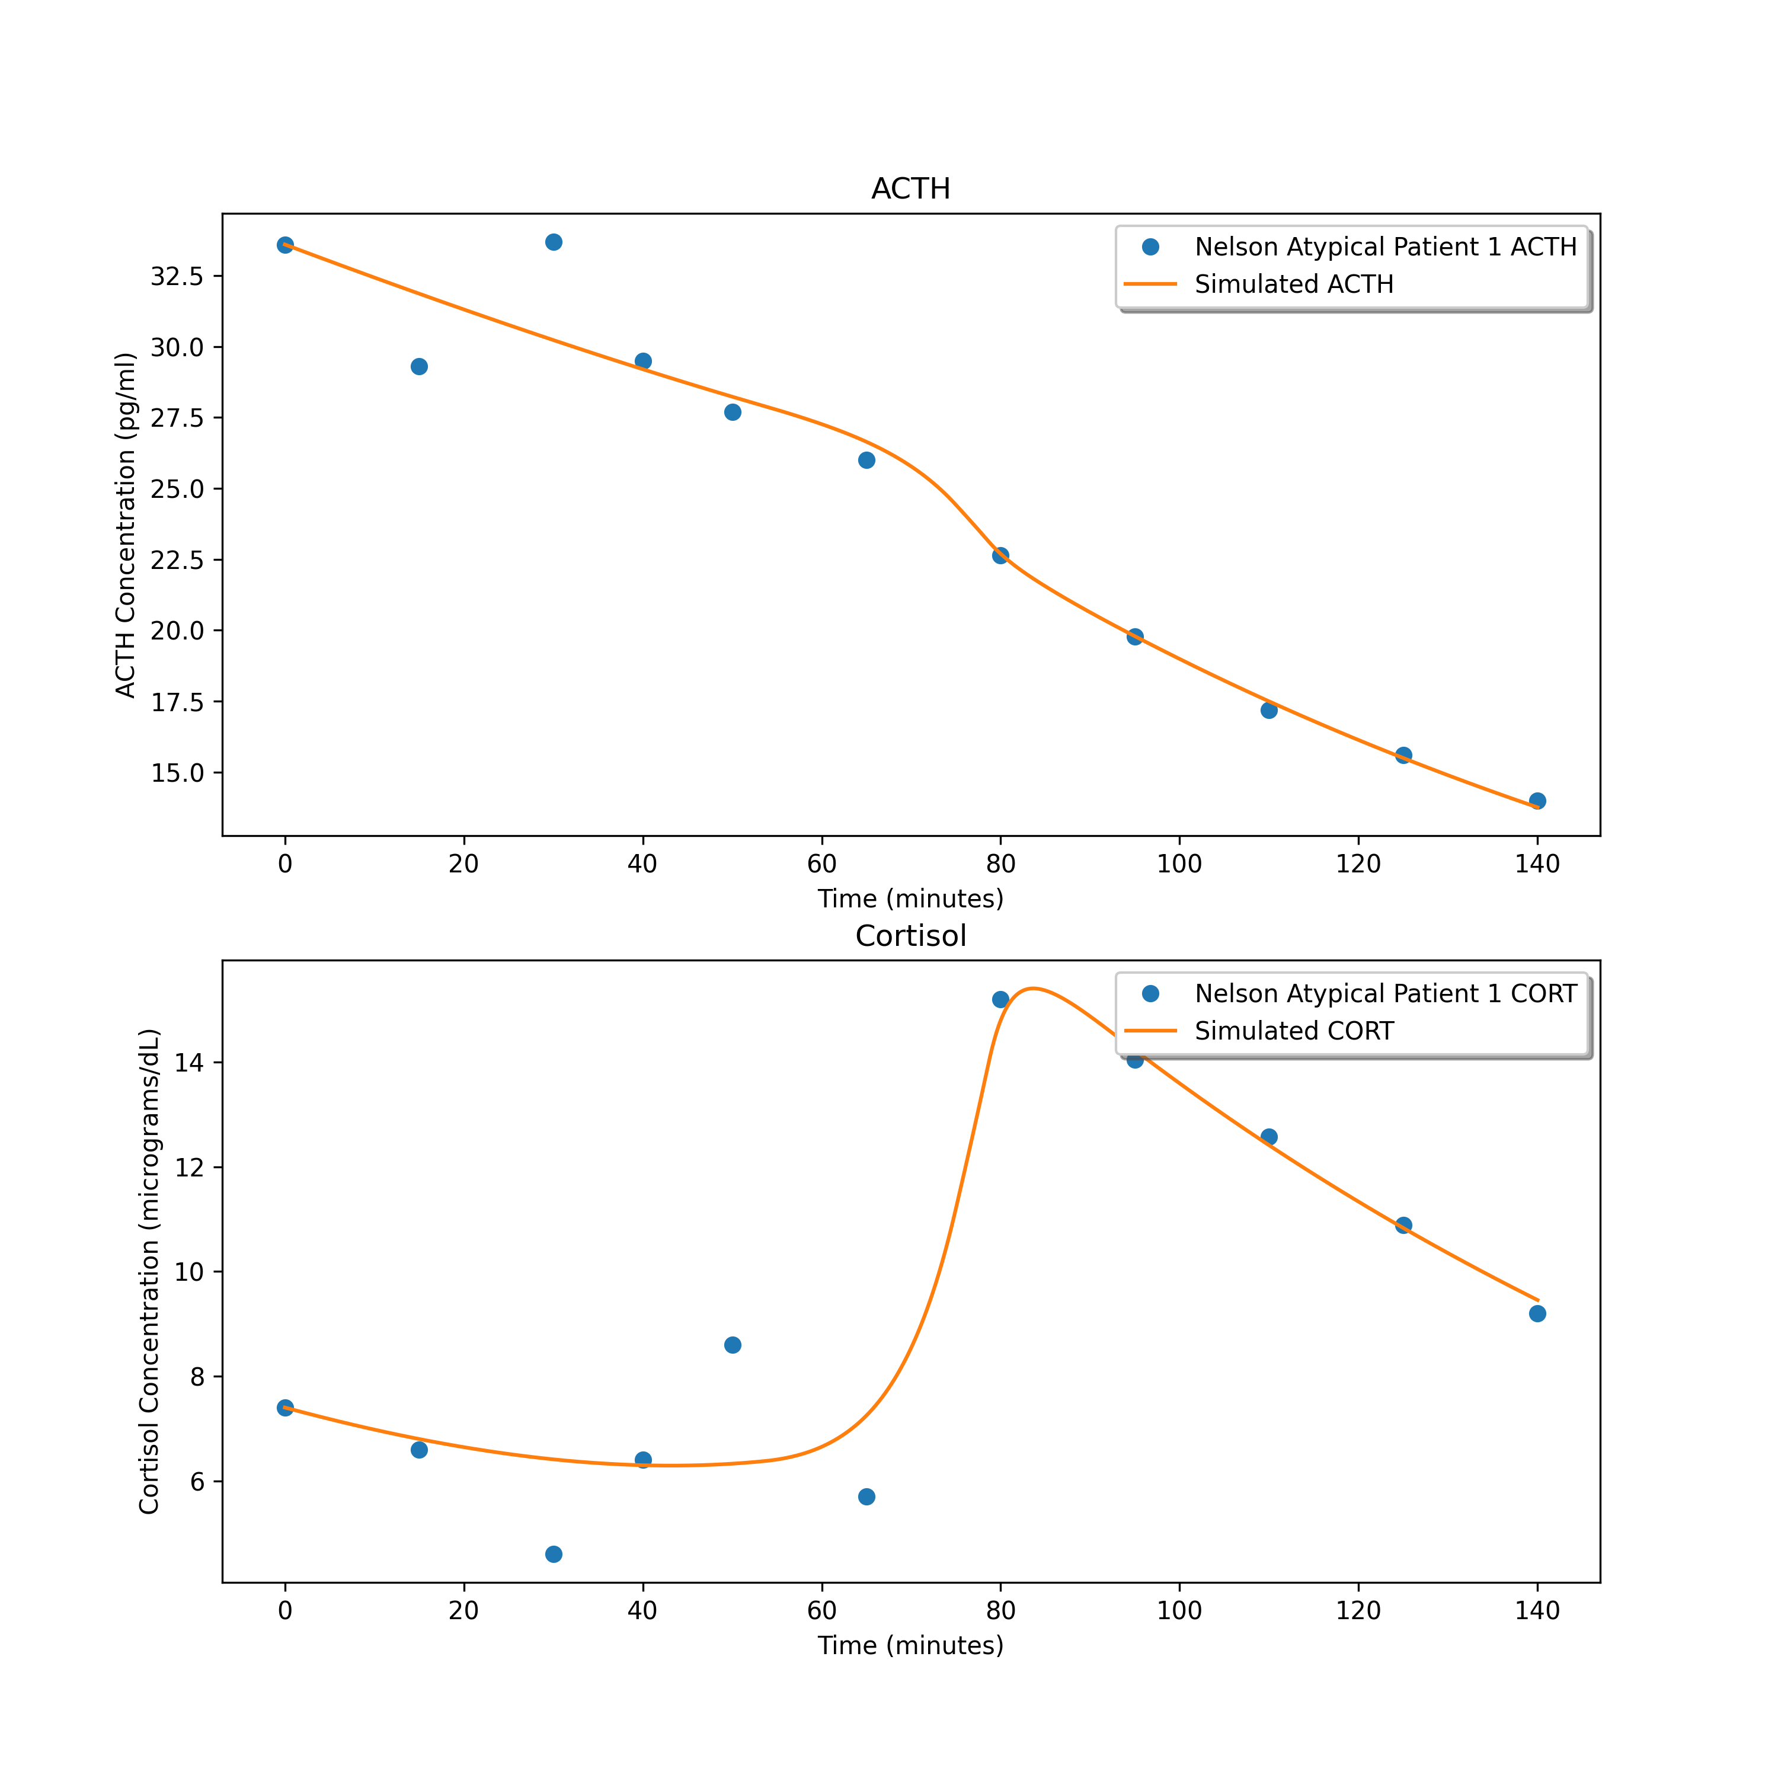
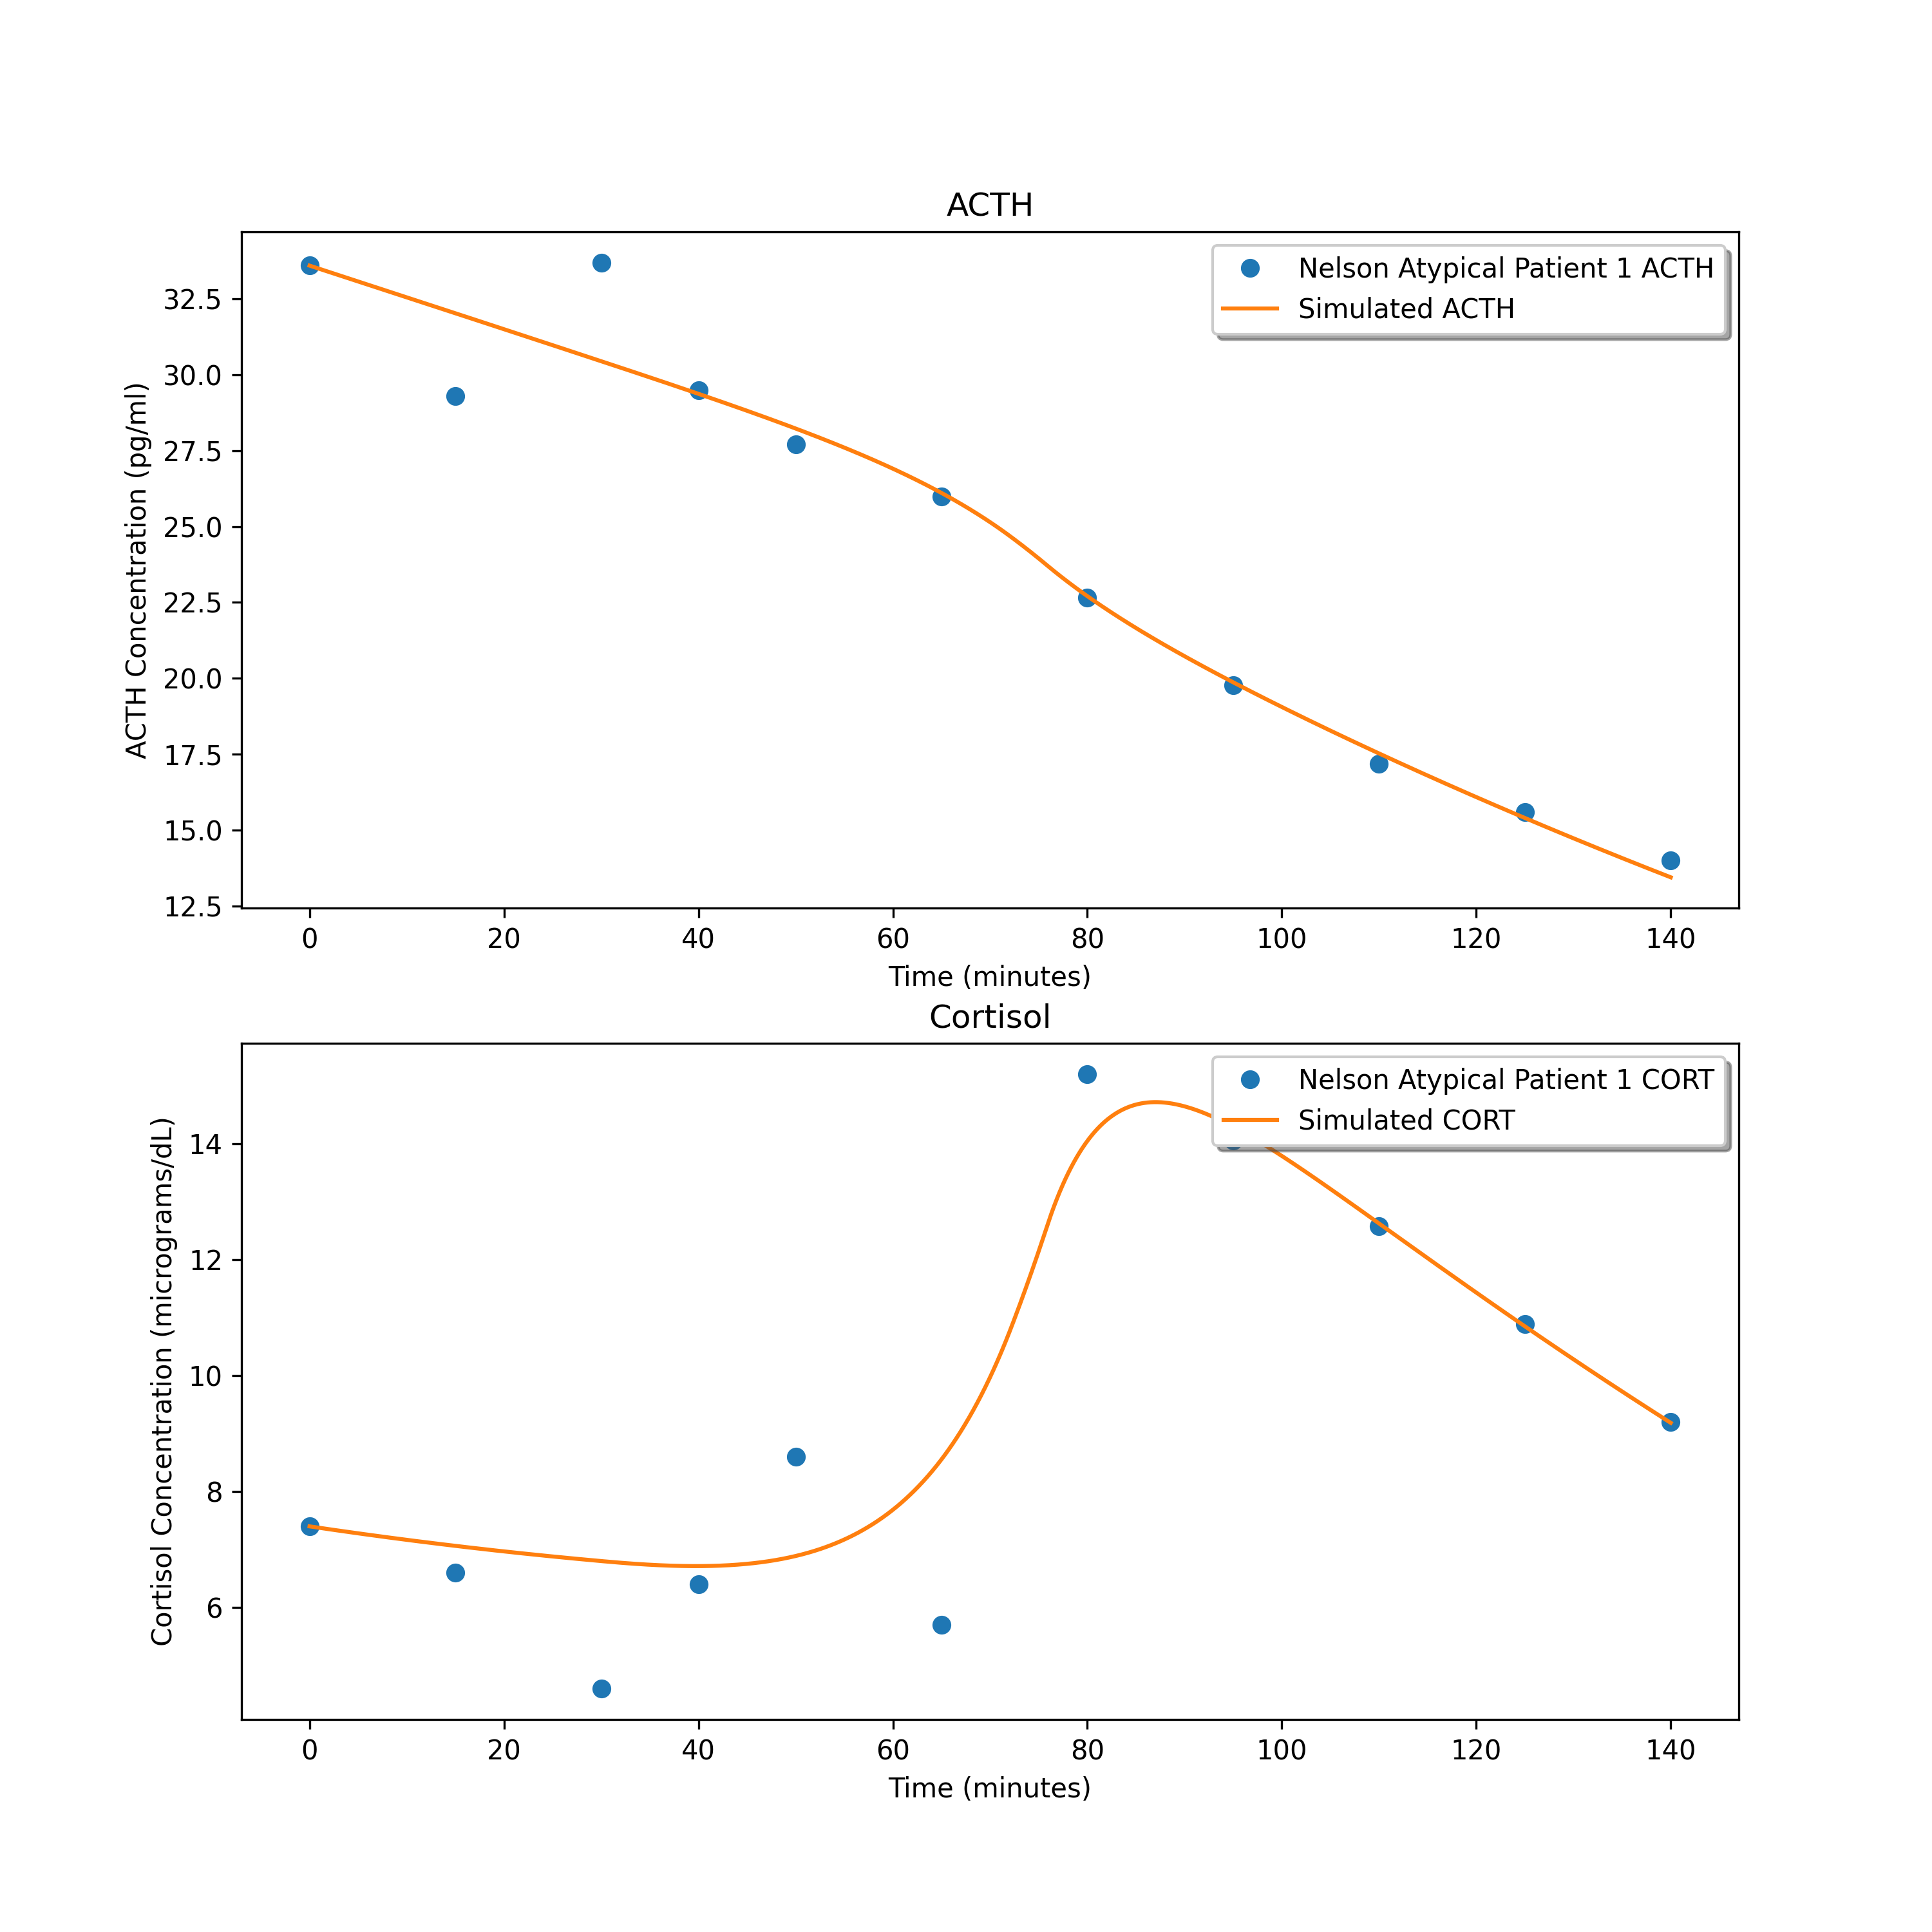
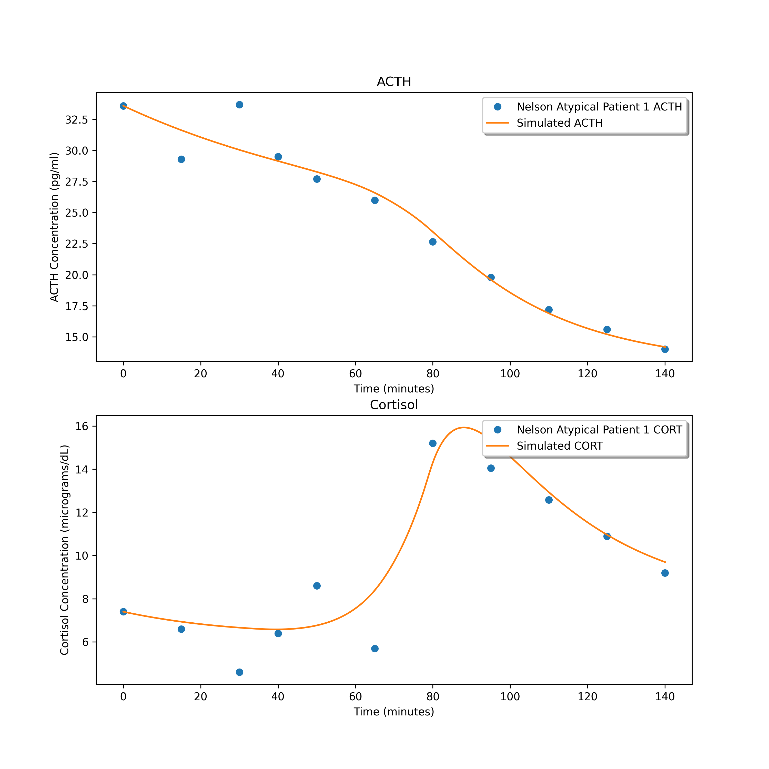
1.3981734691814947
1.6563365345055383
1.7461990741846203

Slide 17
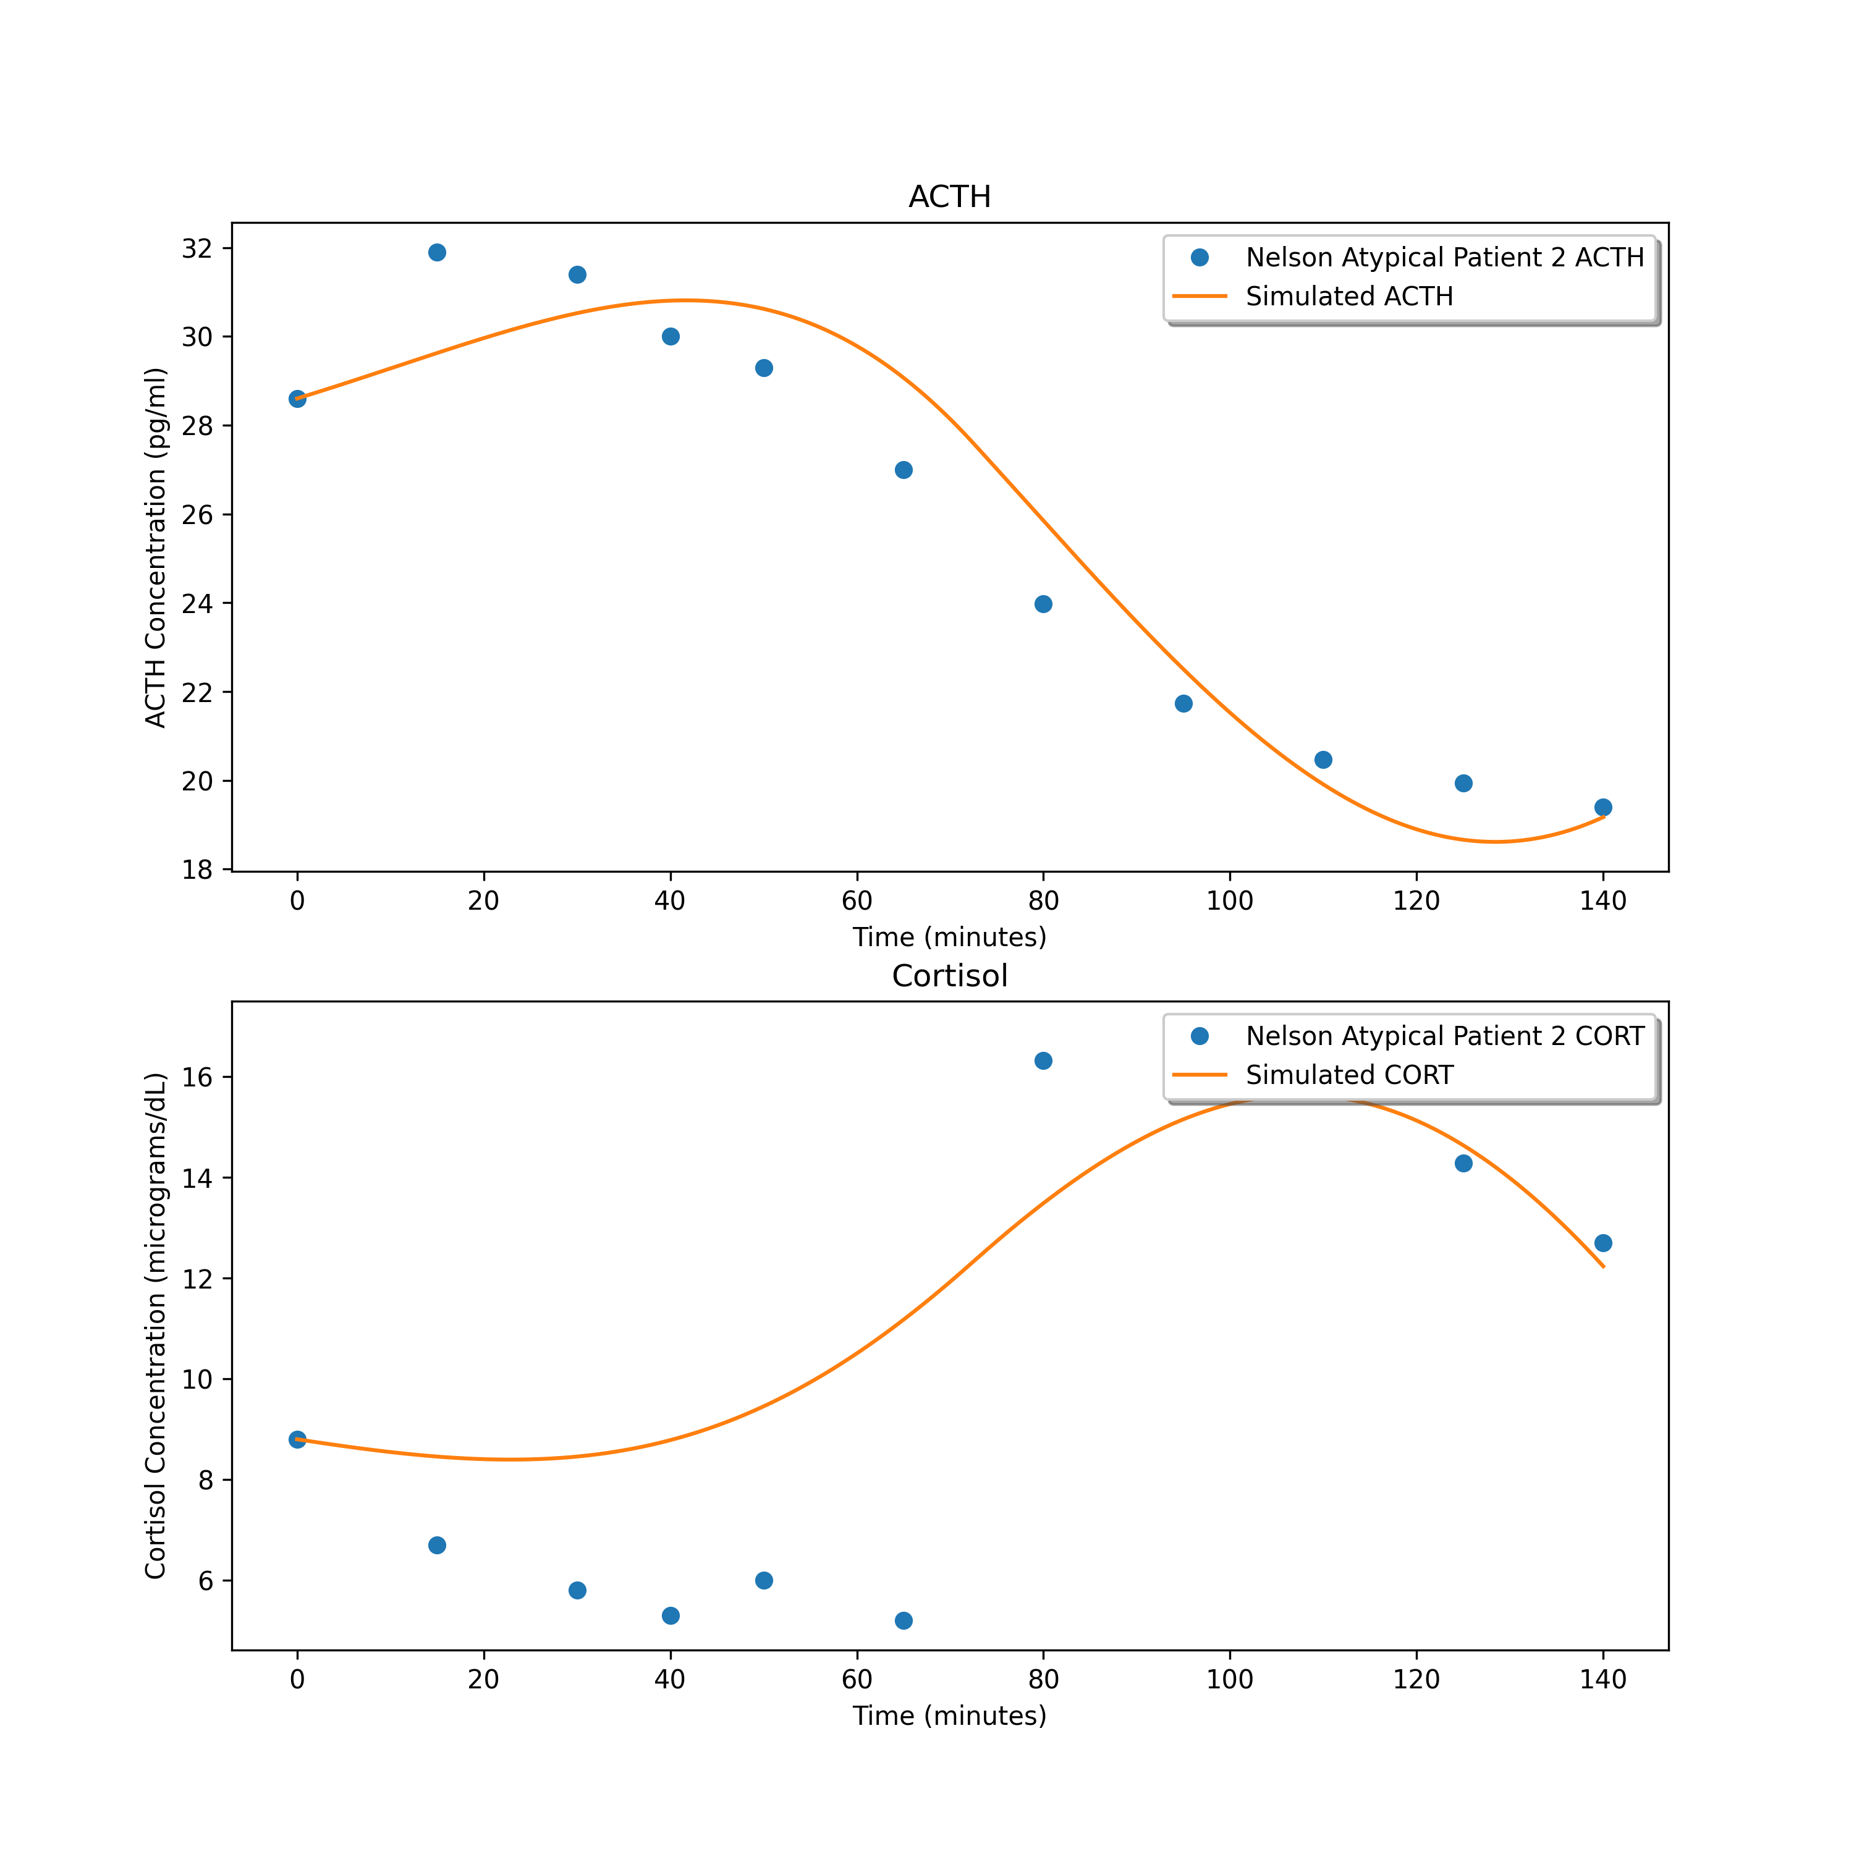
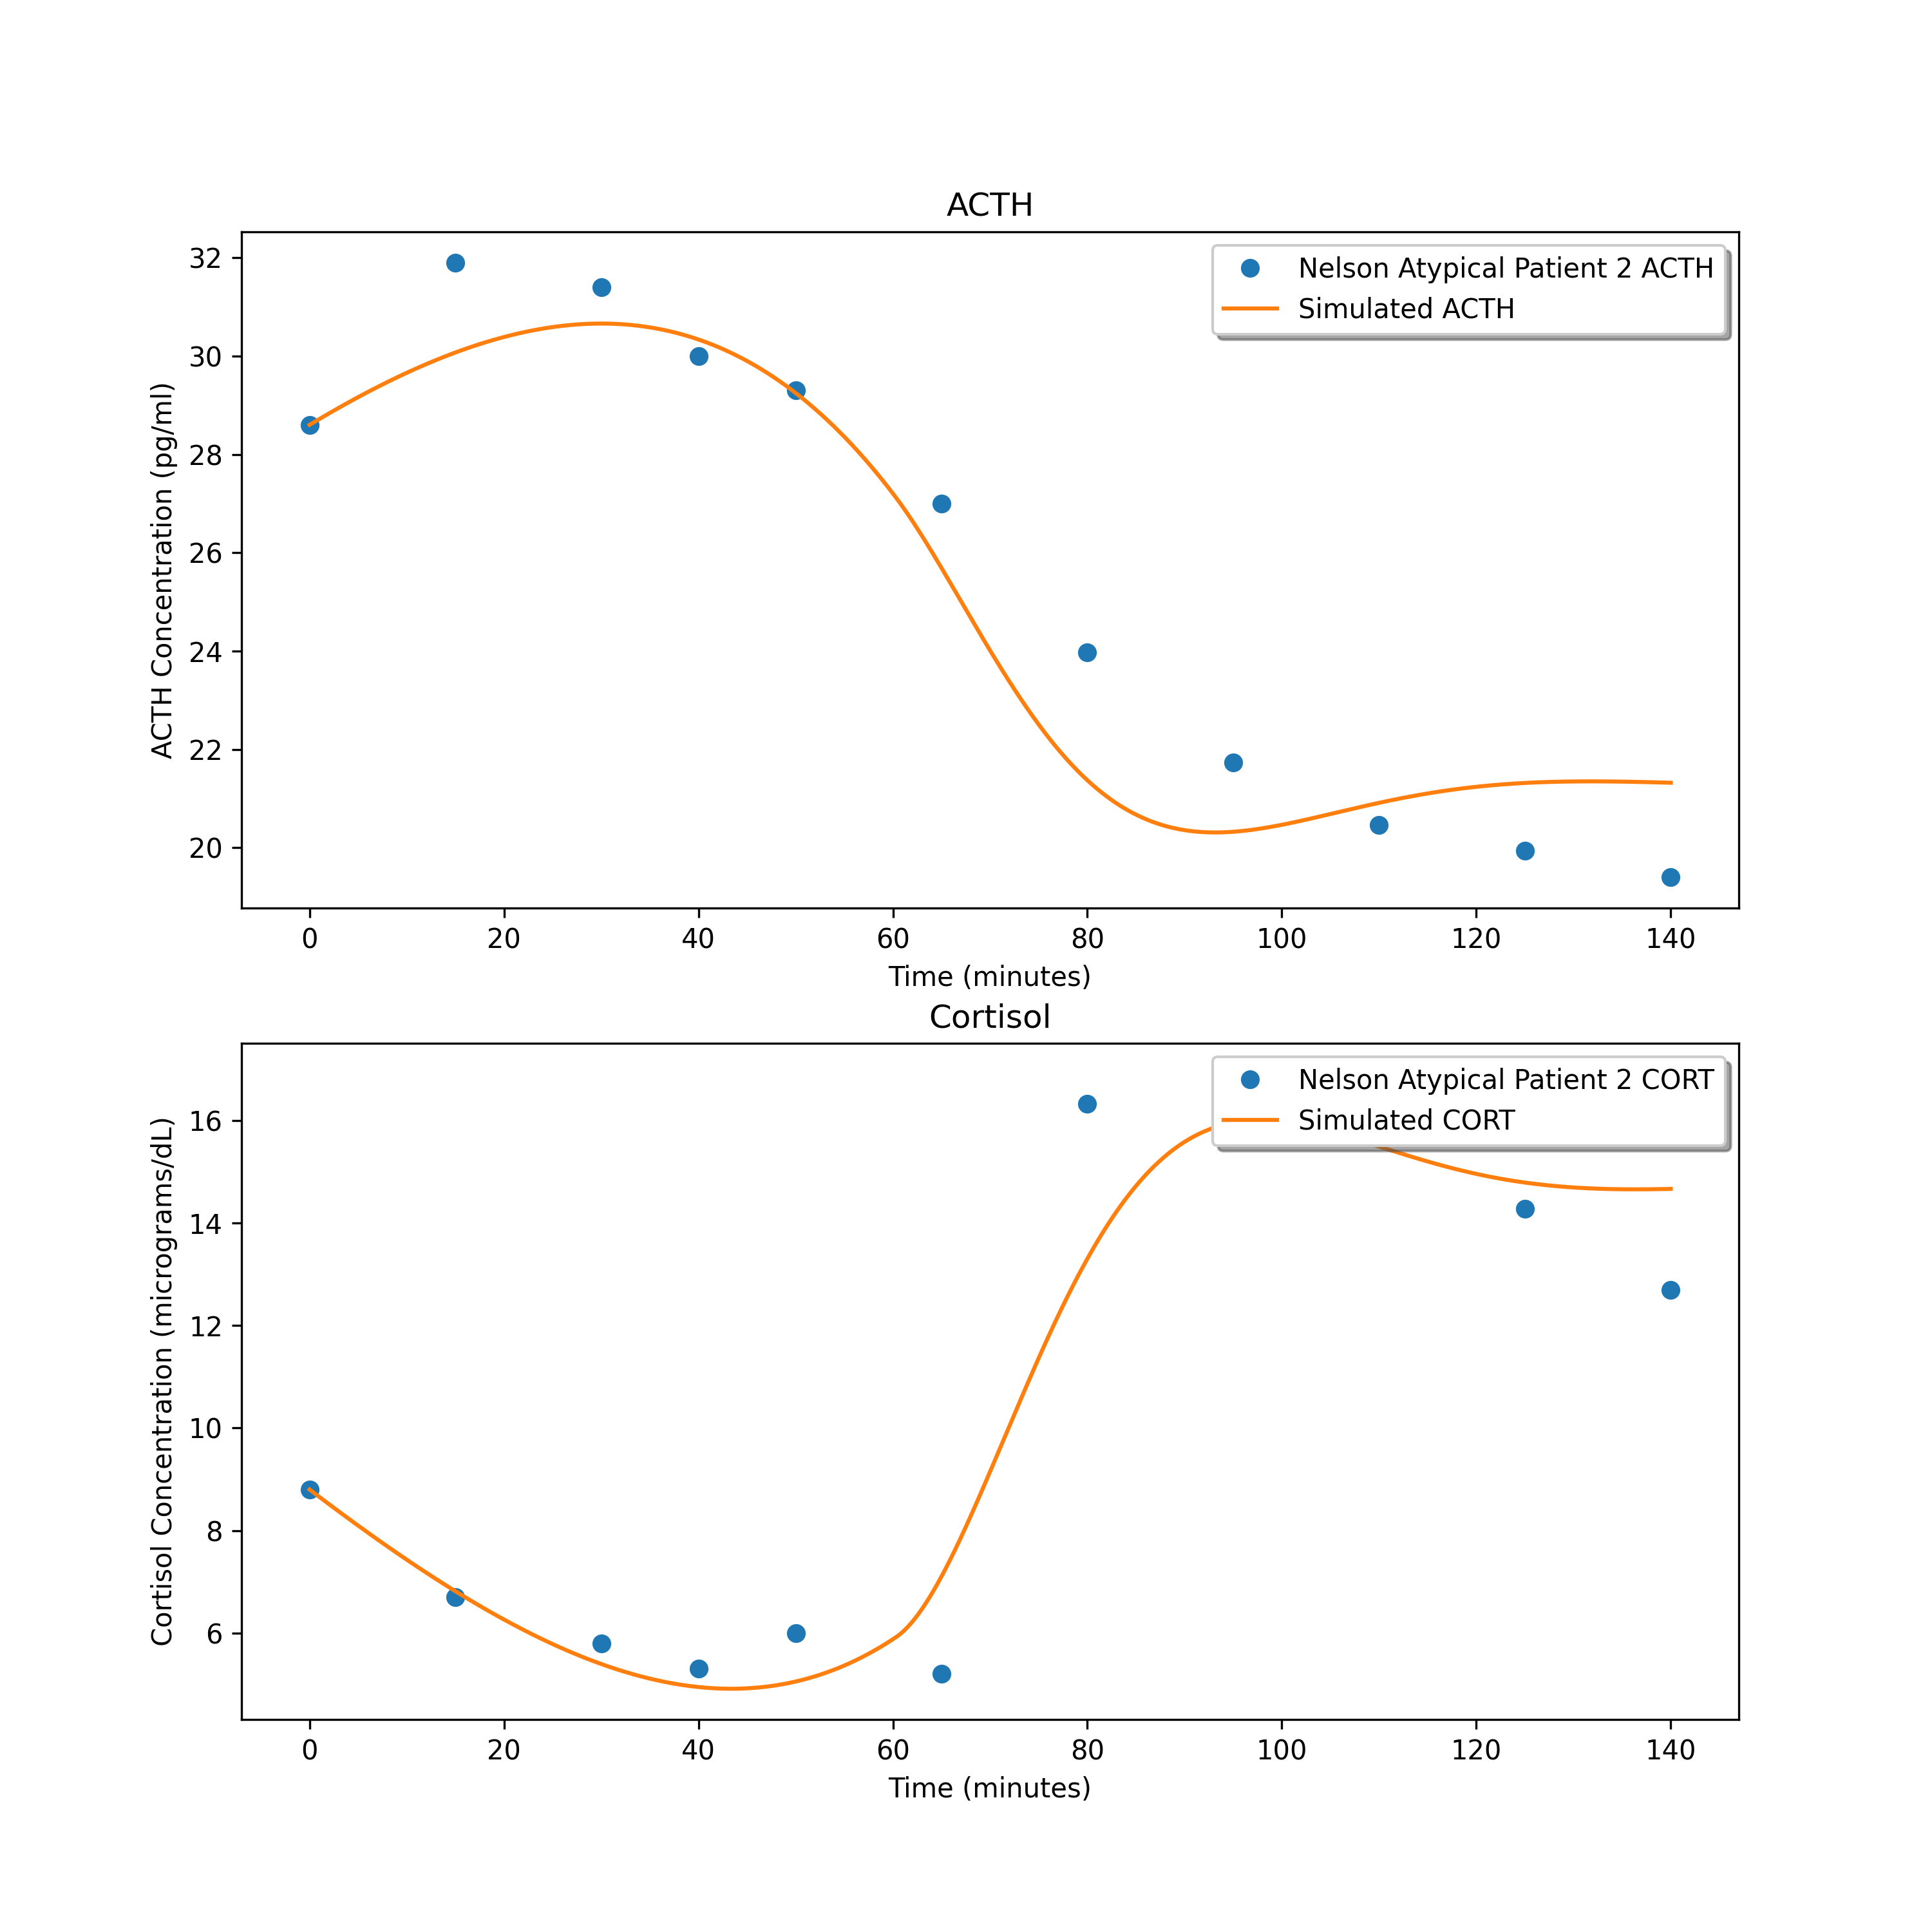
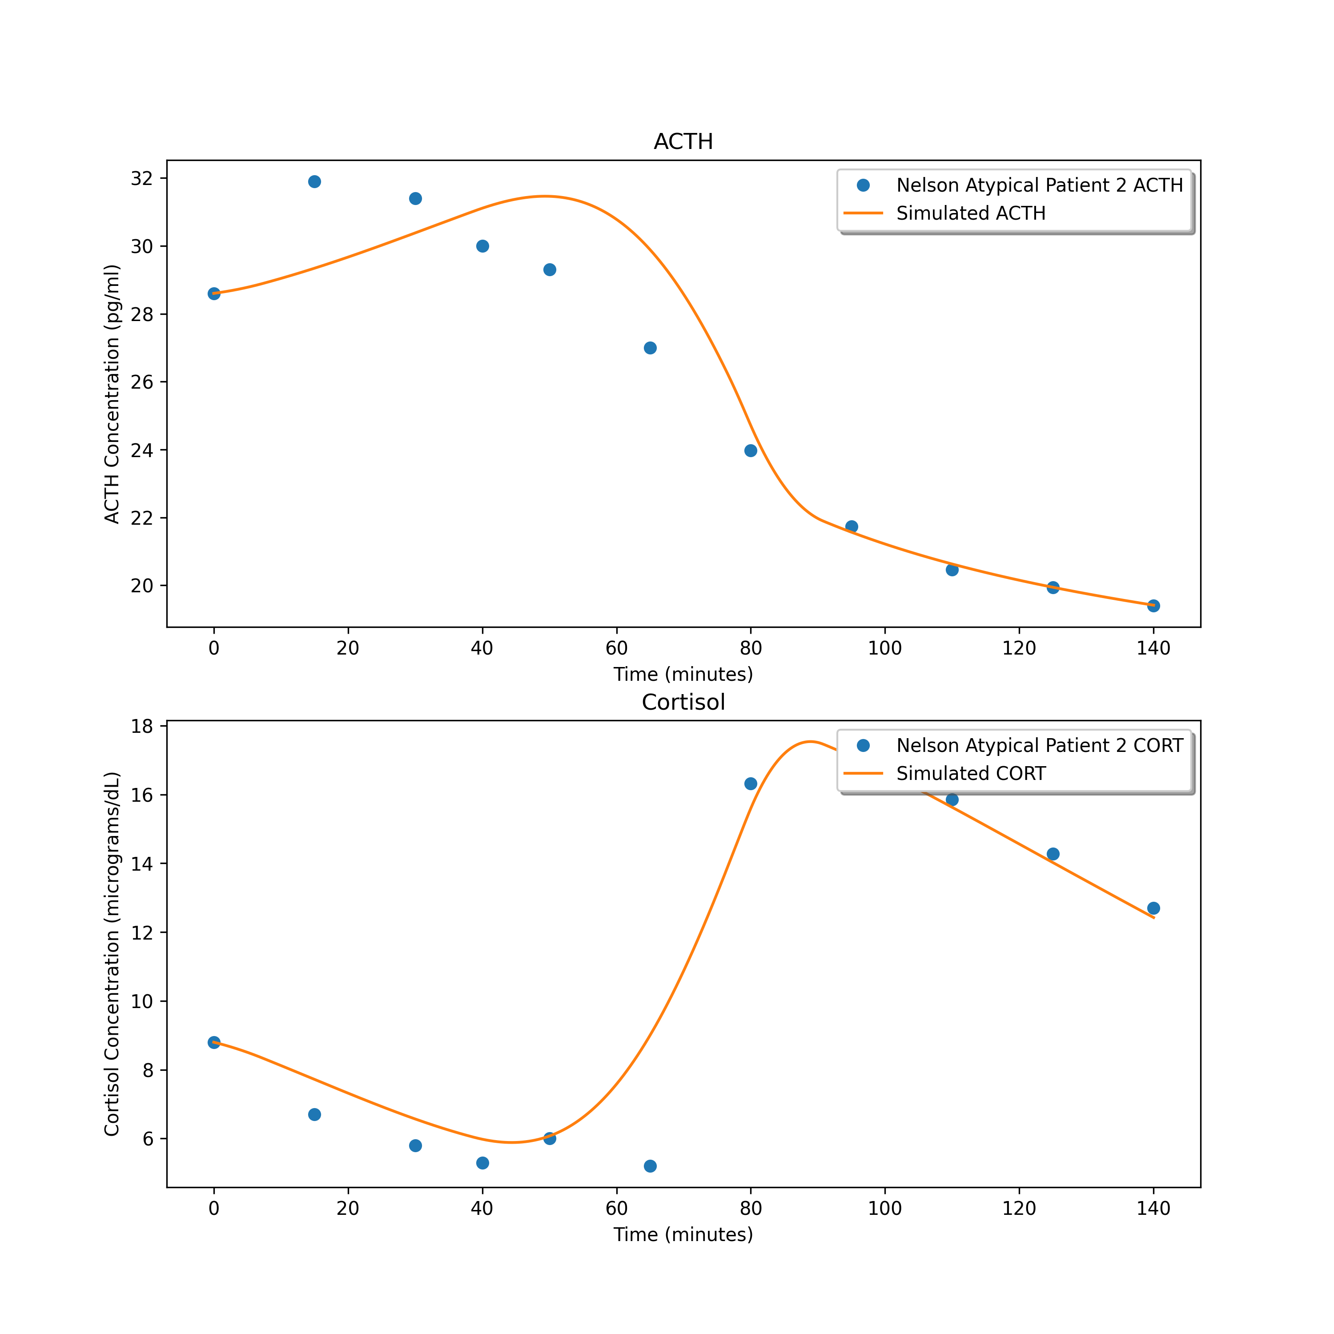
4.550549588424688
1.7916805172419836
1.805497324589158

Slide 18



0.9657536974664769
1.3312696779208624
1.333210087866042

Slide 19



3.3006574371913655
2.9549930988817183
2.7952580020780764

Slide 20



0.23145022352472633
0.5021417161972977
0.8949960185330376

Slide 21



1.4070343811486952
1.833766103106028
1.3302711491408596

Slide 22



3.3992673871402403
2.4862145125249873
2.132575871847766

Slide 23



0.4388248424374613
1.193807825959636
1.1917158875124114

Slide 24



0.3738209709967151
0.9524625992159524
0.9520504351168859

Slide 25



1.249036915347386
2.1678520112941246
1.6822837098024543

Slide 26



0.7303042626579025
1.37342560417194
1.3712681638280273

Slide 27



2.972056416294885
1.1115174190740618
0.9784417017545536

Slide 28



28.669328454307685
7.198187020922961
5.472225636517829

Slide 29



0.7132335104454035
1.8964933019180512
4.216176761957865

Slide 30
Loss Summary
First set: 8 best for Atypical, 5 best for Control (72% successful with CNNs)
Mean:
Control = 8.8083231424491
Atypical = 3.599963682611794
Total = 6.293942713562125
Second set: 1 best for Atypical, 4 best for Control (64% successful with CNNs)
Mean:
Control = 12.136383797766647
Atypical = 2.032153424495367
Total = 7.258479479635685
Third set: 5 best for Atypical, 6 best for Control (53% successful with CNNs)
Mean:
Control = 8.193844405176704
Atypical = 1.993012130337828
Total = 5.200339169047591

Slide 31
Best Fits
Control Patients:
1: 2
2: 3
3: 3
4: 2
5: 1
6: 2
7: 3
8: 2
9: 1
10: 3
11: 1
12: 3
13: 3
14: 1
15: 1
Atypical Patients:
1: 1
2: 2
3: 1
4: 3
5: 1
6: 3
7: 3
8: 1
9: 1
10: 1
11: 1
12: 3
13: 3
14: 1

